Slide 1
Phase 2 : Understanding climate change
Module 1. Energy issues
What’s at stake?

Slide 2
E
NERGY issues
What is energy?
Where does energy come from?

Slide 3
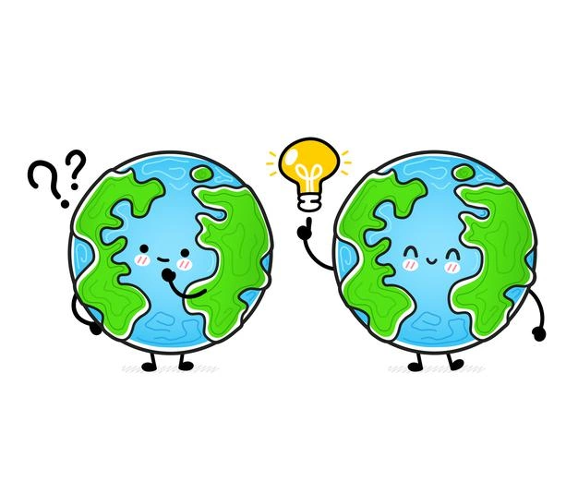
Why do we look at energy issues when we discuss climate?
Notes:
This is an open question to start the discussion and introduce the topics. The energy-climate challenges: where does climate change come from? What is the use of energy? How to act in everyday life? Few leads on answers : 1- We are addicted to fossil fuels. 2- There isn’t much fossil energy left. 3- The impact of energy use on climate. Here we also are questioning ourselves : What do we do next?

Slide 4
What is energy?
List the words or terms that come to your mind.
Notes:
Explanations : Ask your students.

Slide 5
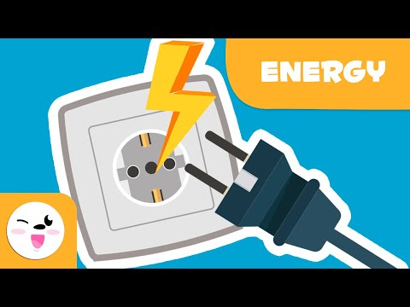
What is energy?
Other languages
FR
ES
IT
Notes:
List of resources :
French : https://www.youtube.com/watch?v=BKfufXnupMA
Spanish : https://www.youtube.com/watch?v=NAPAMIpGB-s
Italian : https://www.youtube.com/watch?v=wT1hPaBMfO4
English : https://www.youtube.com/watch?time_continue=8&v=aFpC1vAIgNc&feature=emb_logo
Etc….

Slide 6
What is energy?
Energy is what modifies
Speed
Temperature
The shape of an object
Chemical composition
Altitude
Light
Etc.
When something changes, energy is involved.
Energy measures the transformation of the world
Energy consumption = the rate at which the world is changing
Notes:
Explanations :
Energy characterizes the change of state of a system. We consume energy when we ...
- changes the speed (kinetic energy)
- heats (or cools) something (thermal energy)
- deforms something (deformation energy)
- makes a chemical reaction (chemical energy)
- makes something go up or down (potential gravity energy)
- emits light (electromagnetic energy)
etc
As soon as something changes, an energy is put into play. In a way, energy measures the extent of change: our energy consumption simply corresponds to the speed at which we are transforming our world!
Key Messages :
Energy measures the transformations of the world
Humanity's energy consumption can be seen as the speed at which we are transforming the planet, giving us material wealth, but this is not insignificant, because too much transformation makes for pollution.

Slide 7
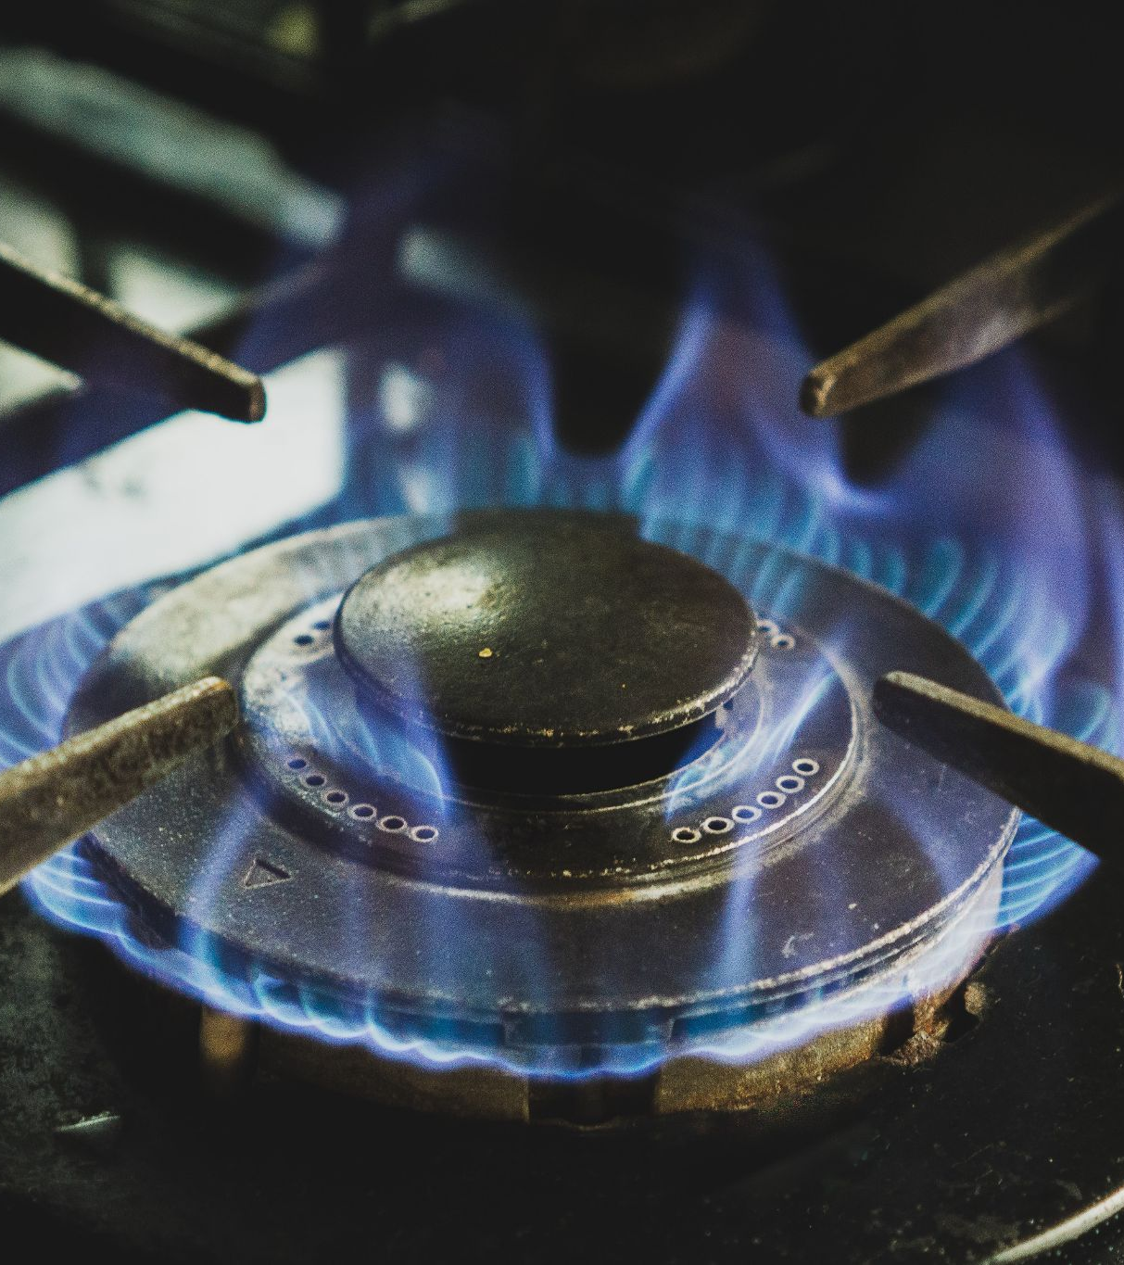
Forms of energy
Kinetic energy
Mechanical energy
Thermal energy
Chemical energy
Electric energy
Energy is everywhere, in various forms.
It can’t be created or destroyed,
we can only transform it from one form to another.
Notes:
Explanations :
Many forms of energy exist around us, here are some examples.
- A moving body has kinetic energy. For example, rivers or wind contain more or less kinetic energy depending on the force of their motion.
- The wagon at the top of a roller coaster has potential energy that manifests itself when it enters motion and begins its descent. It then acquires kinetic energy related to its motion. The sum of the potential and kinetic energy corresponds to the mechanical energy.
- Thermal energy is heat
- Chemical energy is the energy contained in matter. Chemical energy is very useful for life. Indeed, it is contained in glucose for example and is used by cells to live. Chemical energy is also at stake when the combustion of fossil fuels or biomass is used to convert the chemical energy of these materials into heat.
- Electrical energy is energy available in the form of electron current (electricity). This energy that arrives in our electrical outlets is used directly to produce light for example.
Be careful not to confuse energy and electricity. Electricity is a particular form of final energy.
To go further :
Primary energy is the "potential" energy contained in natural resources (such as wood, gas, oil, etc.) before any transformation.
Final energy is the energy consumed and billed, taking into account losses during the production, transportation and transformation of the fuel.
The Energy Explorers site (http://www.explorateurs-energie.com/) contains several resources available to talk about energy.
Key Messages :
Energy is everywhere and in many forms.
It can’t be created or destroyed, we can only transform it from one form to another.

Slide 8
Energy use
People convert and use energy according to their needs: to clothe and feed themselves, to move around, to keep warm, to acquire goods and services, etc.
I eat
I heat and cool my home
I consume goods and services
I travel
Are there any activities for which we do not consume energy?
Notes:
Ask your students.

Slide 9
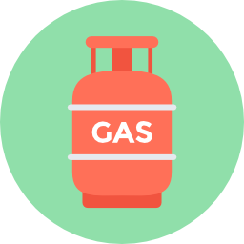
Forms and Sources of energy are not all alike
Renewable source of energy
Non-renewable source of energy
Fossil fuels
Solar
energy
Mechanical
energy
Chemical
energy
Nuclear
energy
Different sources of energy means
different advantages and drawbacks for each of them!
Could you name some ?
Notes:
Explanations :
To produce these different types of energy, different sources can be used. Some are renewable, such as wind, sun, water or wood. The energy produced from these sources (via wind turbines, solar panels, hydraulic dams or wood burning) is called renewable energy. Some sources are not renewable. This is the case of the uranium needed to produce nuclear energy. It is also the case of fossil resources: gas, coal and oil, which allow the production of fossil fuels.
Beware, although in the category of non-renewable energy, nuclear power is not a fossil energy.
All energies are not equal and have advantages and disadvantages.
Animation: ask the students to identify the advantages and disadvantages?

Slide 10
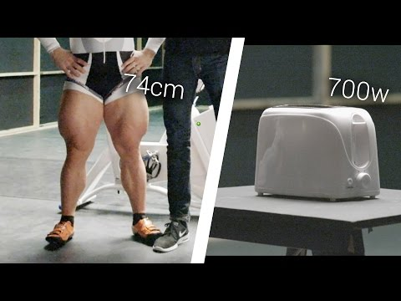
Our human force is very little energy
Notes:
This video is an opportunity to give your students some food for thoughts. "While it only takes one Robert to run the toaster, it will take a whopping 180 to start a car for an hour and 43,000 to start a plane.
And if it takes a whole Robert Förstemanns to run a toaster, have you ever wondered how many of us would take to do the same?"

Slide 11
Ten bicycle riders pedalling for one hour is equivalent to
=
10 cyclists for one hour
Baking a cake in an electric oven (1 kWh)
Notes:
Explanations:
To compare the energies we will take the example of a cake that we bake for one hour in an electric oven.
With human energy, we would need 10 cyclists pedaling for one hour to bake this cake.
A cyclist at 20km/h develops a power of 100W. So it takes 10 cyclists to make one kilowatt (kW).
What are the alternatives?
To go further :
This slide may be an opportunity to remind students of the difference between power and energy:
We measure energy with the (kilo-watt-hour) kWh. The more energy we need to run something, the more kWh we have to produce. Energy is related to the concept of Power. It is measured in kilowatts.
What is the difference between power and energy? Let's imagine a cyclist. The power in kW represents the speed of the cyclist at a given moment while the energy in kWh represents the distance traveled by the cyclist. The use of 1 kWh of energy corresponds to the use of a power of 1kW during 1 hour.
We go from power to energy by multiplying the power by a time. This may seem technical but the two are often confused.

Slide 12
To bake a cake in one hour, we need ten bicycle riders or
8 000 L of water *
50m² of solar panels *
A wind turbine 5m in diameter *
One log of wood
One canister of gaz * *
A small heap of coal
33cl of oil
A pinch of uranium
Fossil fuels
* Under average climate conditions in France - ** At 200 bar
Notes:
Explanations :
To bake this cake in one hour
We could have used :
- Through the turbine of a 50 m high dam, one would have to pour into the 8000 L to supply 1 kWh to the plug.
- 50m2 of solar panels (about a tennis court) or a 5m diameter wind turbine.
Now let's look at the resources that would have to be burned in a thermal power plant.
With wood, a log would have to be burned.
With gas, 1,4L of compressed gas
With coal, you have to burn a small pile of coal.
With oil, you have to burn the equivalent of a can of oil.
Gas, coal and oil are called fossil fuels or energies because they come from the fossilization of ancient living beings.
Finally, it only takes a few atoms of uranium to produce 1kWh because nuclear energy is a resource 1 million times more concentrated than fossil fuels.

Slide 13
Ten bicycle riders pedalling for one hour is equivalent to
=
100 €
10 cyclistes
0.10 €
=
Mains electricity
Notes:
Explanations :
You can imagine that these cyclists won't pedal for free for an hour! At the hourly minimum wage (about 10€ gross per hour), you will have to pay them up to 100€. But with an electric plug, you don't have this kind of worries. For information, this kwh at 100€/10 cyclists, would only cost you 10 cents if you used your electric plug. Moreover, it is so much less bulky!
With all this ease it offers us, we understand why energy has taken so much space in our lives. We don't realize it every day, but that's what makes the difference between before and after the industrial revolution. Before, we used most of our muscles, so we didn't do much. Today with energy, everything is allowed!
Key messages :
The energy we use every day is very concentrated compared to human energy.
Modern energies are 1000 times cheaper than muscular energy.
It is not human energy, our muscles, which allows us our current wealth, but other energies.
To go further :
The purpose of this part is to show that abundant and cheap energy is the essence, no pun intended, of our "modern" society. The purpose of this board is to make us feel a little bit the orders of magnitude to which we are not at all accustomed. For example, the average French person consumes several thousand kWh of electricity per year. So let's ask ourselves the question of knowing what ONE kWh already represents. This is enough to run an x kilowatt appliance for 1/x hours. For example: baking a cake for 1 hour in the oven or 1 hour vacuuming (1 kW), leaving the TV or a lamp on for 10 hours (100 W), using a laptop for 20 hours (50 W), etc.
For your information, the cake baked to be shared by 10 people will not allow the cyclists to recover the calories spent. It should be remembered that in any energy transformation, there are losses, here especially in the form of heat.

Slide 14
Sources of energy are not all alike
High-carbon
source of energy
Low-carbon source of energy
Hydro
Wind and sun
Biomass
Uranium
Gas
Coal
Oil
Little CO₂ emission
Fossil fuels
Easy to store
Unlimited
Renewable
High
energy
output
Easy to store and transport
High energy output
Low energy
output
Soil use competition
Limited places
Lot of CO₂ emission
Nuclear
waste
Intermittent
Renewable source of energy
Non-renewable source of energy
Notes:
All these different sources of energy, have advantages and drawbacks. Here you can find some of them but of course, there are other advantages and drawbacks not listed here and which may depend on the area on the globe where those sources of energy are used (especially biomass and hydro).
Explanations :
Low-carbon source of energy
The use of these sources of energy produce very little CO₂ emission.
Wind and sun are unlimited source of energy but it is not so easy to use. We can only transform a little part of thi primary energy into final energy and they are intermittent sources, which means that you can’t have energy whenever you like. If these sources of energy are unlimited, their use is not. Indeed, in order to transform energy we need infrastructures that require some materials which are limited.
Biomass is a renewable source of energy, but it takes some time for a tree to grow, so there is a limit of how much biomass we can use at the same time. In addition, biomass (wood, crops, algae, etc.) are not only used to produce energy, we also use them for food, clothes, construction, and we have to maintain unused forest or lands in order to protect biodiversity.
Hydro, is a useful source of energy that can be stored, but it can’t be used everywhere. Dams can’t be constructed anywhere for geological or ecological reasons. Many big dams in the world have been constructed by driving people out of their homes or flooding large natural areas. Small hydro may be a solution but produces smaller amount of energy.
Uranium is a very concentrated source of energy but its use produces nuclear waste which remains radioactive for a long term. Uranium is a very specific resource because it is the only one to emit very little CO2 and to be non-renewable with limited stocks. As we will see, there is no miracle energy, the first thing to do is to reduce our energy consumption.
High-carbon source of energy
If gas, coal and oil are the main source of energy used in the world it is mainly because they are easy to store and transport and they have a high density of energy. But sadly, they emit a lot of CO₂ emissions that are causing climate change that we will see in the other modules.

Slide 15
Global energy consumption
Notes:
All our daily objects (transport, food, construction and heating of houses, ...) our whole way of life depends at more than 80% on fossil fuels (oil, coal, gas).

Slide 16
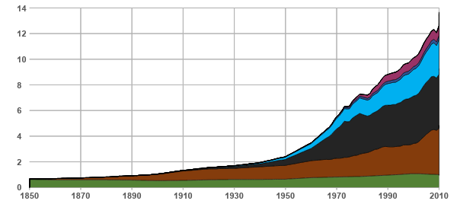
World energy consumption
5%
3%
0.7%
0.3%
Your birth
Billions of tonnes oil-equivalent- Gtoe
Birth of your parents
84% of energy consumed comes from fossil resources
Birth of your grandparents
1/4 (23%)
1/3 (34%)
World population (billions)
1/4 (27%)
7%
World primary energy consumption over time (Gtoe)
Vaclav Smil (2017). Energy Transitions: Global and National Perspectives; BP Statistical Review of World Energy: 2017
Notes:
Explanations :
This graph represents the world's energy consumption.
the horizontal axis represents time
the vertical axis represents the consumption of different energy resources for the year under consideration. These are energy resources, otherwise known as "primary energy", which corresponds to what is found directly in nature. Electricity or gasoline (which are forms of energy used by the consumer, otherwise known as "final energy") are not shown on this graph because there are no deposits of electricity or gasoline in nature. On the other hand, uranium, wind, oil, etc., will be found. Since oil is the planet's main energy resource, all other forms of energy are reported to it (for example, burning one ton of coal is considered to release the same energy as burning 0.66 tons of oil). Consumption is thus expressed in Tons of Oil Equivalent (pronounced "toe"), in this case in billions of toe.
The world consumption in 2012, was approximately 12,500 Mtoe. This is the equivalent of 2 billion cyclists pedaling 7/7d - 24/24h.
Oil alone accounts for 1/3 of the world's energy consumption. It is mainly used for transportation.
Coal represents 1/4 of the consumption. It is mainly used for the production of electricity.
Gas accounts for 1/4 of world consumption. It is mainly used for heating and is also used to produce electricity.
Fossil fuels such as oil, gas and coal alone account for more than 80% of the energy consumed by the whole of humanity.
Wood, which has been used for a long time, accounts for 7% of world consumption. It is burned for heating.
Nuclear energy, which is consumed at a rate of 3% worldwide, is used to produce electricity.
Renewable energies (geothermal, solar, wind) are in full development but account for only 1% of the energy sources consumed in the world.
Key messages :
The world relies on fossil fuels
More and more of each resource is consumed.
For the moment, no energy is a substitute for another.
Speaker's notes :
Here is the 1st graph of the presentation. It is very important to explain each time the axes, so that everyone follows you well.
Clarification for curious people
NB: 1 toe = 11,630 kWh
Before you start, do not hesitate to ask the room: "Can you remind me which are the 3 fossil energies? "Oil, coal and gas. Then "Of all the energy resources that Humanity uses, really counting everything like firewood, burning garbage to make electricity, solar panels, wind turbines, dams, nuclear, geothermal, etc., how much do the 3 fossil energies represent in percentages? Everyone raises their hand. Those who think that fossil energies provide 100% of the energy of Humanity, put down your hand. Those who think that fossil fuels provide more than 80% of the energy of humanity, put your hand down. More than 60%, put your hand down. 40%, put your hand down. 20%, put your hand down. »
Oil alone accounts for 1/3 of humanity's energy consumption. Its consumption has never decreased. It is mainly used to run cars and fly airplanes.
It is followed by coal, with 1/4 of humanity's energy consumption. By the way, the quantity of coal consumed in a year corresponds to the black thickness in that year (it is a graph of stacked areas). We can thus notice that coal consumption has never decreased either... It is essentially used to produce electricity.
Then comes gas, for 1/4 (same principle, the quantity of gas consumed in a year corresponds to the pale blue thickness of the year considered). Its consumption has not decreased either... It is mainly used for heating and electricity production.
Oil, coal and gas = 1/3, 1/4 and 1/4, easy to remember no? The total gives in the 83%. The answer to the question at the beginning is therefore more than 80%. Humanity therefore uses mainly fossil resources.
Then comes wood, still widely used in the world for heating. Its consumption seems to be more or less constant, probably because it would not be possible to consume more wood without causing the forests to disappear (this needs to be confirmed, hence the use of "probably" and the conditional).
Next come the dams, only to produce electricity.
Then comes nuclear power, again to produce electricity.
Finally come all other renewable energies, namely in decreasing order of importance (according to BP Statistical Review 2009):
Geothermal energy
Burning garbage (and yes, it's counted in renewables and it's even 20% of it!).
Biofuels
Biogas
Thermal solar
Wind (10% of total renewables)
Photovoltaic (so solar panels. It is only 1% of the renewable)
Tidal energy
In short, these 8 sources of energy, together, make up less than 2% of humanity's energy consumption in 2011... While oil alone makes up 1/3! Moreover, it took more than 50 years for it to reach this size, and it is far, far more practical than all the other renewable energy sources mentioned. So do you think that they are capable of replacing it in the short term?
Since the industrial revolution (around 1860), the population has increased sevenfold, and energy consumption has increased fifteenfold. Each human therefore consumes on average more than twice as much energy. In addition, each "new" energy source is added to the previous ones, without replacing it. For example, oil has never replaced coal, nuclear power and RE has never replaced fossil fuels, etc.
Apart from nuclear and photovoltaic (solar panels), all energy sources have been known since ancient times. For example, the word "oil" comes from the Latin "Petra Oleum" which means "rock oil". Finally, new ways (such as the steam engine or the combustion engine) have "only" been discovered to use the energy sources known since ancient times. Not very encouraging to find a super new miracle energy source all that ...
The graph was constructed by Avenir Climatique (Julien Marcinkowski) on the basis of data from The Shift Project Data Portal (http://www.tsp-data-portal.org/Energy-Production-Statistics.aspx), which itself is a compilation of many recognized sources. The curve for wood has been reconstructed on the basis of Exxon Mobil 2013's Outlook for Energy, http://www.exxonmobil.com/Corporate/Files/news_pub_eo2013.pdf, page 48.

Slide 17
Global energy consumption
The world relies on fossil fuels.
Coal is the resource we first used in history because it can be found in many places of the world.
Oil is by far the most practical and flexible of all energy resources.
We never switched from one source to another, we are only using more and more energy.
Renewable and low carbon sources of energy are still very low compared to our global energy consumption.
Notes:
Conclusion of the module if you are following the light initiative

Slide 18
Primary energy and final energy
Notes:
An additional content in the complete initiative to understand what is the difference between primary and final energy.

Slide 19
Primary energy and final energy
Primary energy is a raw energy resource that has not been transformed and is found in its “natural” state in the environment.
Final energy is obtained by industrial conversion of a primary energy resource.
Give examples of primary energy and final energy.
Primary energy
Final energy
Notes:
Ask your students to give different examples of primary and final energy. You can also make a small table on a board : Raw material - Primary energy - Final energy, for example : coal - chemical energy - electricity. The same primary energy can be transformed in very different final energies, and the opposite is also true.

Slide 20
Primary energy and final energy
Example : producing electricity through coal combustion
Chemical energy
Thermal energy
Mechanical energy
Extraction of primary energy resources: coal
leakage
Line losses
Only a primary energy resource can replace another primary energy resource: transition from a fossil source of energy to a renewable source of energy.
Electricity
Final energy: energy bill
Notes:
Explanation: A toaster uses electrical energy. But electrical energy is not really a storable resource in nature. Lightnings are too powerful and intermittent to be harnessed and no one would think of using thousands of electric eel to toast its bread. So we need to transform a primary source of energy to electricity. Here we take the example of coal.
First we need to extract coal. To do so, men had to go deep down into the earth to extract coal with a pick. There are still a lot of people doing so all around the world, for coal or for other material resources we use in our everyday life, but we have some machines too.
Then, the common way to produce energy is to use a steam engine. Once you get the coal, you burn it in order to heat a certaine amount of water to produce steam. By doing so, you are transforming the chemical energy stored in the coal into thermal energy transferred to water.
The steam you just created will now pass through a turbine. The turbine will start to turn and produce electricity via an electrical coil or piezoelectric materials. You are transforming the mechanical energy of the turbine into electricity.
In each step of this process, you may face leakages and energy losses. So the amount of final energy you are using is always smaller than the amount of primary energy you had. It doesn’t mean energy disappeared, it can’t be destroyed, it just means you lost some of it. When we say “only a primary energy resource can replace another primary energy resource”, it means that we cannot say “ok we stop using coal and we will use electricity” because you cannot find available electricity in nature, you have to transform it somehow. So you have to replace coal by another raw material that fit in the actual industrial process or find a new industrial process to get the final energy you need.

Slide 21
Summary
Energy measures the transformation of the world. Energy is everywhere, in various forms.
All sources of energy are not alike, each has its advantages and drawbacks.
It is more practical and less costly to use mains electricity than to hire cyclists!
Fossil fuels provide the vast majority of our energy.
Only a primary energy resource can replace another primary energy resource.
Notes:
Explanations :
Here is the summary of this first part. If necessary / possible, you can take a question / answer round or ask the students to write down their questions for later and continue.

Slide 22
Additional focuses on oil, uranium and solar energy.

Slide 23
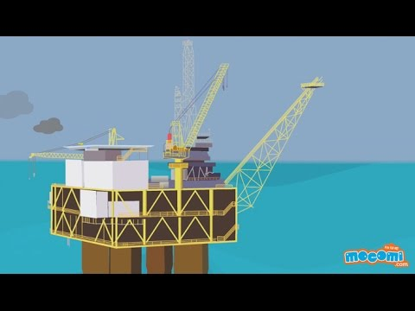
Focus 1: Oil
FR
ES
IT
Notes:
Longer versions : FR https://www.youtube.com/watch?v=TCIO38TCspk EN https://www.youtube.com/watch?v=JasIvS7oYw4
ES: https://www.youtube.com/watch?v=N-DYWTc9iP4

Slide 24
What is oil ?
Oil is called a fossil fuel because it is derived from accumulated organic and vegetal matter stored underground for hundreds of million of years. It is one of the hydrocarbons.
Oil is a non-renewable resource.
Where is oil found? How much do we consume?

Slide 25
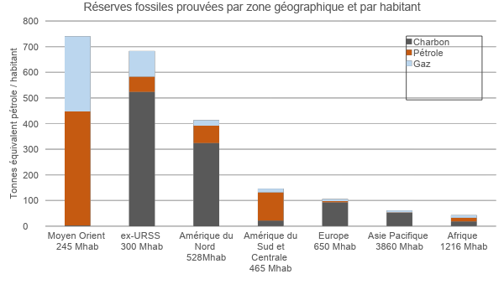
Where are proven fossil reserves located?
Proven fossil fuel reserves by geographic zone and population
Coal Oil Gas
Possession of energy resources gives countries the power to influence countries without resources.
Tonnes oil equivalent per capita
Europe has the most to lose if the energy transition fails, because it is energy-dependent!
Middle East pop. 245 million
Former USSR pop. 300 million
North America pop. 528 million
South and Central America pop. 465 million
Europe pop. 650 million
Asia and Pacific pop. 3 860 million
Africa pop. 1 216 million
Source : Avenir Climatique et BP Statistical Review
Notes:
‹#›
Message clé
Définition ; les réserves prouvées sont les réserves économiquement et techniquement viables
L’Europe est actuellement entièrement dépendante du reste du monde car elle ne possède presque aucune ressource fossile.
Le reste du monde continuera-t-il à nous donner une part de ses ressources ?
Contrairement à certaines idées reçues, la France n’est pas indépendante au niveau de sa consommation d’énergie.
Explications
Le graphe présente les réserves prouvées des différents combustibles fossiles PAR HABITANT par grande zone géographique (on prend les réserves de la zone et on divise par le nombre d’habitants). Ce graphe donne quelques éclaircissements géopolitiques intéressants comme :
L’intérêt pour le Moyen-Orient
L’intérêt pour la Russie
La difficulté des Américains à se « mettre au vert ». Pas facile en effet quand on est assit sur plus du quart du charbon de la planète pour même pas le 20ème de sa population
Le fait que l’Europe insiste le plus pour que le monde se « mette au vert ». Facile de demandez aux autres de réduire quand on ne possède rien. « S’il-vous-plaît, ne consommez pas trop… et surtout laissez-nous en ! ». Comment, nous ne sommes pas simplement de bonne volonté ?!? ;-)
Oui, parce que l’Europe ne possède rien, ou si peu…
En 2009, la France importait 91% de ses ressources d’énergie
Précisions pour les curieux
Le graphique a été construit par Avenir Climatique en prenant les réserves prouvées sur la BP Statistical Review 2010 et en recalculant la population pour la zone géographique concernée.
Quelques anecdotes sur les explications :
Il est très facile aux pays qui n’ont rien (Europe) de demander à ceux qui ont tout (Etats-Unis par exemple) de faire un effort, et à ces derniers de refuser (non ratification du protocole de Kyoto par exemple). Par ailleurs, fait majeur dont on n’a pas parlé en France : le 21/01/2010, la Cour Suprême américaine a supprimé le plafond de financement des campagnes électorales par les sociétés privées (loi en vigueur depuis 1907) malgré l’opposition d’Obama et de 70% des américains. Les pétroliers participent d’ailleurs activement aux soutiens des candidats. De nombreux autres exemples tendent à faire penser que les sociétés font la pluie et le beau temps en politique américaine, et notamment les compagnies qui exploitent le pétrole et le charbon américain.
En 2010, la France a reçu en grande pompe la Russie dans le cadre de l’année France-Russie qui a été au passage l’occasion de vendre des bateaux de guerre et négocier des accords pour le gaz.
Pour l’Europe, l’ensemble des ressources fossiles prouvées (qui sont les seules déclarées, mais il y a encore les probables et possibles) représente 49 tep/habitant, avec une consommation annuelle moyenne de plus de 4 tep/ha. Alors, combien de temps ? Il n’y a plus qu’à espérer que les autres soient prêteurs, ou plutôt qu’on en ait pas besoin pour éviter les rapports de force.
Pour le monde, une moyenne de 108 tep/ha et une consommation annuelle de 1,7 tep/ha (mais toute la planète aspire à consommer au moins autant qu’un Européen). Il pourrait y avoir du sport !
‹#›
Explanations :
The graph shows the proven reserves of the different fossil fuels PER HOUSEHOLD by large geographical area (take the reserves of the area and divide by the number of inhabitants). This graph gives some interesting geopolitical insights such as :
Interest in the Middle East
Interest in Russia
The difficulty for Americans to "go green". Not easy indeed when you are sitting on more than a quarter of the planet's coal for not even a 20th of its population. Europe's insistence that the world should "go green". "Please, don't consume too much... and above all, leave us some! ».
Yes, because Europe has nothing, or so little ...
In 2009, France imported 91% of its energy resources.
Key Messages :
Europe is currently entirely dependent on the rest of the world because it has almost no fossil resources.
Will the rest of the world continue to give us a share of its resources?
Clarifications for curious people :
The graph was constructed by Avenir Climatique by taking the proven reserves from the BP Statistical Review 2010 and recalculating the population for the geographical area concerned.
Some fun facts about explanations:
It is very easy for countries that have nothing (Europe) to ask those that have everything (United States for example) to make an effort, and the latter to refuse (non-ratification of the Kyoto Protocol for example). In addition, a major fact that has not been mentioned in France: on January 21, 2010, the American Supreme Court removed the ceiling on funding of election campaigns by private companies (law in force since 1907) despite the opposition of Obama and 70% of Americans. Numerous other examples tend to make one think that companies make rain and shine in American politics, especially companies that exploit American oil and coal.
In 2010, France welcomed Russia with great pomp and circumstance as part of the France-Russia Year, which was an opportunity to sell warships and negotiate gas agreements.
For Europe, the total of proven fossil resources (which are the only ones declared, but there are still the probable and possible ones) represents 49 toe/capita, with an average annual consumption of more than 4 toe/ha. So, how long? We can only hope that the others are lenders, or rather that we don't need them to avoid power struggles.
Worldwide, an average of 108 toe/ha and an annual consumption of 1.7 toe/ha (but the whole planet aspires to consume at least as much as a European).

Slide 26
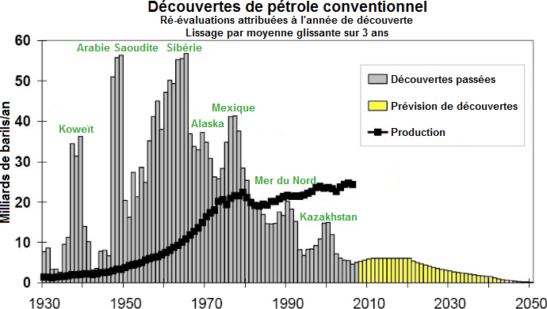
The oil supply is beginning to peak
Conventional oil discoveries
Revised amounts are listed for the year of discovery
Smoothing by rolling 3-year average
Production
Peak (= maximum) production
Saudi Arabia
Siberia
Past discoveries
Predicted discoveries
Production
Mexico
Kuwait
North Sea
Billions of barrels/year
Time
Nearly all oil reserves have already been discovered
We are getting close to peak oil production
Source: Association for the Study of Peak Oil (ASPO)
Notes:
Explanations :
On the first graph, the grey bars present the conventional oil discoveries each year. The yellow bars show that for the last 20 years or so, no very large deposits have been discovered. The black bars represent annual production. We are therefore living essentially on the discoveries of the past.
The second graph represents what happens when a resource is non-renewable. In the beginning we consume a lot of it because it's easy to produce. We consume more and more because techniques are being modernized. Then, the availability of the resource makes production more difficult and slower. Inexorably, consumption begins to decrease, it is the peak.
Regardless of the resource, it is difficult to predict the exact date of the production peak because it is not only linked to the physical availability of the resource. It also depends on our technical, political and economic choices!
Key messages :
Less and less conventional oil is being discovered every year.
Yet production and consumption are increasing every year: today, we are living on yesterday's discoveries.
We consume more and more energy to produce it. In 1900, it took 1 barrel to produce 100 barrels. Today with the oil sands we produce 3 barrels by consuming 1 barrel. It is interesting to produce energy only if we recover more energy than we consume to produce it.

Slide 27
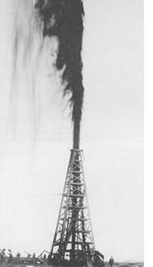
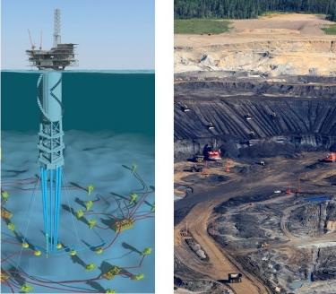
Available oil is harder and harder
to extract
In 1900...
and today
The oil we use is harder and harder to extract.
We consume 35 billion barrels of oil a year.
To get 100 , you only had to spend the equivalent of 1
Now with 1 , you only get 3
Conventional oil
Non-conventional oil (offshore, shale oil, …)
Notes:
Explanations :
At the beginning of the oil era (mid 19th century), it was not uncommon that a well was drilled and the oil came out of the ground by itself, due to underground pressure, as in Lucky Luke. As the well empties, the pressure drops and then you have to pump if you want to continue to extract oil from the well. And in order to work, the pumps consume oil and it also took energy to build all the infrastructure. In 1930, about 1% of the extracted oil had to be consumed to provide the energy needed for extraction. This type of oil (liquid, in a pocket underground on a continent or under the ocean at shallow depths) is called "conventional".
Time goes by and we must not stop looking for oil further away. As opposed to conventional oil, which is easy to extract and cheap, deep offshore, oil sands and other forms of oil are referred to as "unconventional oil".
The record drilling on the continent is 12'376 m (Exxon, August 2012, in Russia)! Under the ocean, 12'289 m below the surface (this is called deep offshore drilling). Can you imagine? In the end, on average today, about 6% of the oil extracted is consumed by extraction. For some techniques, we consume 1 third of the oil produced for extraction!
We are also starting to tackle much less nice oils that are mixed with sand. These are called "tar sands". Here, no more pipes and pumps, but construction machines that dig and fill trucks. The oil sands are then transported to a plant where they are mixed with water and boiled to separate the sand from the oil. The cooking water containing the oil is then recovered and the oil is separated from the water (which cannot be done 100%). Then remains the problem of recycling this polluted water... And finally, we can end up with 1/3 of the extracted barrels consumed by this heavy extraction process.
Key messages :
The further we go, the more expensive the oil becomes to extract (in money but also in energy).
In 1900, one barrel was needed to extract 100.
Today, new unconventional oil techniques make it possible to produce 3 barrels while consuming 1.
To go further :
Our economists nicely call this fatality the "theory of diminishing returns". But by the way, why does "more difficult" mean "more expensive"? Feel free to ask the audience. The answer, at the end of the slide (always be suspenseful ;-) :
If difficult = expensive, it's because more infrastructure has to be mobilized for a smaller quantity that is ultimately extracted.

Slide 28
What is oil used for?
Most-used energy source in the world: ≈ 35% of energy consumption
Principal raw material for transport fuels
Petrochemical industry: plastics, cosmetics, paints, dyes, asphalt, pharmaceuticals, etc.
Notes:
Oil is everywhere as a source of energy or material like plastic.

Slide 29
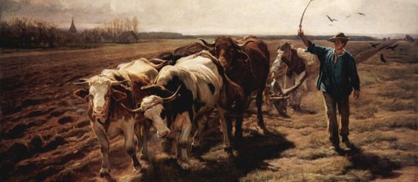
Putting it into perspective
The future without oil does not have to be like the past without oil.
25 -
20 -
10 -
5 -
0 -
The future remains to be constructed. There will be work for everybody in all domains.
Fossil fuels will be only a short-lived chapter in human history
Billions tonnes oil equivalent
-10 000 -8000 -6000 -4000 -2000 0 4000
Notes:
Explanations :
This graph is similar to the one we saw earlier on energy consumption around the world. However, the time scale should be put into perspective. If we look back at the history of modern humanity (the invention of agriculture 10,000 years ago), fossil fuels have every chance of being just a parenthesis. Energy consumption = the speed at which the world is being transformed. Transformation so fast that we see differences from generation to generation (children are born into a different world from that of their parents).
Key messages :
Oil and fossil fuels will only be a brief moment in human history.
The future without oil is not the same as the past without oil.
The future has to be built and there will be work for everyone in this great journey.

Slide 30
Key messages
Oil is the main source of energy used by humans – 35% of world energy consumption.
Oil reserves are limited in quantity and unequally distributed around the globe.
We have to get ready for life “after oil”…

Slide 31
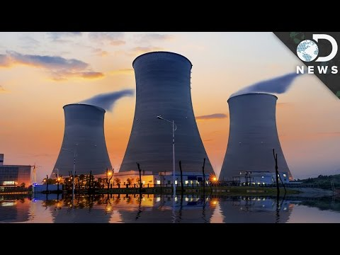
FOCUS 2: Uranium
FR
ES
IT
EN
Notes:
EN : https://www.youtube.com/watch?v=apODDbgFFPI ES: https://www.youtube.com/watch?v=RRWyIy1MCaw
IT: https://www.rtve.es/alacarta/videos/noticias-24-horas/uranio-mineral-enriquecido-sirve-para-fabricar-armas-nucleares/2167090/
FR : https://www.youtube.com/watch?v=V3U_l2LESFw

Slide 32
Uranium
Uranium is a radioactive chemical element that is naturally present on Earth. It is primarily used as fuel in nuclear power plants (nuclear energy).
It is a non-renewable resource that was formed in stars billions of years ago.
Where is uranium found?
Notes:
Where is uranium found ? → Map in the next slide

Slide 33
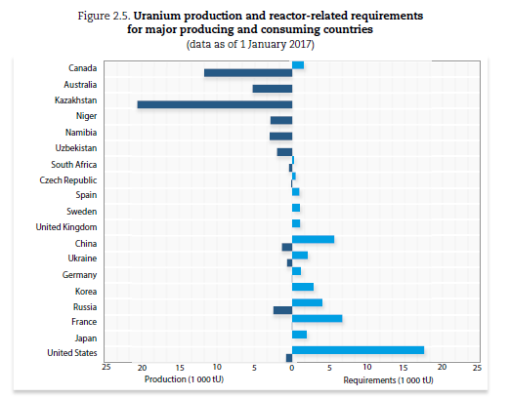
Uranium
Uranium is found in
Mines
Water
Food (plants, animals)
Source: URANIUM 2018: RESOURCES, PRODUCTION AND DEMAND, NEA No. 7413, © OECD 2018
Notes:
Resources are unequally shared in the world. Here, on the graphic you can see the main localisation of uranium resources. In white blue, you see the consumption and in dark blue the production.

Slide 34
Uranium
Uses:
Nuclear reactor for power generation
Arms
Medical imaging
Drawbacks:
Radioactive waste must be treated

Slide 35
Focus 3: solar energy

Slide 36
The Sun
The energy of sunlight is contained in particles of energy called photons.
This energy can be converted into heat or electricity.
Solar energy is a renewable resource.

Slide 37
Photovoltaic systems
Photovoltaic electricity is the most well known of solar energy conversion systems.
Operating principle: photovoltaic cells are made of silicium, a material that converts solar energy directly into electricity.

Slide 38
Photovoltaic systems
Pros and cons:
Use of solar energy does not release CO2, but –
The manufacture of photovoltaic (PV) panels requires fossil energy, and generates pollution.
Manufacturing costs are high, for the time being.
Sunshine is an intermittent resource – it is not always available.

Slide 39
What have you learned so far?
List renewable sources of energy.
List non-renewable sources of energy.

Slide 40
Quiz
What distinguishes final energy from primary energy?
A : Carbon content
B : Conversion losses
C : Geological origin
D : Answer D

Slide 41
Quiz
What distinguishes final energy from primary energy?
A : Carbon content
B : Conversion losses
C : Geological origin
D : Answer D

Slide 42
Conclusion
Fossil energy will become scarce.
Renewable energy will not solve all our problems.
We must economize energy.
Use less energy -- Use energy efficiently – Use renewable energy
In that order !

Slide 43
Credits
Icones from Flaticon by : SmashIcons, Roundicons, Icon Pound, Vectors Market, Pixel Perfect, Freepik, Gregor Cresnar
Icones from 123RF by : oianaesi
Icones from VectorStock by : ProStockStudio
Icones from Shutterstock by : Sudowoodo
Icones from The Noun Project by : IQON
Icones from pngset by : Aliya Yoder
Picture : Pflügende Ochsen by Rudolf Koller

