Slide 1
Phase 2 : Understanding Climate Change
Module 1. Energy Issues

Slide 2
Welcome to Clicks On educational content!
Choose your path!
You can tailor your presentation to suit the content of your class, the time you have available and the topics you want to explore! To make things easier for you, we've created two easy-to-identify slide types : the light and the complete initiative :
Light initiative
Complete initiative
→ the red wire and fundamental concepts of the module
→ slides and activities to deepen your knowledge!
Don't forget the comments below the slides
Each slide is accompanied by notes to guide you through your presentation.
Complete your session with suggested activities from the module
You'll find suggested activities for each phase on our website!
Enjoy your session!

Slide 3
Energy issues
What is energy ?
Where does energy comes from ?
Global energy consumption
Focus : Oil, Uranium et Solar

Slide 4
What is energy ?
Part 1

Slide 5
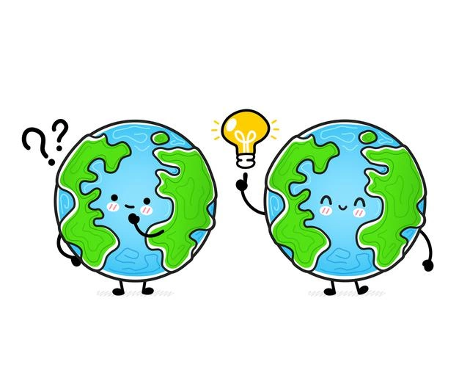
What is energy ?
Why do we talk about energy when we talk about climate ?
Notes:
Explanation:
This is an open question to launch the discussion and introduce the topic.
Energy-climate challenges: what is the origin of climate change? How is energy used? How can we take action on a daily basis?
Some possible answers:
1- We are dependent on fossil fuels.
2- There is not much fossil fuel left.
3- The impact of energy use on the climate.
What do we do next?

Slide 6
What is energy ?
Notes:
Explanation:
Ask your students what the concept of energy means to them

Slide 7
What is energy ?
Other languages :
ES
IT
FR
Notes:
List of resources:
French : https://www.youtube.com/watch?v=BKfufXnupMA
Spanish : https://www.youtube.com/watch?v=NAPAMIpGB-s
Italian : https://www.youtube.com/watch?v=wT1hPaBMfO4
English : https://www.youtube.com/watch?time_continue=8&v=aFpC1vAIgNc&feature=emb_logo
Etc….

Slide 8
What is energy ?
Energy enables us to change :
Speed
Temperature
The shape of an object
Chemical composition
Altitude
Luminosity
Etc.
As soon as something changes, energy is involved.
Energy measures the world's transformation
Energy consumption = the rate at which the world is changing
Notes:
Explanation:
Energy describes the change in state of a system. We consume energy when we :
change speed (kinetic energy)
heat (or cool) something (thermal energy)
deform something (strain energy)
produce a chemical reaction (chemical energy)
make something rise or fall (potential energy of gravity)
emit light (electromagnetic energy)
Etc....
As soon as something changes, energy comes into play. In a way, energy measures the scale of change: our energy consumption simply corresponds to the speed at which we are transforming our world!
Key messages:
Energy measures changes in the world
Humanity's energy consumption can be seen as the speed at which we transform our planet, which gives us material wealth, but it's not insignificant because too much transformation causes pollution.

Slide 9
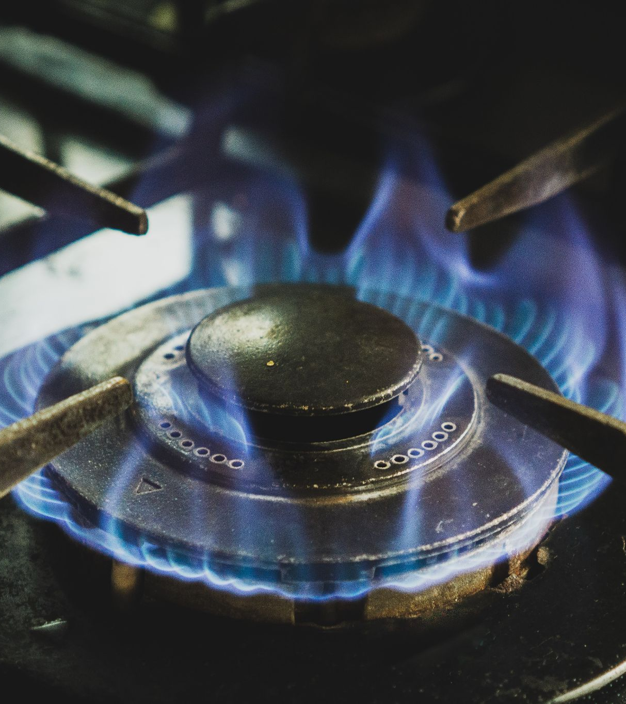
The different forms of energy
Kinetic energy
Mechanical energy
Thermal energy
Chemical energy
Electrical energy
Energy is everywhere, in many different forms.
It can neither be created nor destroyed,
we can only transform it from one form to another.
Notes:
Explanation:
There are many forms of energy around us, and here are a few examples.
A moving body has kinetic energy. For example, rivers or the wind contain more or less kinetic energy depending on the force of their movement.
The carriage at the top of a rollercoaster has potential energy that manifests itself when it starts moving and begins its descent. It then develops kinetic energy linked to its movement. The sum of kinetic and potential energy is mechanical energy.
Thermal energy is heat
Chemical energy is the energy contained in matter. Chemical energy is very useful for life. It is contained in glucose, for example, and is used by cells to live. Chemical energy is also involved when the combustion of fossil fuels or biomass is used to convert the chemical energy of these materials into heat.
Electrical energy is the energy available in the form of a current of electrons (electricity). This energy, which comes into our electrical sockets, is used directly to produce light, for example.
Be careful not to confuse energy and electricity. Electricity is a particular form of final energy.
To find out more :
Primary energy is the "potential" energy contained in natural resources (such as wood, gas, oil, etc.) before any transformation.
Final energy is the energy consumed and invoiced, taking into account losses during the manufacture, transport and processing of oil.
The Energy Explorers site [in French] (http://www.explorateurs-energie.com/) contains several sources available to talk about energy.
Key messages:
Energy is everywhere and in many forms.
It cannot be created or destroyed; we can only transform it from one form to another.

Slide 10
The different uses of energy
People convert and use energy according to their needs: to clothe and feed themselves, to get around, to keep warm, to buy goods and services, and so on.
I eat
I heat or cool my house
I consume goods and services
I travel
Are there any activities that don't consume energy?
Notes:
Explanation:
Ask your students this question and show them that we're always using energy, even when we're asleep!

Slide 11
Where does energy comes from ?
Part 2

Slide 12
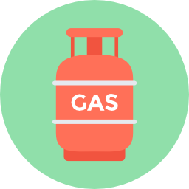
There are different forms and sources of energy
Renewable energy sources
Non-renewable energy sources
Fossil fuels
Solar energy
Mechanical energy
Chemical energy
Nuclear energy
Different energy sources mean different
advantages and disadvantages for each of them !
Do you know some of them?
Notes:
Explanation:
Different sources can be used to produce different types of energy. Some are renewable, such as wind, sun, water or wood. The energy produced from these sources (by wind turbines, solar panels, water dams or burning wood) is called renewable energy. Some sources are not renewable. This is the case with uranium, which is needed to produce nuclear energy. The same is true of fossil fuels: gas, coal and oil, which are used to produce fossil fuels.
Although nuclear energy is not a renewable energy, it is not a fossil energy.
All energies are not equal and have advantages and disadvantages.
Activity: Ask the students to identify the advantages and disadvantages of each energy source.

Slide 13
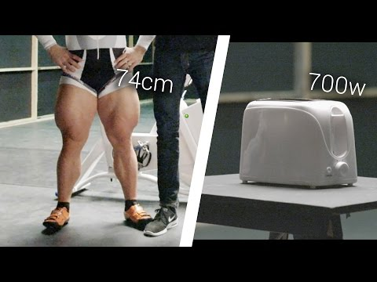
Our human strength represents little energy
Notes:
Explanation:
This video will give your students food for thought on the subject.
"While it only takes one Robert to start a toaster, it takes 180 to start a car for an hour and 43,000 to start a plane.
If it takes a whole Robert Förstemanns to start a toaster, have you ever wondered how many of us it takes to do the same thing?"

Slide 14
Power and energy: what's the difference?
=
10 cyclists for one hour :
1 kW of power for one hour
Baking a cake in an electric oven (1 kWh)
Notes:
Explanation:
To compare energies, we'll take the example of a cake that bakes for an hour in an electric oven.
With human energy, 10 cyclists would have to pedal for an hour to bake the cake.
A cyclist travelling at 20 km/h develops a power of 100 W. So you need 10 cyclists to produce one kilowatt (kW).
What are the alternatives?
Further reading:
This slide can be used to remind students of the difference between power and energy:
Energy is measured in (kilo-watt-hours) kWh. The more energy we need to make something work, the more kWh we need to produce. Energy is linked to the concept of Power. It is measured in kilowatts.
What is the difference between power and energy? Let's imagine a cyclist. Power in kW represents the speed of the cyclist at a given moment, while energy in kWh represents the distance travelled by the cyclist. Using 1 kWh of energy is equivalent to using 1 kW of power for 1 hour.
We go from power to energy by multiplying power by time. It sounds technical, but the two concepts are often confused.

Slide 15
Ten cyclists to bake a cake for an hour…
=
Or instead :
8 000 L of water
50 m² of solar panels
A 5 m diameter wind turbine
A log of wood
A gas cylinder
A small pile of coal
33 cl of oil
A pinch of uranium
Fossil fuels
Fossil fuels are much more concentrated than most energies
Notes:
Explanation:
To bake this cake in one hour, we could have used :
8000 L of water* from the turbine of a 50 m high dam to supply 1 kWh to the socket.
50 m² of solar panels* (about the size of a tennis court) or a wind turbine 5 m in diameter*.
Now let's look at the resources that would have been burnt in a thermal power station.
With wood, you need to burn a log.
With gas, ⅓ of a camping stove (1200W)**.
With coal, you need to burn a small pile of coal.
With oil, you need to burn the equivalent of a can (33cL) of petrol.
Gas, coal and oil are called fossil fuels or energies because they come from the fossilisation of ancient living beings (zooplankton and algae for oil, plants from the Carboniferous age for coal).
Finally, it only takes a few atoms of uranium to produce 1 kWh, because nuclear energy is a resource that is 1 million times more concentrated than fossil fuels.
*Based on average climatic conditions in France
**At 200 bars

Slide 16
... But fossil fuel reserves are limited!
Known reserves = 2 950 GtCO2
Already emitted since 1850
2390 GtCO2
Known reserves = 525 GtCO2
Known reserves
= 730 GtCO2
Source : IPCC AR6 WG1
Notes:
Explanation:
We have already consumed around ⅓ of the available reserves known since 1850.
We will see later that our energy consumption is accelerating exponentially, and burning fossil fuels emits huge quantities of greenhouse gases.
What's more, this graph conceals many of the problems associated with the increasing scarcity of fossil fuels (for example, the deeper the oil is buried, the more complex it is to extract).
For the curious:
For the basic distinction between resources and reserves, you can refer to the appendix dedicated to peak oil, or to the article on this website: https://www.profolus.com/topics/oil-gas-difference-between-resources-reserves/
Source: IPCC AR6 - WG1

Slide 17
But hiring 10 cyclists is expensive!
110 €
=
10 cyclists
0,20 €
=
Power supply
Notes:
Explanation:
As you can imagine, these cyclists won't be pedalling for free for an hour! At the minimum hourly wage (around €11 gross per hour in 2022), you'll have to pay them €110. But with an electric socket, you don't have to worry about that. For your information, that kWh at €100/10 cyclists would cost you just 20 cents (in 2022) if you used your electric socket. What's more, it takes up far less space!
With all the convenience it offers, it's easy to see why energy has become such a big part of our lives. We don't realise it every day, but that's what makes the difference between before and after the industrial revolution.
Key messages:
The energy we use every day is highly concentrated compared with human energy.
Modern energies are around 500 times cheaper than muscular energy.
It is no longer thanks to our muscular strength, but to other sources of energy that we produce so many (too many?) goods and services.
To go further:
The aim of this section is to show that abundant and inexpensive energy has greatly facilitated the development of our economic activities.
Here we look at orders of magnitude that we are not at all used to. For example, the average English person consumes several thousand kWh of electricity a year. The first question is to understand what a kWh is. A kWh is the energy used to operate an appliance of x kilowatts for 1/x hours. For example: baking a cake for 1 hour in the oven or using the hoover for 1 hour (1 kW), leaving the TV or a lamp on for 10 hours (100 W), using a laptop for 20 hours (50 W), etc.
Anecdote: The cake baked to be shared between 10 people will not allow cyclists to recover the calories expended! It's important to remember that for every energy transformation, there are losses, particularly in the form of heat.

Slide 18
Different energy sources
Renewables
Fissile
Fossils
Hydraulics
Solar and wind
Biomass
Uranium
Gas
Coal
Oil
Low CO₂ emissions
Easy to store and transport
Easy to store
Unlimited
Renewable
Highly concentrated energy
Highly concentrated energies
Limited spaces
Variable output
Competition for land use
Nuclear waste
High CO₂ emissions
Notes:
Explanation:
What are the advantages of renewable resources?
They are virtually inexhaustible on a human scale, because they come from physical phenomena that occur regularly without human intervention.
In this respect, biomass requires special attention, because its renewable nature depends on the management of the environment from which it is extracted. Cutting down an entire forest to burn wood is totally incompatible with sustainable forest management.
They generate little pollution, either directly (when they are used) or indirectly (mainly when the infrastructure is built). In particular, renewable resources emit very few greenhouse gases, which is why they are being given particular attention in the energy transition.
What are the disadvantages of renewable resources?
They are not very concentrated, because they are more diffuse. This has two consequences:
For the same volume of material, renewable resources tend to provide less energy than non-renewable resources.
For the same amount of energy, the infrastructure of renewable resources requires much more space than that of non-renewable resources (see the slide Ten cyclists for 1 hour is equivalent to...). For example, building a dam requires nothing less than flooding an entire valley! This can lead to conflicts of use, or damage to ecosystems: for example, should land be given over to agriculture or a photovoltaic solar power plant built instead? It should also be noted that some renewable resources may meet with a degree of local hostility that can hinder their development.
They are variable, meaning that they are not permanently available and that their availability varies greatly. For example, a solar panel only works on sunny days and not at night, while a wind turbine only works when the wind is not too strong.
Why is this a problem? Most of these renewable resources are used to produce electricity. However, as large-scale electricity storage is proving to be complex, the output of power stations must meet electricity demand at all times: this is known as controllability. In short, renewable resources are not very controllable, which poses a serious constraint if we want to have a 100% renewable energy mix.
What are the advantages of fossil fuels?
They are highly concentrated and therefore provide much more energy than renewable resources. This concentration is the result of a long process of accumulation of carbonaceous matter.
They can be transported and stored. It is much simpler to transport solid, liquid or gaseous matter than it is to transport a physico-chemical process! Non-renewable resources are therefore "more practical" to use, which is why we use them so much:
Oil is the easiest to transport because of its liquid nature, which is the main reason why it is used as a fuel.
Gas can easily be transported in cylinders, but must be compressed to make it easier to transport. On the other hand, it presents risks of leakage and explosion.
They are controllable: if necessary, it is not very difficult to run a gas, coal or oil-fired power station to meet an increased demand for electricity.
What are the disadvantages of fossil fuels ?
They are not renewable on a human scale: quantities of natural gas, coal and oil are limited on a human scale.
They generate a lot of pollution, of different kinds depending on the resource:
When they are burned, fossil fuels release toxic waste into the air, soil and even water. In particular, their combustion emits carbon dioxide (CO2), which has a significant impact on the climate (see following sections).
What are the advantages of nuclear energy?
It is highly concentrated and therefore supplies much more energy than renewable resources.
It can be controlled.
It has low greenhouse gas emissions.
What are the disadvantages of nuclear energy?
Nuclear power plants produce irradiating waste that is impossible to dispose of in a human lifetime, and must be stored in secure locations that are difficult to access. They can also be the site of accidents with harmful consequences. Nuclear power plants, on the other hand, do not generate greenhouse gas emissions, and are also the focus of particular attention in the energy transition.
What can we learn from all this? No energy source is perfect, ideal or clean; they all have their qualities and shortcomings. There is no such thing as a miracle energy source, so the first thing to do is to reduce our energy consumption. In what follows, we will see that there is an urgent need to move away from fossil fuels.
Finally, this slide may give the impression that all these energy resources are used for the same thing, which is obviously not true: energy sources are not entirely substitutable for each other. This point is dealt with in a little more detail in the slide What are we using energy for?.
Key messages:
No energy resource is perfect.
Fossil energy sources (oil, gas and coal) are much more concentrated, versatile and simple to exploit than all the others, but they are also the most polluting.

Slide 19
Global energy consumption
Part 3
Notes:
Explanation:
In this section, we present the global energy mix.

Slide 20
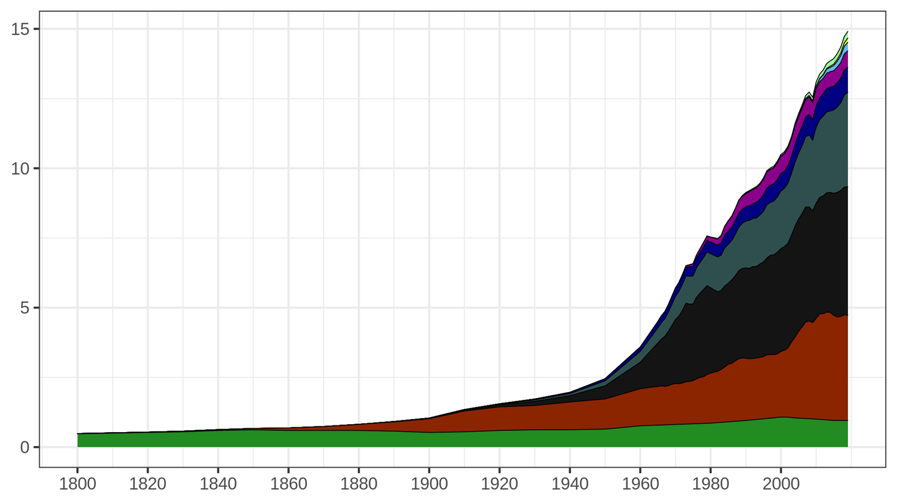
Global energy consumption
Your birth
6 %
4 %
2 %
1 %
Source : https://ourworldindata.org/global-energy-200-years
Billions of tonnes of oil equivalent (Gtoe)
Birth of your parents
79% of energy consumption comes from fossil fuels
Birth of your grandparents
≈ 1/4 (23 %)
≈ 1/3 (31 %)
≈ 1/4 (25 %)
6 %
Années
World primary energy consumption over time
Notes:
Activity : Before you start, ask the audience: "Can you remind me of the 3 fossil fuels? "Oil, coal and gas". Then "Of all the energy resources used by mankind, if you really count them all, such as firewood, burning waste to produce energy, solar panels, wind turbines, hydroelectric dams, nuclear power, geothermal energy, etc., what percentage comes from the 3 fossil fuels? Everyone raises their hand. Those who think that fossil fuels provide 100% of humanity's energy, put your hand down. If you think that fossil fuels provide more than 80% of humanity's energy, put your hand down. Over 70%, put your hand down. Over 60%, put your hand down. 50%, put your hand down. 20%, put your hand down". Explanation:
This graph shows global primary energy consumption over time.
The horizontal axis represents the different years.
The vertical axis represents primary energy consumption for the year in question. The unit used is the Gtoe (Giga tonne of oil equivalent), which measures the energy released by the equivalent of burning one billion tonnes of "standard" oil. This is another unit of energy, much more practical on this scale than the kilowatt-hour (kWh).
We are talking here about primary energy, which corresponds to what is found directly in nature. Electricity and petrol (which are forms of energy used by consumers) are not represented on this graph because there are no deposits of electricity or petrol in nature. Uranium, wind, oil, etc. are included. Since oil is the planet's main energy resource, all other forms of energy are related to it (for example, burning one tonne of coal is equivalent to burning around 0.66 tonnes of oil). Consumption is therefore expressed in tonnes of oil equivalent (toe), in this case in billions of toe. In contrast to primary energy, final energy is the energy that is used by the consumer, after the losses associated with transporting the energy to the user.
Global consumption in 2019 was around 14.9 Gtoe.
Oil alone accounts for 1/3 of global energy consumption. It is mainly used for transport.
Coal accounts for 1/4 of consumption. It is mainly used to produce electricity.
Gas accounts for 1/4 of global consumption. It is mainly used for heating and is also used to produce electricity.
Fossil fuels such as oil, gas and coal alone account for almost 80% of the energy consumed by the whole of humanity.
Wood, which has been used for a very long time, accounts for 6.4% of the world's energy consumption. It is burnt for heating.
Nuclear energy, which accounts for 4% of global energy consumption, is used to produce electricity.
Renewable energies (geothermal, solar, wind, hydro) are in full development, but account for only 10.4% of the energy consumed worldwide.
For comparison: in United Kingdom (in 2022), oil represents 36,4% of the final energy consumed, gas 35,4%, renewable energy 18,3%, nuclear 5,8% and coal 2,8%.. Source : infographie https://ourworldindata.org/grapher/energy-consumption-by-source-and-country?tab=chart&country=~GBR
Since the industrial revolution (around 1860), the population has increased 7-fold, while energy consumption has increased more than fifteen-fold. Each human being therefore consumes more than twice as much energy on average. What's more, each "new" source of energy adds to the previous ones, without replacing them. For example, oil has never replaced coal, nuclear energy and renewable energies have never replaced fossil fuels, and so on.
Key messages:
The world relies on fossil fuels
Every energy resource is consumed more and more.
For the moment, no energy has replaced another.
Remarks:
This is the first graph in the presentation. It is very important to explain the axes and definitions each time, so that everyone understands you.
Clarification for the curious
NB: 1 tpe = 11,630 kWh
Source : Vaclav Smil (2017) & BP Statistical Review of World Energy
https://ourworldindata.org/global-energy-200-years

Slide 21
Global energy consumption
The world relies on fossil fuels.
Coal was the first fossil resource used in the past, and is found in many parts of the world.
Oil is by far the most widely used energy resource, as it is more concentrated and easier to transport.
We've never switched from one energy source to another, we've just used more and more energy.
Low-carbon and renewable energy sources are still the minority in our global energy consumption.
Notes:
Explanation:
This slide summarises the key information from the graph in the previous slide.

Slide 22
Primary and final energy
Primary energy is a raw energy resource that has not been transformed and is found in its "natural" state in the environment.
Final energy is obtained through the industrial conversion of a primary energy resource. It is this energy that is available to the end user.
Find some examples of primary and final energy!
Primary energy
Final energy
Notes:
Explanation:
This slide and the next one provide additional content for understanding primary and final energy if you follow the advanced approach.
Ask your students to give you several examples of primary and final energy.
You can also make a small table: Raw material - Primary energy - Final energy.
Example: coal - chemical energy - electricity.
NB: The same primary energy can be transformed into several very different final energies. For example, oil can be transformed into petrol or electricity.

Slide 23
Primary and final energy
Example : Electricity production via coal combustion
Chemical energy
Thermal energy
Mechanical energy
Extraction of primary energy resources: in this case, coal
Leaks
Transport losses
Only a primary energy resource can replace another primary energy resource: transition from a fossil energy source to a renewable energy source
Electricity
Final energy
Notes:
Explanation:
A toaster uses electrical energy. But electrical energy is not really energy that can be recovered directly from nature. Lightning is too powerful and intermittent to control, and no one would think of using thousands of electric eels to toast their bread. So we need to transform a primary energy source into electricity. Let's take coal as an example.
First, we have to extract the coal available underground. Then, the most common method of transforming fossil energy into mechanical energy is to use a steam engine. The coal is burnt to heat a certain quantity of water to produce steam. In doing so, the chemical energy stored in the coal is transformed into thermal energy, which is used to heat the water. The steam you have just produced now passes through a turbine. The turbine starts to turn and produces electricity via an electrical coil or piezoelectric materials. The mechanical energy of the turbine is thus transformed into electricity.
At each stage of this process, you can have energy leaks and losses. The amount of final energy you recover will always be less than the amount of primary energy you had. This does not mean that the energy disappears, but that it is used for something else (e.g. heating the surrounding air when there are heat losses, etc). It only means that there have been losses in the process.
When we say "Only one primary energy resource can replace another primary energy resource", this means that we cannot stop using coal by replacing it with electricity, because we cannot find electricity in nature, we have to transform it from something. So we have to replace the coal with a raw material that corresponds to the current industrial process or find a new industrial process to obtain the final energy we need.

Slide 24
Summary
Energy reflects the changes taking place in the world. Energy is everywhere, in many different forms.
Not all energy sources are equivalent, and each has its advantages and disadvantages.
It's more practical and less expensive to use power supply than to hire cyclists!
Fossil fuels provide most of our energy
Only one primary energy resource can replace another primary energy resource.
Notes:
Explanation:
Here is the summary of this first part if you are following the "light" module. If necessary / possible, you can do a round of questions / answers or ask students to write down their questions for later and continue. The following slide concludes this module if you are following the "complete" path.

Slide 25
Focus :
Oil, Uranium et Solar
Part 4

Slide 26
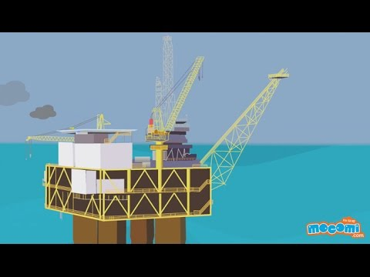
Focus 1 : Oil
FR
ES
IT
Notes:
Long version : FR https://www.youtube.com/watch?v=TCIO38TCspk EN https://www.youtube.com/watch?v=JasIvS7oYw4
ES : https://www.youtube.com/watch?v=N-DYWTc9iP4

Slide 27
What is oil?
Oil is a fossil fuel because it is derived from organic and plant matter accumulated and stored in the ground over millions of years. It is one of the hydrocarbons.
Oil is a non-renewable resource
Where is oil found? How much of it do we consume?
Notes:
Animation : Introduce the following slides by asking the question.

Slide 28
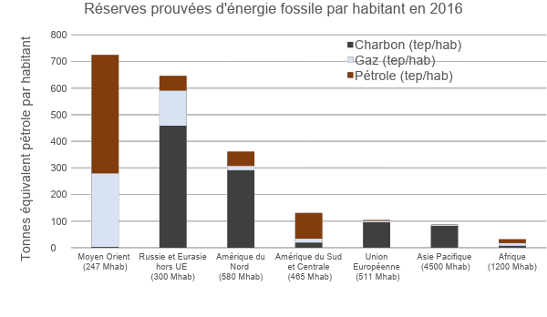
Where do we find fossil fuels?
Proven fossil fuel reserves per capita in 2016
Coal (toe/cap)
Gas (toe/cap)
Oil (toe/cap)
Energy resources give some countries leverage over countries without resources
Tonnes of oil equivalent per capita
Because of its energy dependence, Europe has a lot to lose if the energy transition fails.
Middle East
(247 Minhab.)
Russia and Eurasia outside EU
(300 Minhab.)
North
America
(580 Minhab.)
South and Central America
(465 Minhab.)
European
Union
(511 Minhab.)
Pacific Asia
(4 500 Minhab.)
Africa
(1 200 Minhab.)
Source: Avenir Climatique based on data from BP Statistical Review
Notes:
‹#›
Message clé
Définition ; les réserves prouvées sont les réserves économiquement et techniquement viables
L’Europe est actuellement entièrement dépendante du reste du monde car elle ne possède presque aucune ressource fossile.
Le reste du monde continuera-t-il à nous donner une part de ses ressources ?
Contrairement à certaines idées reçues, la France n’est pas indépendante au niveau de sa consommation d’énergie.
Explications
Le graphe présente les réserves prouvées des différents combustibles fossiles PAR HABITANT par grande zone géographique (on prend les réserves de la zone et on divise par le nombre d’habitants). Ce graphe donne quelques éclaircissements géopolitiques intéressants comme :
L’intérêt pour le Moyen-Orient
L’intérêt pour la Russie
La difficulté des Américains à se « mettre au vert ». Pas facile en effet quand on est assit sur plus du quart du charbon de la planète pour même pas le 20ème de sa population
Le fait que l’Europe insiste le plus pour que le monde se « mette au vert ». Facile de demandez aux autres de réduire quand on ne possède rien. « S’il-vous-plaît, ne consommez pas trop… et surtout laissez-nous en ! ». Comment, nous ne sommes pas simplement de bonne volonté ?!? ;-)
Oui, parce que l’Europe ne possède rien, ou si peu…
En 2009, la France importait 91% de ses ressources d’énergie
Précisions pour les curieux
Le graphique a été construit par Avenir Climatique en prenant les réserves prouvées sur la BP Statistical Review 2010 et en recalculant la population pour la zone géographique concernée.
Quelques anecdotes sur les explications :
Il est très facile aux pays qui n’ont rien (Europe) de demander à ceux qui ont tout (Etats-Unis par exemple) de faire un effort, et à ces derniers de refuser (non ratification du protocole de Kyoto par exemple). Par ailleurs, fait majeur dont on n’a pas parlé en France : le 21/01/2010, la Cour Suprême américaine a supprimé le plafond de financement des campagnes électorales par les sociétés privées (loi en vigueur depuis 1907) malgré l’opposition d’Obama et de 70% des américains. Les pétroliers participent d’ailleurs activement aux soutiens des candidats. De nombreux autres exemples tendent à faire penser que les sociétés font la pluie et le beau temps en politique américaine, et notamment les compagnies qui exploitent le pétrole et le charbon américain.
En 2010, la France a reçu en grande pompe la Russie dans le cadre de l’année France-Russie qui a été au passage l’occasion de vendre des bateaux de guerre et négocier des accords pour le gaz.
Pour l’Europe, l’ensemble des ressources fossiles prouvées (qui sont les seules déclarées, mais il y a encore les probables et possibles) représente 49 tep/habitant, avec une consommation annuelle moyenne de plus de 4 tep/ha. Alors, combien de temps ? Il n’y a plus qu’à espérer que les autres soient prêteurs, ou plutôt qu’on en ait pas besoin pour éviter les rapports de force.
Pour le monde, une moyenne de 108 tep/ha et une consommation annuelle de 1,7 tep/ha (mais toute la planète aspire à consommer au moins autant qu’un Européen). Il pourrait y avoir du sport !
‹#›
Explanation:
The graph shows the proven reserves of different fossil fuels PER CAPITA by major geographical area (take the reserves for the area and divide by the number of inhabitants). This graph provides important geopolitical information, such as :
The interest of the Middle East given their oil and gas reserves
Russia's interest, given its large coal reserves
America's interest, given its large coal reserves
Europe's insistence that the world should "go green", given its energy dependence.
Key messages:
Europe is currently entirely dependent on the rest of the world because it has virtually no fossil fuels.
Will the rest of the world continue to share its resources with us?

Slide 29
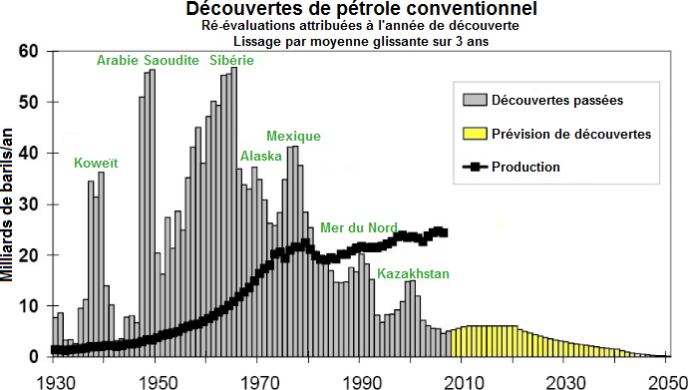
Oil supplies will eventually peak
Conventional oil discoveries
Discovered quantities listed by year
Smoothed by 3-year average
Production
Peak of production
Saudi Arabia
Siberia
Past discoveries
Predicted discoveries
Production
Mexico
Koweït
North Sea
Billions of barrels/year
Time
Almost all oil reserves have already
been discovered
We are approaching peak oil production
Source : Association for the Study of Peak Oil (ASPO)
Notes:
Explanation:
In the first graph, the grey bars of the histogram represent conventional oil discoveries each year. The yellow bars show that no major deposits have been discovered in the last 20 years. The black dots represent annual production. So we are producing more oil despite the fact that we are discovering less and less. So we are essentially living on past discoveries.
As oil is non-renewable, its consumption is leading us inexorably towards what is known as peak oil (shown in the second graph). Before the peak, production is facilitated by the modernisation of techniques, leading to a sharp increase in consumption because oil seems to be readily available. Over time, the availability of the resource decreases, making production slower and more difficult, until production starts to decline. The moment when production was at its peak is known as the "peak".
Whatever the resource (in this case, oil), it is difficult to predict the exact moment when this production peak will be reached, because it is not linked solely to the physical availability of the resource. It also depends on our technical, political and economic choices! According to the IEA, a plateau has been reached since 2008 for conventional oil (production is stagnating) and a peak could be reached by 2025 for oil (conventional and non-conventional).
Key messages:
Less and less conventional oil is being discovered every year.
Yet consumption and production are increasing every year: we are now living on yesterday's discoveries.
We are consuming more and more energy to produce it. In 1900, it took 1 barrel to produce 100 barrels. Today, with the oil sands, we can produce 3 barrels by consuming 1 barrel. Energy production is only interesting when we recover more energy than we consume to produce it.

Slide 30
Oil extraction, an increasingly costly and energy-intensive process
1900
Today
For conventional oil
with 1
we used to obtain 100
For non-conventional oil
with 1
we obtain 3
Conventional and non-conventional oils are increasingly difficult to extract, as they are located deeper underground or require more complex extraction processes.
By 2021, we were consuming 94 million barrels of oil a day.
Notes:
Explanation:
At the beginning of the oil era (mid-19th century), it was not uncommon for a well to be drilled and for the oil to come out of the ground on its own, due to the underground pressure, as in Lucky Luke. As the well empties, the pressure drops and you have to pump if you want to continue extracting oil. To operate, the pumps themselves consume oil, and energy is also needed to build and operate the entire infrastructure. In 1930, around 1% of the oil extracted had to be consumed to provide the energy needed for extraction. This type of oil (liquid, in an underground pocket on a continent or deep in the ocean) is known as "conventional".
Other types of oil exist, known as "unconventional", such as tar sands, heavy oil, oil shale, oil in deep offshore or polar conditions.
The record for drilling on a continent is 12,376m (Exxon, August 2012, in Russia)! In the ocean, it's 12,289m below the surface (this is called deep offshore drilling). Can you imagine? In the end, on average today, around 6% of the oil extracted is consumed by the extraction itself.
Oil is also extracted from tar sands. These are sands that are mixed with oil. Here, there are no more pipes or pumps to extract the oil, but construction machinery that digs and loads trucks. The oil sands are then transported to a facility where they are mixed with water and boiled to separate the sand from the oil. The cooking water containing the oil is then recovered, and some of the oil is separated from the water. The result is oil and water that still contains a little oil. There remains the problem of recycling this polluted water. In the end, a third of the oil produced is consumed by this extraction process.
Key messages :
The more oil we produce, the more expensive it becomes to extract (both in terms of money and energy).
In 1900, it took 1 barrel to extract 100 barrels.
Today, new non-traditional techniques consume 1 barrel to produce 3.

Slide 31
How is oil used?
The world's most widely used energy source: ~31% of energy consumption
Main source of energy for transportation
Petrochemical industry: plastics, cosmetics, paints, dyes, asphalt, pharmaceuticals, etc.
Notes:
Oil is used almost everywhere, either as a source of energy or as a plastic.

Slide 32
Putting things into perspective
These are just a short chapter in the history of mankind
25 -
20 -
10 -
5 -
0 -
A future without fossil fuels doesn't have to resemble the lifestyles of the past!
In billions of tons of oil equivalent
For thousands of years, humans have lived without fossil fuels
-10 000 -8000 -6000 -4000 -2000 0 1855 - ? 4000
Notes:
Explanation:
This graph is similar to the one we saw earlier on global energy consumption. However, the time scale needs to be put into perspective. If we look back at the history of modern humanity (the invention of agriculture 10,000 years ago), fossil fuels are likely to be just a parenthesis. Energy consumption = the speed at which the world is changing. Transformation so rapid that we can see the differences from one generation to the next (children are born into a different world from their parents).
Key messages:
Oil and fossil fuels will only be around for a short time in human history.
The future without oil is not the same as the past without oil.
The future must be built, and there is work for everyone in this great adventure.

Slide 33
Key messages
Oil is the main source of energy used by our society - accounting for 31% of global energy consumption.
Oil reserves are limited in quantity and unevenly distributed around the world.
We need to prepare for the "post-oil era"...

Slide 34
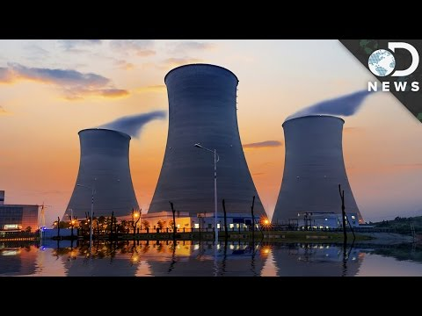
Focus 2 : Uranium
Focus 2 : Uranium
FR
ES
IT
Notes:
EN : https://www.youtube.com/watch?v=apODDbgFFPI ES: https://www.youtube.com/watch?v=RRWyIy1MCaw
IT: https://www.rtve.es/alacarta/videos/noticias-24-horas/uranio-mineral-enriquecido-sirve-para-fabricar-armas-nucleares/2167090/
FR : https://www.youtube.com/watch?v=V3U_l2LESFw

Slide 35
Focus 2 : Uranium
Uranium is a radioactive chemical element that exists naturally on Earth. It is used as an energy source in nuclear power plants.
It's a non-renewable resource that was formed within stars billions of years ago.
Where is uranium found?
Notes:
Introduce the following slides by asking the question.

Slide 36
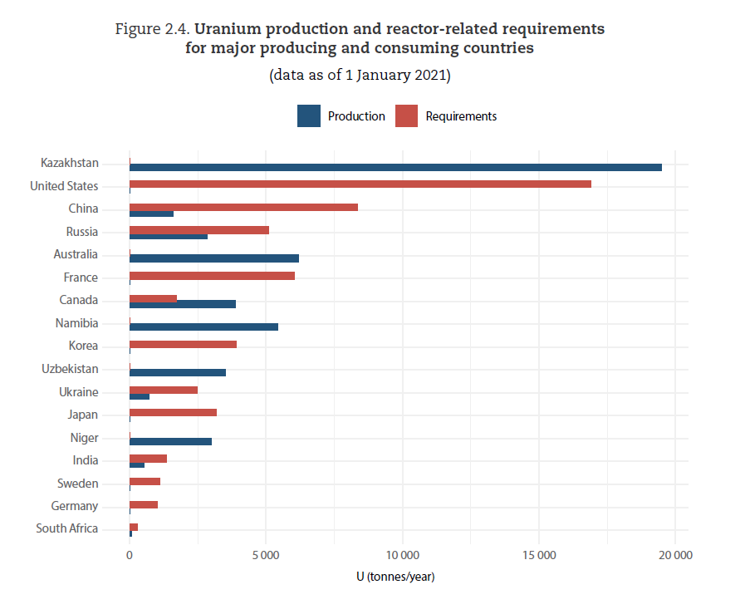
Focus 2 : Uranium
Focus 2 : Uranium
Uranium can be found in :
Mines
Water
Food (plants, animals)
Source : URANIUM 2022: RESOURCES, PRODUCTION AND DEMAND, NEA No. 7634, © OECD 2023
Notes:
Explanation: Uranium resources are unevenly distributed around the world. Here, the graph shows the countries that produce uranium (in dark blue), and the countries that consume it (in light blue).

Slide 37
Focus 2 : Uranium
Focus 2 : Uranium
Use :
Nuclear power plants for power generation
Weaponry and deterrence
Medical imaging
Disadvantages :
The fission reaction produces long-lived radioactive waste, which is expensive and complex to treat and dispose of
Notes:
This slide briefly presents the characteristics of nuclear power

Slide 38
Focus 3 : Solar energy
The energy of the sun's rays is contained in particles of energy called photons.
This energy can be converted into heat or electricity.
Solar energy is a renewable resource.

Slide 39
Photovoltaic systems
The photovoltaic panel is the best-known solar energy conversion system.
How it works: photovoltaic cells are made of silicon, a material that converts solar energy directly into electricity.

Slide 40
Photovoltaic systems
Advantages and disadvantages:
Solar power generation is CO₂e-free and can be decentralized. It is predictable and based on a local resource
The manufacture of photovoltaic panels emits few greenhouse gases. This depends on whether or not the electricity used is generated from fossil fuels
The mass production of photovoltaic panels clashes with other metal-intensive production processes, and requires the emergence of a dedicated recycling chain

Slide 41
Quiz !
What is the difference between final energy and primary energy?
A : Carbon content
B : Conversion losses
C : Geological origins
D : The answer D

Slide 42
Quiz !
What is the difference between final energy and primary energy?
A : Carbon content
B : Conversion losses
C : Geological origins
D : The answer D

Slide 43
To put it in a nutshell
The best energy is the energy that we don't use!
Reducing our energy consumption must therefore be a priority.
There are a number of ways to achieve this, including :
Adopting new, more energy-efficient behaviors
Manufacturing appliances that consume less energy.
For energy production :
Fossil fuels are becoming scarce, and their use generates greenhouse gases. Nuclear energy will be available, depending on the current stock of nuclear power plants in the various EU countries.
Renewable energies will have to account for a considerable share of the electricity mix by 2050. The deployment of renewable energies must minimize damage to the environment, landscape and biodiversity.

Slide 44
Image credits
Icônes of 123RF by : oianaesi
Icônes of VectorStock by : ProStockStudio
Icônes of Shutterstock by : Sudowoodo
Icônes of The Noun Project by : IQON
Icônes of pngset by : Aliya Yoder
IM
Icônes of Vectors Markets by : Icons Mind, Nazar M
Painting : Pflügende Ochsen by Rudolf Koller
Icônes of Flaticon by : SmashIcons, Roundicons, Icon Pound, Vectors Market, Pixel Perfect, Freepik, Gregor Cresnar, DinosoftLabs

