Slide 1
Phase 2: Understanding climate change
Module 2. Human activities

Slide 2
Welcome to Clicks On educational content!
Choose your path!
You can tailor your presentation to suit the content of your class, the time you have available and the topics you want to explore! To make things easier for you, we've created two easy-to-identify slide types : the light and the complete initiative :
Light initiative
Complete initiative
→ the red wire and fundamental concepts of the module
→ slides and activities to deepen your knowledge!
Don't forget the comments below the slides
Each slide is accompanied by notes to guide you through your presentation.
Complete your session with suggested activities from the module
You'll find suggested activities for each phase on our website!
Enjoy your session!

Slide 3
Human activities
How is energy being used?
The evolution of our lifestyles
The impact on the environment

Slide 4
How is energy being used?
Part 1

Slide 5
A few reminders
What is energy?
How do we use energy in our daily lives?
Find some examples!
Notes:
Explanation:
Ask students questions about :
1. What energy is: Normally this was covered in the presentation on Energy Issues, so this is a reminder and a link to what they've already seen!
Reminder of the definition of energy: Energy is the quantity that measures transformations in the world.
2. Energy use: Examples are shown on the next slide - Did your students find those?

Slide 6
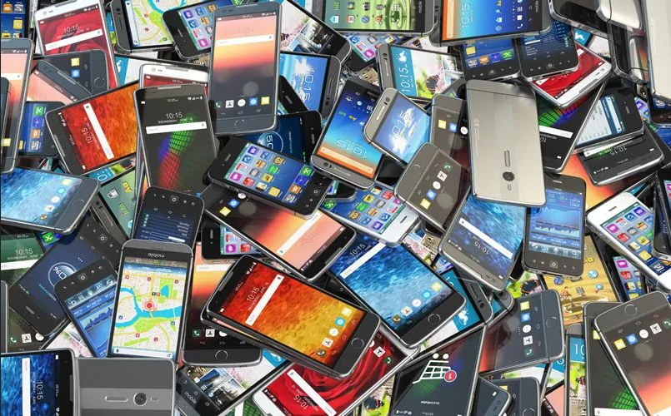
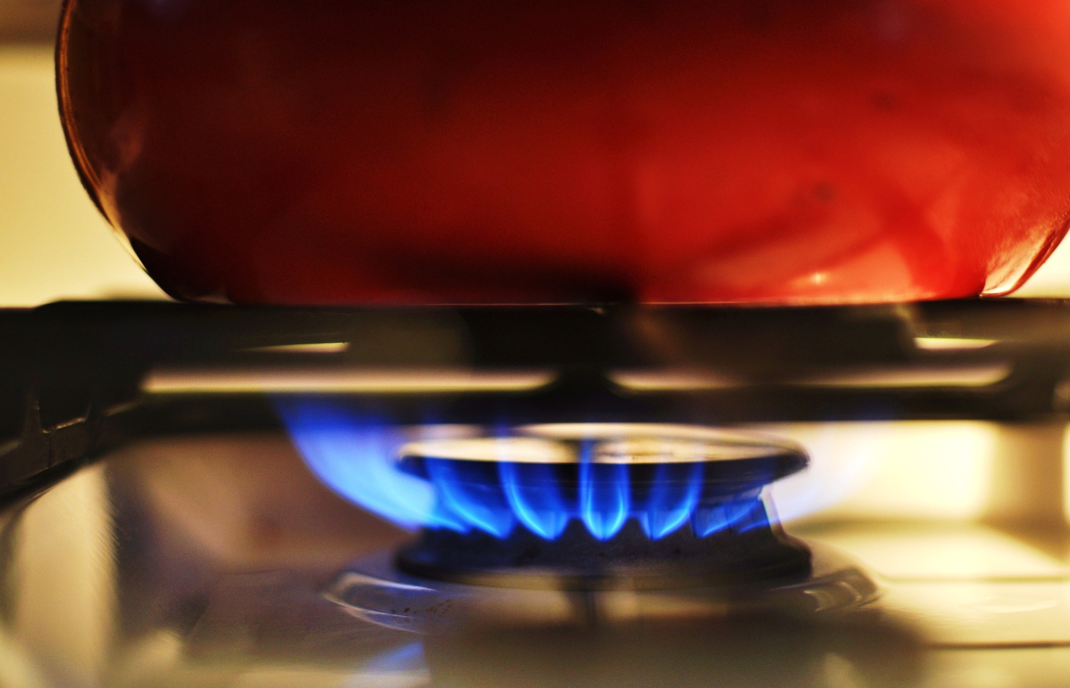
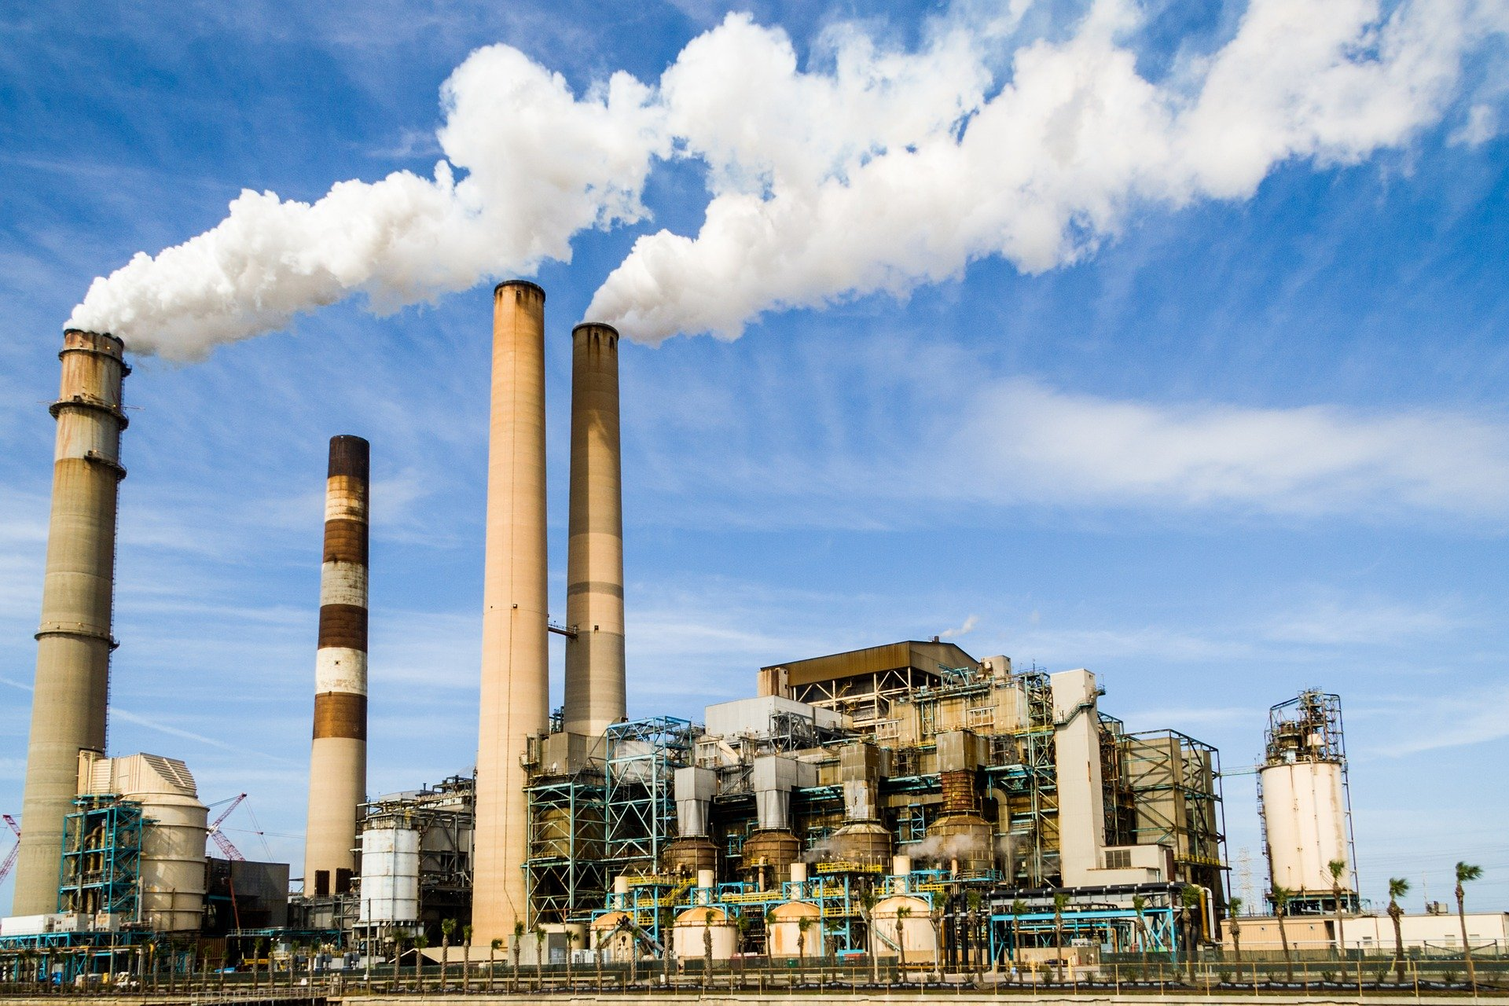
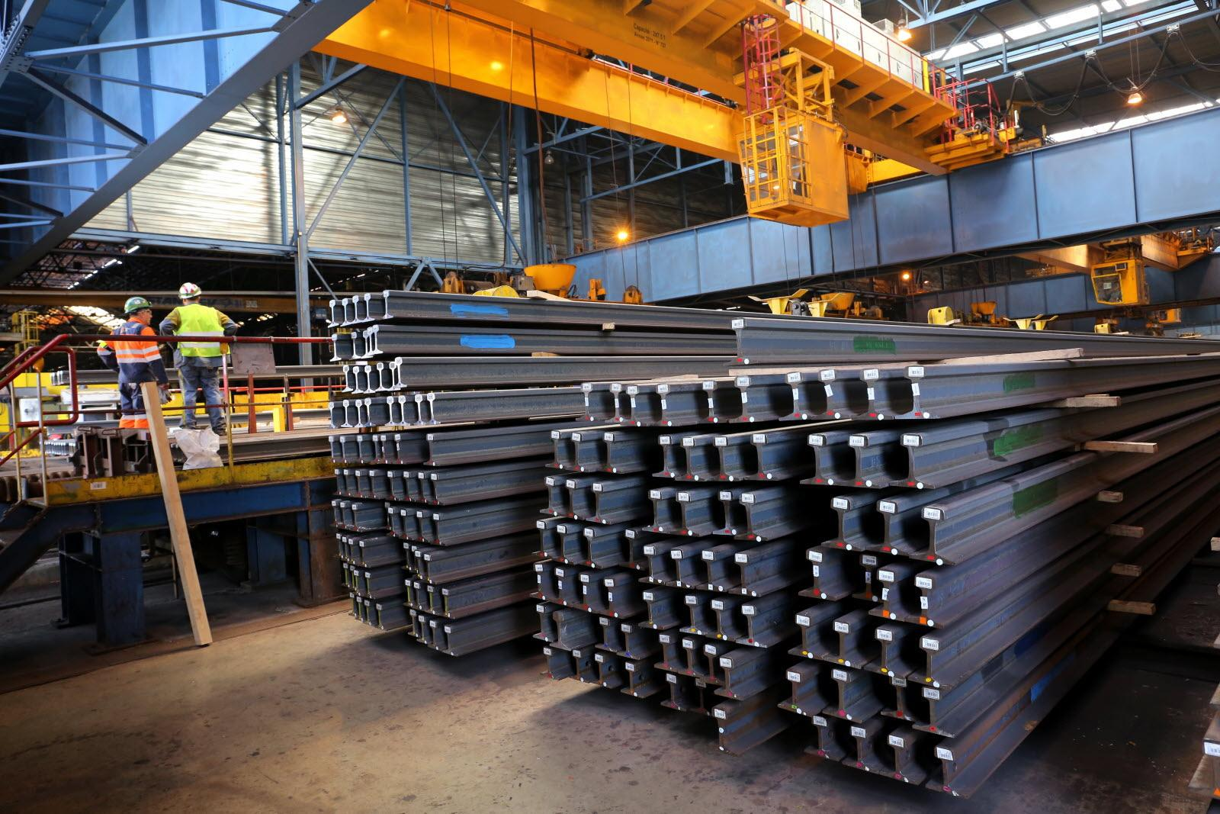
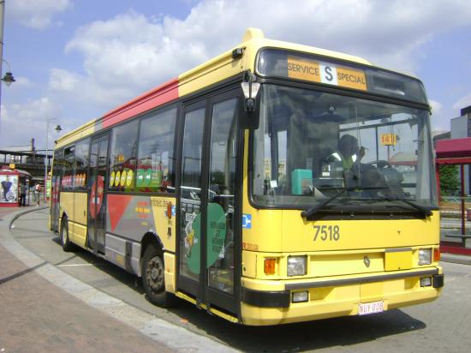
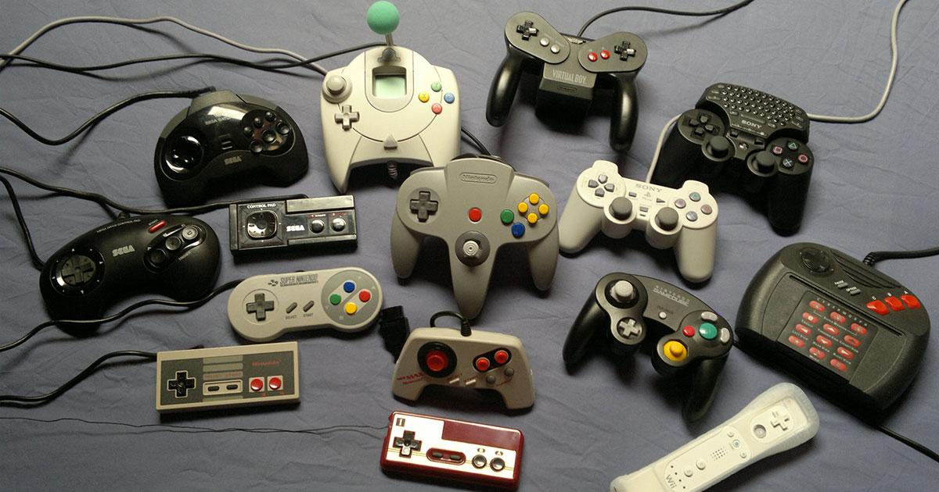
How is energy being used?
Lighting
Entertainment
Heating
Industry
Transportation
Notes:
Explanation:
Here are a few examples of how we use energy in our daily lives:
Animation: Compare these examples with the answers the students gave earlier!
Lighting
Entertainment (leisure, streaming…)
To heat and use air conditioning
To produce materials and manufactured products: clothing, smartphones, but also the steel used in construction...
To move humans or goods by land, sea or air
To feed ourselves
As soon as something changes, energy is involved!

Slide 7
What energy sources do we use?
Find examples!
Notes:
Explanation:
Ask students some questions about energy sources.
(Normally this was seen in the presentation on Energy Issues, so this is a reminder and a link to what they've already seen!)
We'll see those in the next slide!

Slide 8
Different energy sources
Renewables
Fissile
Fossils
Hydraulics
Solar and wind
Biomass
Uranium
Gas
Coal
Oil
Low CO₂ emissions
Easy to store and transport
Easy to store
Unlimited
Renewable
Highly concentrated energy
Highly concentrated energies
Limited spaces
Variable output
Competition for land use
Nuclear waste
High CO₂ emissions
Notes:
Explanations:
What are the advantages of renewable resources?
They are virtually inexhaustible on a human scale, because they come from physical phenomena that occur regularly without human intervention.
In this respect, biomass requires special attention, because its renewable nature depends on the management of the environment from which it is extracted. Cutting down an entire forest to burn wood is totally incompatible with sustainable forest management.
They generate little pollution, either directly (when they are used) or indirectly (mainly when the infrastructure is built). In particular, renewable resources emit very few greenhouse gases, which is why they are being given particular attention in the energy transition.
What are the disadvantages of renewable resources?
They are not very concentrated, because they are more diffuse. This has two consequences:
For the same volume of material, renewable resources tend to provide less energy than non-renewable resources.
For the same amount of energy, the infrastructure of renewable resources requires much more space than that of non-renewable resources (see the slide Ten cyclists for 1 hour is equivalent to...). For example, building a dam requires nothing less than flooding an entire valley! This can lead to conflicts of use, or damage to ecosystems: for example, should land be given over to agriculture or a photovoltaic solar power plant built instead? It should also be noted that some renewable resources may meet with a degree of local hostility that can hinder their development.
They are variable, meaning that they are not permanently available and that their availability varies greatly. For example, a solar panel only works on sunny days and not at night, while a wind turbine only works when the wind is not too strong.
Why is this a problem? Most of these renewable resources are used to produce electricity. However, as large-scale electricity storage is proving to be complex, the output of power stations must meet electricity demand at all times: this is known as controllability. In short, renewable resources are not very controllable, which poses a serious constraint if we want to have a 100% renewable energy mix.
What are the advantages of fossil fuels?
They are highly concentrated and therefore provide much more energy than renewable resources. This concentration is the result of a long process of accumulation of carbonaceous matter.
They can be transported and stored. It is much simpler to transport solid, liquid or gaseous matter than it is to transport a physico-chemical process! Non-renewable resources are therefore "more practical" to use, which is why we use them so much:
Oil is the easiest to transport because of its liquid nature, which is the main reason why it is used as a fuel.
Gas can easily be transported in cylinders, but must be compressed to make it easier to transport. On the other hand, it presents risks of leakage and explosion.
They are controllable: if necessary, it is not very difficult to run a gas, coal or oil-fired power station to meet an increased demand for electricity.
What are the disadvantages of fossil fuels ?
They are not renewable on a human scale: quantities of natural gas, coal and oil are limited on a human scale.
They generate a lot of pollution, of different kinds depending on the resource:
When they are burned, fossil fuels release toxic waste into the air, soil and even water. In particular, their combustion emits carbon dioxide (CO2), which has a significant impact on the climate (see following sections).
What are the advantages of nuclear energy?
It is highly concentrated and therefore supplies much more energy than renewable resources.
It can be controlled.
It has low greenhouse gas emissions.
What are the disadvantages of nuclear energy?
Nuclear power plants produce irradiating waste that is impossible to dispose of in a human lifetime, and must be stored in secure locations that are difficult to access. They can also be the site of accidents with harmful consequences. Nuclear power plants, on the other hand, do not generate greenhouse gas emissions, and are also the focus of particular attention in the energy transition.
What can we learn from all this? No energy source is perfect, ideal or clean; they all have their qualities and shortcomings. There is no such thing as a miracle energy source, so the first thing to do is to reduce our energy consumption. In what follows, we will see that there is an urgent need to move away from fossil fuels.
Finally, this slide may give the impression that all these energy resources are used for the same thing, which is obviously not true: energy sources are not entirely substitutable for each other. This point is dealt with in a little more detail in the slide What are we using energy for?.
Key messages:
No energy resource is perfect.
Fossil energy sources (oil, gas and coal) are much more concentrated, versatile and simple to exploit than all the others, but they are also the most polluting.

Slide 9
Machines transform the world
Transportation
Industrial revolutions
Agriculture
Industrialized societies rely on fossil fuels for energy
Notes:
Explanations:
In industrialized societies, human activities are carried out by many different, sophisticated machines. The role of a machine is to transform a system: some are used to move people or goods, while others are used to heat or cool a building... Since a machine transforms the world, it must necessarily supply energy, according to what we saw on the slide What is energy?
What makes machines so useful is the power they develop, i.e. the amount of energy per second they are capable of delivering: the power of a well-designed machine is far greater than that of humans or even animals.
However, to develop such power, these machines need a lot of energy (we can't "produce" or "consume" energy, we can only convert one form of energy into another), which must be drawn from primary energies.
Over the course of history, mankind has come to realize that fossil fuels are highly versatile sources of energy. As soon as we were able to exploit fossil resources industrially, we didn't hesitate to build machines and processes that ran thanks to them.
Historians have called Industrial Revolutions the periods of disruption that saw the emergence of the industrial exploitation of fossil fuels:
The 1st Industrial Revolution is associated with the industrial exploitation of coal.
The 2nd Industrial Revolution is associated with the industrial exploitation of oil.
The Industrial Revolutions had profound repercussions on the societies that benefited from them (emergence of new classes, transfer from an economy based on agriculture to one based on industry...), and favored the emergence of globalization.
Let's take 2 examples that are unfortunately very caricatural, but which illustrate the real paradigm shift:
Transport: today's machines (cars, trains, planes, boats, etc.) enable us to travel faster, further and with far less effort than ever before.
Agriculture: tractors and the massive use of nitrogen fertilizers make it possible to cultivate large plots of land and work on short timescales.
But the massive use of these machines comes at a price: many of them run exclusively on fossil fuels, with oil being the most common. This is just one aspect of our heavy dependence on fossil fuels.
Key message: In industrialized societies, human activities are based on the use of energy-intensive machines, the vast majority of which require fossil fuels to operate.

Slide 10
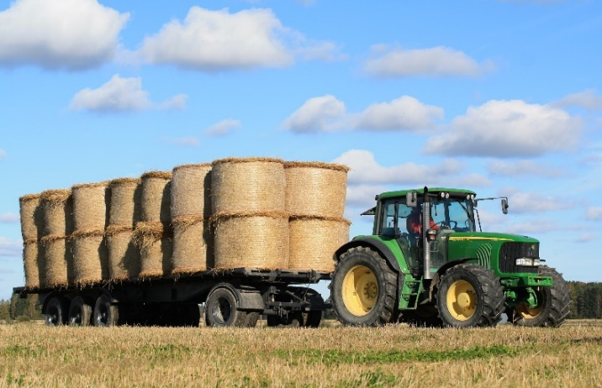
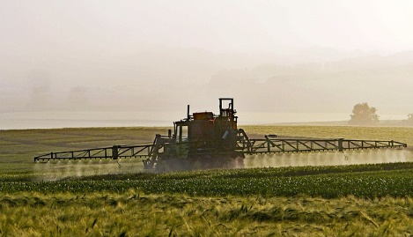
Energy sources are also material resources
🡺 Petroleum is used as a component for...
Synthetic textiles
Plastics
Cosmetics and pharmaceuticals
Fertilizers
Agriculture
Notes:
Explanations:
We don't just use oil as an energy source, it's also a material, involved in the majority of what we consume today:
The plastic we find everywhere: shoes and synthetic textiles, food packaging, toys, and so on.
It is also used in cosmetics and medicines.
Oil is used extensively in agriculture and some fertilizers.

Slide 11
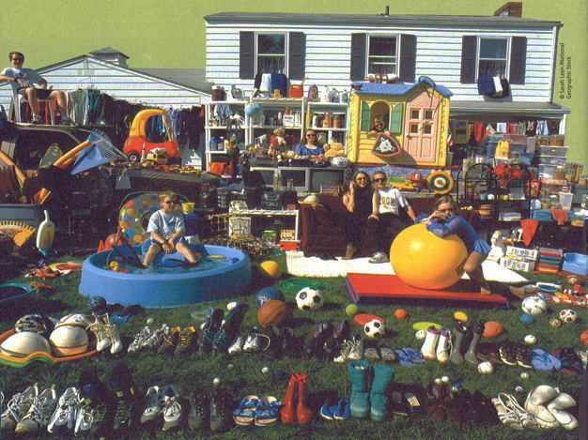
Oil is EVERYWHERE!
Notes:
Explanations:
This American family has put all the objects usually stored indoors and made of plastic in front of their house. It's a striking illustration of the importance this material now plays in the manufacture of our "everyday objects".
Photo source : Peter Menzel, Material World A Global Family Portrait, 1994

Slide 12
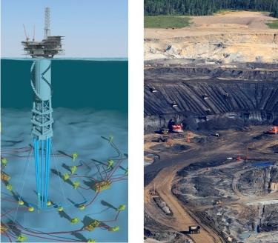
We also use energy... to extract energy!
1900
Today
With 1
we used to get 100
With 1
we get 3
We use oil that is increasingly difficult to extract
Notes:
Explanations:
The process through which fossil fuels are formed is extremely long: they are carbon-rich materials derived from the slow degradation of organic matter in the soil (hence the term "fossil"!), via geological processes that can last hundreds of millions of years.
For example, oil is the result of a deposit of living organisms on the ocean floor dating back over 200 million years. Under pressure, heat and lack of oxygen, chemical and biological reactions transform the accumulation of organic matter into oil. The migration of oil to the upper geological layers in the form of a deposit facilitates oil extraction, but it has become less and less accessible over time.
And the increasingly complicated search for oil is driving up the cost of energy!
Key messages :
The more oil we produce, the more expensive it becomes to extract (both in terms of money and energy):
In 1900, it took 1 barrel to extract 100.
Today, new non-conventional techniques consume 1 barrel to produce 3.
2. Extracting fossil fuels requires more and more energy as the resources get depleted: it's a vicious circle that is hard to escape.

Slide 13
The evolution of our lifestyles
Part 2

Slide 14
Quiz!
How much of the total energy consumed by mankind comes from fossil fuel?
A : Around 20 %
B : Around 40 %
C : Around 60 %
D : Around 80 %

Slide 15
Quiz!
How much of the total energy consumed by mankind comes from fossil fuel?
A : Around 20 %
B : Around 40 %
C : Around 60 %
D : Around 80 %

Slide 16
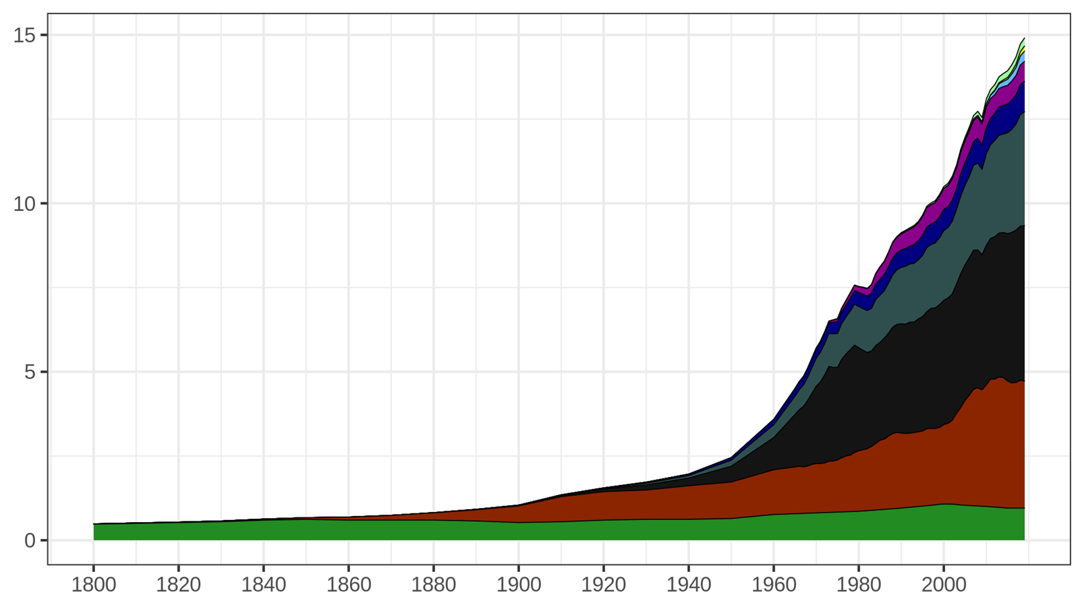
Global energy consumption
Your birth
6 %
4 %
2 %
1 %
Source : https://ourworldindata.org/global-energy-200-years
Billions of tonnes of oil equivalent (Gtoe)
Birth of your parents
79% of energy consumption comes from fossil fuels
Birth of your grandparents
≈ 1/4 (23 %)
≈ 1/3 (31 %)
≈ 1/4 (25 %)
6 %
Années
World primary energy consumption over time
Notes:
Activity : Before you start, ask the audience: "Can you remind me of the 3 fossil fuels? "Oil, coal and gas". Then "Of all the energy resources used by mankind, if you really count them all, such as firewood, burning waste to produce energy, solar panels, wind turbines, hydroelectric dams, nuclear power, geothermal energy, etc., what percentage comes from the 3 fossil fuels? Everyone raises their hand. Those who think that fossil fuels provide 100% of humanity's energy, put your hand down. If you think that fossil fuels provide more than 80% of humanity's energy, put your hand down. Over 70%, put your hand down. Over 60%, put your hand down. 50%, put your hand down. 20%, put your hand down". Explanation:
This graph shows global primary energy consumption over time.
The horizontal axis represents the different years.
The vertical axis represents primary energy consumption for the year in question. The unit used is the Gtoe (Giga tonne of oil equivalent), which measures the energy released by the equivalent of burning one billion tonnes of "standard" oil. This is another unit of energy, much more practical on this scale than the kilowatt-hour (kWh).
We are talking here about primary energy, which corresponds to what is found directly in nature. Electricity and petrol (which are forms of energy used by consumers) are not represented on this graph because there are no deposits of electricity or petrol in nature. Uranium, wind, oil, etc. are included. Since oil is the planet's main energy resource, all other forms of energy are related to it (for example, burning one tonne of coal is equivalent to burning around 0.66 tonnes of oil). Consumption is therefore expressed in tonnes of oil equivalent (toe), in this case in billions of toe. In contrast to primary energy, final energy is the energy that is used by the consumer, after the losses associated with transporting the energy to the user.
Global consumption in 2019 was around 14.9 Gtoe.
Oil alone accounts for 1/3 of global energy consumption. It is mainly used for transport.
Coal accounts for 1/4 of consumption. It is mainly used to produce electricity.
Gas accounts for 1/4 of global consumption. It is mainly used for heating and is also used to produce electricity.
Fossil fuels such as oil, gas and coal alone account for almost 80% of the energy consumed by the whole of humanity.
Wood, which has been used for a very long time, accounts for 6.4% of the world's energy consumption. It is burnt for heating.
Nuclear energy, which accounts for 4% of global energy consumption, is used to produce electricity.
Renewable energies (geothermal, solar, wind, hydro) are in full development, but account for only 10.4% of the energy consumed worldwide.
For comparison: in United Kingdom (in 2022), oil represents 36,4% of the final energy consumed, gas 35,4%, renewable energy 18,3%, nuclear 5,8% and coal 2,8%.. Source : infographie https://ourworldindata.org/grapher/energy-consumption-by-source-and-country?tab=chart&country=~GBR
Since the industrial revolution (around 1860), the population has increased 7-fold, while energy consumption has increased more than fifteen-fold. Each human being therefore consumes more than twice as much energy on average. What's more, each "new" source of energy adds to the previous ones, without replacing them. For example, oil has never replaced coal, nuclear energy and renewable energies have never replaced fossil fuels, and so on.
Key messages:
The world relies on fossil fuels
Every energy resource is consumed more and more.
For the moment, no energy has replaced another.
Remarks:
This is the first graph in the presentation. It is very important to explain the axes and definitions each time, so that everyone understands you.
Clarification for the curious
NB: 1 tpe = 11,630 kWh
Source : Vaclav Smil (2017) & BP Statistical Review of World Energy
https://ourworldindata.org/global-energy-200-years

Slide 17
Our energy needs
Our energy consumption is increasing due to :
World population growth
Rising living standards in most countries
Our increasingly resource-hungry lifestyles
But...
Energy consumption is highly uneven on a global scale, and depends on wealth levels. Not all countries have the same access to energy, and countries with developed economies consume more than developing countries.

Slide 18
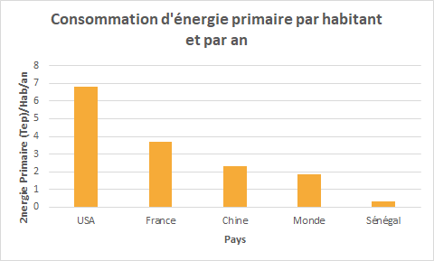
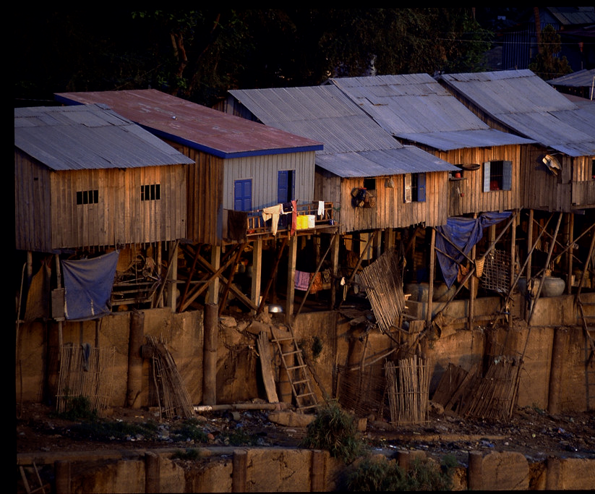
Energy inequalities around the world
Many countries aspire to consume more energy!
Perhaps there's a balance to be found between living comfort, safety for all and energy waste!
Primary energy consumption
per capita per year
x3,6
x2
Primary energy (Toe/cap/year)
x1,2
÷6,3
USA France China World Senegal
6,9 Toe
3,8 Toe
Pays
2,2 Toe
1,9 Toe
0,3 Toe
Source: IEA 2020
Notes:
Explanations:
— Explain the graph —
We've seen that we consume a lot of energy. Is this the case in all countries? Well, not really. Outside the developed world, few countries consume as much energy as we do.
Take a developing country like Senegal. It consumes 0.3 tonnes of oil equivalent per capita.
Worldwide, the average per capita energy consumption is 1.9 tonnes of oil equivalent, i.e. already 6 times higher!
This is due to consumption in developed countries, which pushes up the average. For example, the UK consumed 2.7 tonnes of oil equivalent per capita (In 2014), 9 times more than Senegal and 1.5 times more than the world average...
In the USA, it's 6.9 tonnes of oil equivalent, or 23 times more than in Senegal (and 3.6 times more than the world average)!
So it's only natural that developing countries should aspire to consume more energy in order to build their infrastructures (already built in developed countries...) and have access to at least basic needs. Access to energy is a human right!
However, there is surely a balance to be struck between this precarious situation and the energy wastage seen in developed countries.
Key messages:
Outside the developed world, few countries consume as much energy as we do.
For developing countries, it's normal to aspire to consume more energy. Access to basic energy is a human right!
There is a balance to be struck between this precarious situation and the energy wastage seen in developed countries. One of the challenges for the future is to help developing countries gain access to the basic services they need, without replicating our energy-intensive development models.
Source : IEA, International Energy Agency, https://www.connaissancedesenergies.org/laie-publie-ledition-2020-de-ses-key-world-energy-statistics-200828

Slide 19
Economic activity, development and energy consumption
Our economy is based on energy consumption. We transform resources into products and services.
Developing countries are consuming more and more energy to produce the services they need for their development.
Developed economies produce more and more goods and services that consume even more energy when used.
Energy consumption
Economy
Notes:
Explanations:
There's a close link between our economy (especially the production of commercial goods) and our energy consumption, for the simple reason that we need energy to do everything, including produce goods. While mankind once thought it possible to overcome this problem by using less energy to produce the same quantity of goods (known as "decoupling"), the current reality is that we are using more and more energy to do more and more things.
So the question is not just: "How can we have clean energy? but also: "How can we consume less energy?

Slide 20
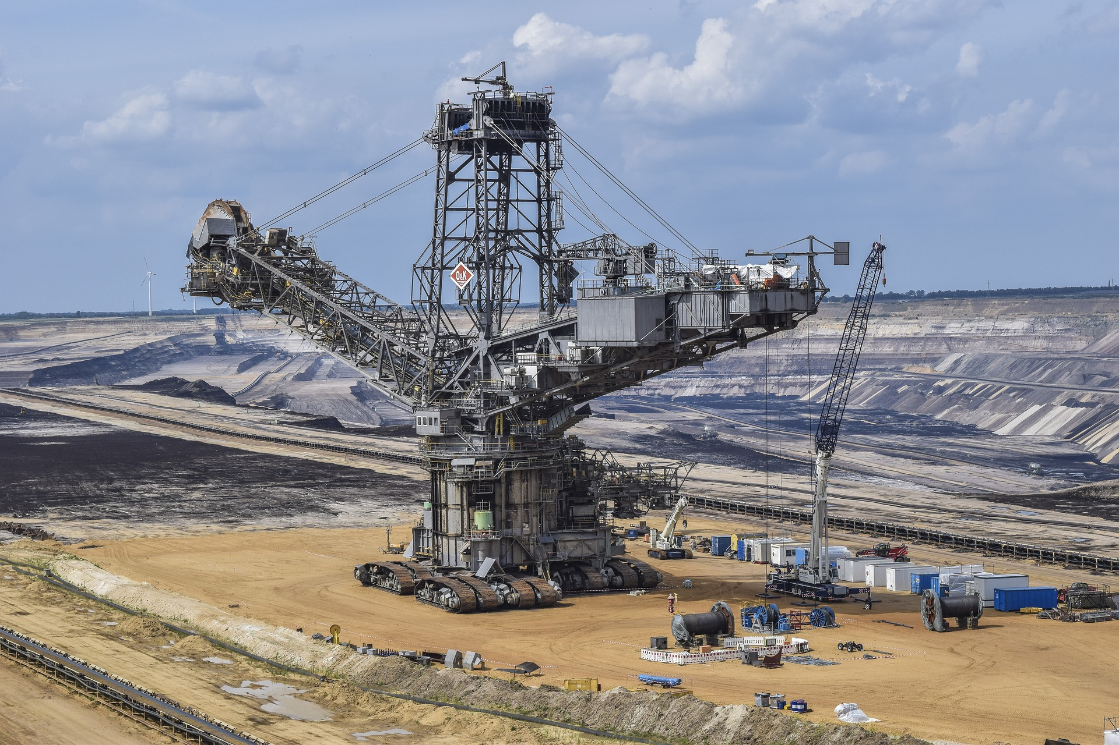
Comfort has a cost!
Increased standard of living
Increasing our infrastructure and assets
Increased resource requirements
2100
World population =
11 billion people (UN)
2020
World population =
7.7 billion people (UN)
What are the impacts?
Notes:
Explanations:
Using more energy brings us greater short-term comfort, but the increase in our quality of life also leads to an increase in our desires, creating a vicious circle of resource consumption. This vicious circle is reinforced by a continuous increase in our quality of life, which contributes to an increase in infrastructure development and consumption of goods.
This has a direct impact on the growing need for resources, reinforced by the continuing growth of the world's population which, according to United Nations figures, will rise from 7.7 billion in 2020 to 11 billion in 2100.
Animation: to make the presentation more dynamic, you can give the floor to students to explain the impact on the environment. These will be discussed in greater detail in Module 3: Climate.

Slide 21
Impact on the environment
Part 3

Slide 22
From energy to greenhouse gases
Combustion
+
+
Energy
Greenhouse gases
Fossil fuels
Burning fossil fuels emits greenhouse gases
Notes:
Explanations:
We have seen that we are consuming more and more energy, that our lifestyles are based on fossil resources (coal, oil, gas) and that, to exploit them, we need to burn them.
But this combustion has a major impact: it emits greenhouse gases, primarily carbon dioxide (CO₂), which are the main cause of climate change, as we will see in the 3rd module on climate.
Note: The small CO₂ cloud icons next to the fossil fuel icons give an indication (not to scale) of the greenhouse gas emissions they generate, for the same amount of energy produced. Coal emits more than oil, which emits more than fossil gas.
Key message:
Burning fossil fuels emits greenhouse gases, which have a major impact on the climate, as we'll see in Module 3.

Slide 23
Emissions vary depending on how electricity is generated
Uranium
Hydro
Wind
Wood
Solar
Gas
Oil
Coal
Renewable energies
Fossil fuels
6 g/kWh
6 g/kWh
14 g/kWh
32 g/kWh
43 g/kWh
418 g/kWh
730 g/kWh
1060 g/kWh
Notes:
Explanations:
On this slide, we can see the greenhouse gas emission factors for different energy sources used to generate electricity. These values would be different if we were looking to produce heat or motion rather than electricity. We can see that fossil fuels emit a lot of CO₂ during combustion.
For the first five energy sources (nuclear and renewable energies), the construction of the infrastructure emits greenhouse gases, but very few are emitted during its operation.
Note: Nuclear power emits very few greenhouse gases, as uranium is not a fossil resource (see Module 1 - Energy issues).
Key message: Fossil fuels emit more greenhouse gases.
Source : Base Empreinte de l'ADEME (Agence de la Transition écologique), 2023

Slide 24
The train example
One train can hide another!
Emissions depend on the primary energy transformed and on technological processes. The train is a good example!
4000 km = 9 kgCO2
4000 km = 112 kgCO2
In France,
electricity is mainly generated by nuclear power, which emits very little CO₂
In Germany,
electricity is mainly generated by coal coal, which emits high levels of CO₂
Notes:
Explanations:
Key message:
The primary energy sources used to generate electricity vary from country to country, resulting in very different CO2 emissions!
Source : IEA-UIC Energy and CO2 Railway Handbook 2017

Slide 25
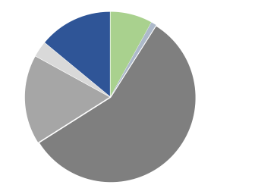
CO2 is not the only greenhouse gas
There are several greenhouse gases and a multitude of emission sources
Blurp!
Nitrous oxide (N₂O)
Methane (CH₄)
Nitrogen fertilizers, chemical industry
Rumbling cattle
Industry
Combustion
of fossil fuels
Deforestation
Carbon dioxyde (CO₂)
We need a common unit of measurement to start counting emissions: CO₂eq.
more than 75%
of annual greenhouse gas emissions
Source : IPCC AR4
Notes:
Explanations:
What are these famous greenhouse gases (GHGs) emitted by human activities? The first thing to know is that they are chemical molecules. We often only talk about CO2, but there are actually many more than that, and we're going to present them to you in this pie chart.
This diagram shows the breakdown of the additional greenhouse effect due to the greenhouse gases emitted by man every year on a global scale. The various gases are not compared in terms of emission volumes, but in terms of their impact on global warming, including both emission volume and global warming potential (GWP).
Let's move on to the various greenhouse gases:
Carbon dioxide (CO₂) alone accounts for 3/4 of annual greenhouse gas emissions from human activities. Emissions of this molecule come mainly from the combustion of fossil fuels (oil, coal and gas), but also from deforestation (as wood burning also releases CO2), and from industrial processes such as steelworks and cement works.
Methane (CH₄) is a molecule produced by the decomposition of organic matter in a low-oxygen environment. Through fermentation in their stomachs, cattle emit methane as they ruminate: for this reason, eating red meat emits a lot of greenhouse gases. Methane is also generated in rice paddies, landfill sites, slash-and-burn sites...
Nitrous oxide (N₂O), also known as laughing gas, comes mainly from the nitrogen fertilizers used in agriculture and certain chemical industry emissions.
Key message:
We talk a lot about CO₂, because it is the greenhouse gas most emitted by human activities.
There are other greenhouse gases. Although they are emitted in much smaller quantities, their impact on the climate is far greater in proportion.
There are many different sources of GHG emissions, just as there are different GHGs, just as there are different currencies in the world. That's why we need a reference, a "dollar", but for GHGs, it is the equivalent CO₂ (CO₂ eq).
We'll take a closer look at GHG emissions in Module 3, "Climate".

Slide 26
Environmental impacts other than pollution
Human activity leads to energy consumption, the main source of greenhouse gas emissions. It is also responsible for emissions of other pollutants.
The human use of certain raw materials has depleted these resources and led to the destruction of natural habitats through mining, deforestation and so on.
The disruption of ecosystems and natural cycles has long-term effects on the environment, such as the alteration of the water cycle, desertification, loss of biodiversity, ocean acidification, and so on.
Humanity continues to depend on its environment for survival.
🡺 Human activity is the cause of climate change.

Slide 27
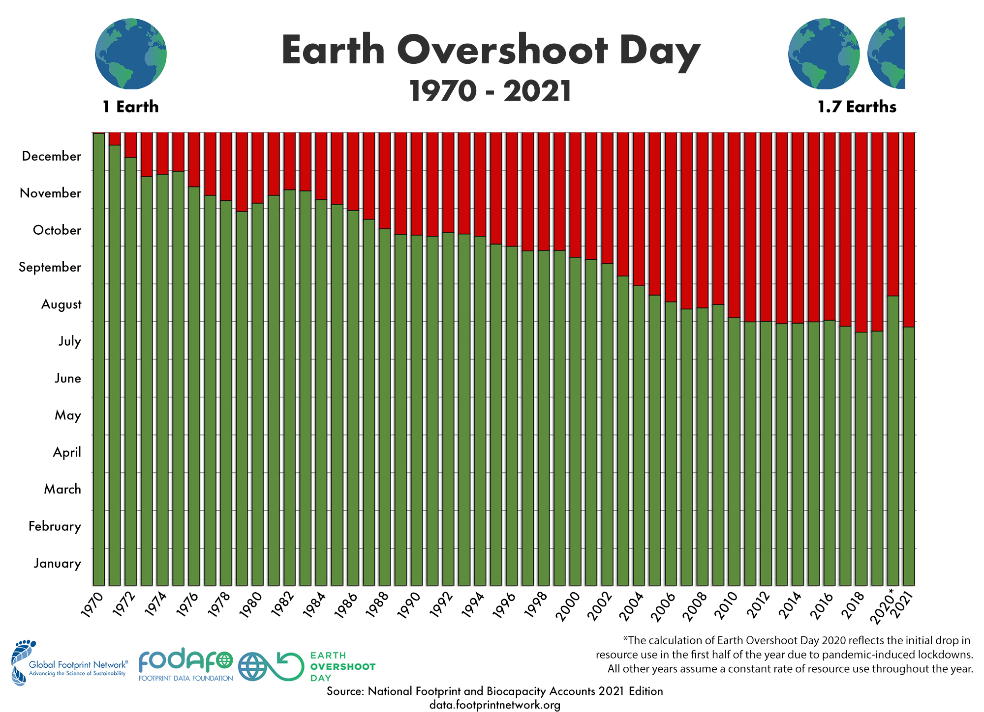
Global resource consumption
Earth Overshoot Day
FR
EN
ES
IT
Notes:
Explanations:
Earth Overshoot Day marks the date when humanity's demand for ecological resources and services in a given year exceeds what the Earth can regenerate in that same year.
In 2021, this fell on July 29, meaning that we are consuming far more than the Earth can regenerate, mainly by using fossil fuels and degrading soils for intensive agriculture.

Slide 28
Global resource consumption
Why was the Earth Overshoot Day date as late as August in 2020?
Notes:
Explanations:
The Covid-19 pandemic caused a worldwide slowdown in international transport and goods production. For several weeks/months, many non-essential human activities came to a standstill. Since our activities are linked to the extraction of material resources and the use of energy, this interruption had a positive impact on several ecosystems, on air pollution and on our global consumption of resources, as can be seen in this graph.
Other beneficial effects on biodiversity and the reduction of our GHG emissions have been demonstrated during this period.

Slide 29
Global resource consumption
How many planets like Earth would we need if everyone lived like the population of...
France
Italy
Portugal
Spain
China
Brazil
India
United States
Australia
Russia
Germany
Switzerland
Japan
United Kingdom
World

Slide 30
And on an individual level?

Slide 31
Annual individual carbon footprint
The main emission categories
Food
2 457 kgCO2e
Transport
1 838 kg CO2e
18
Services
1 783 kg CO2e
Consumer goods
2 393 kg CO2e
Energy consumed at home
1 556 kg CO2e
Source : Faire sa part, Carbone 4, june 2019
Notes:
Explanations:
In Europe, the average person emits 8.4 tonnes of CO₂eq per year, but there are huge differences between European populations. While averages are important, we must not forget that there are also big differences between individuals, with the biggest emitters in some countries emitting 20 times more GHGs than the smallest. Food plays a major role in our GHG emissions, mainly due to the consumption of meat and animal products (milk, cheese, eggs, etc.).
It is generally followed by our consumption of clothing and electronic goods.
Then by our transportation, due to air and car travel. Services include the public and private services we all enjoy: road maintenance, schools, hospitals, and so on.
Finally, the energy consumed in our homes is also a major contributor to our emissions, especially if we heat with oil or gas.

Slide 32
To put it in a nutshell
Fossil fuels have considerably changed our way of life.
Almost 80% of the energy consumed worldwide comes from fossil fuels (oil, coal, gas).
Some countries waste energy for greater comfort, while many others aspire to consume more energy!
Burning fossil fuels produces energy and greenhouse gas emissions.
Notes:
Explanations:
Here's the summary of this second part. If necessary / possible, you can ask your students for questions / answers.

Slide 33
Image credits
Eucalyp via Flaticon
Freepik via Flaticon
Jacques Boyer / Roger-Viollet
Mano
Smashicons via Flaticon
ShareThis_OrDie
EpicCoders

