Slide 1
Phase 2 : Understanding climate change
Module 3. CLIMATE

Slide 2
Welcome to Clicks On educational content!
Choose your path!
You can tailor your presentation to suit the content of your class, the time you have available and the topics you want to explore! To make things easier for you, we've created two easy-to-identify slide types : the light and the complete initiative :
Light initiative
Complete initiative
→ the red wire and fundamental concepts of the module
→ slides and activities to deepen your knowledge!
Don't forget the comments below the slides
Each slide is accompanied by notes to guide you through your presentation.
Complete your session with suggested activities from the module
You'll find suggested activities for each phase on our website!
Enjoy your session!

Slide 3
Climat
How does the climate system work ?
The consequences of climate change
Notes:
Explanation:
Let's move on to the next subject: the climate!
First we'll look at how the climate system works, before trying to understand why climate change is an unprecedented challenge.

Slide 4
How does the climate system work ?
Part 1

Slide 5
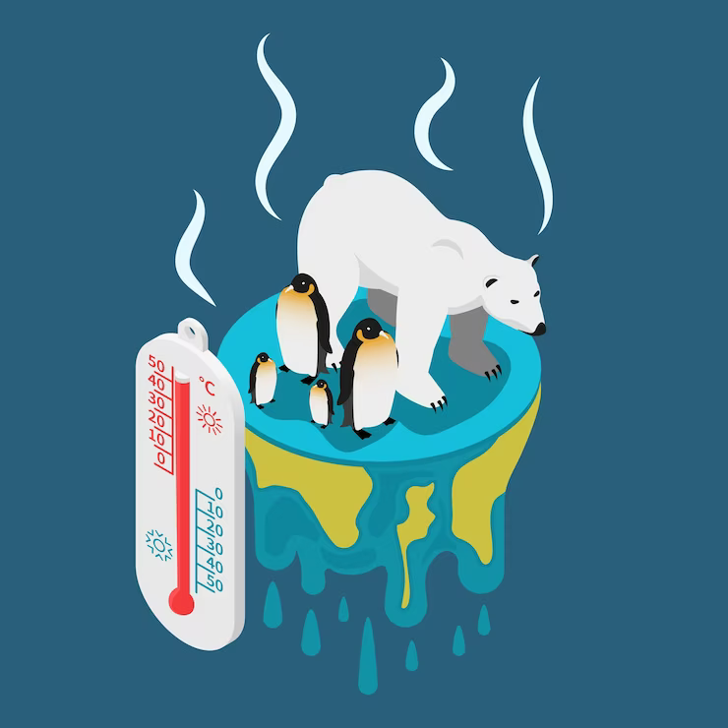
What is the difference between climate and weather?
Notes:
Activity: question put to students They can make suggestions and the answers can be noted on the board.

Slide 6
Weather and Climate, what differences ?
WEATHER
CLIMATE
FEBRUARY 9
Weather: daily changes in meteorological conditions (sunshine, rain, etc.) in a given place.
Climate: average meteorological conditions observed in a given zone over 30 to 40 years.
Notes:
Explanation
The aim of this slide is to explain the difference between climate and weather.
Define the two terms
Weather is the local evolution of the atmosphere over a few days (give the local example of when it rains/is sunny).
Climate, on the other hand, refers to a period of several decades (e.g. from 1990 to 2020) over which we observe the average weather conditions of the climate system (average temperatures and precipitation, but also atmospheric composition, volcanic and solar activity, etc.). When we study climate, we do so over large geographical regions, such as countries or continents, and over long periods of time.
To clarify
The weather is what it's like "now", or tomorrow at my house or my grandparents'. This translates into local and instantaneous values for temperature, precipitation, atmospheric pressure, cloud cover, etc. To make a weather forecast, all you need to do is observe what's going on in the atmosphere.
Climatology studies large geographical regions (countries, continents, the whole Earth) over long periods (one or more decades). For example, when climatologists say that the Earth's temperature has risen by 1°C since the Industrial Revolution, this is an average of temperatures observed over the entire surface of the Earth over at least 30 years.
Let's make an analogy with a middle-school class: the weather corresponds to a student's grade on an assignment, while the climate corresponds to the class's annual average in all subjects.
Parameters that may be considered constant in weather forecasting, such as the Earth's position and orientation in relation to the sun, or the composition of the atmosphere, can no longer be considered constant in the study of climate.
To predict climate change, it's not enough to observe what's happening in the atmosphere. We must also take into account the sun's activity, the oceans, glaciers, volcanoes, continental drift, vegetation and humans. The latter have recently become a new agent of climate disruption, rapidly changing the chemical composition of the atmosphere.
Schematically speaking, the climate system is the Earth-atmosphere system. It evolves over time under the influence of internal processes and external constraints. These constraints may be natural or man-made. Climate models aim to simulate how the system works.
The distinction between the concepts of weather and climate is essential. The two are often confused.
We can talk about global warming even if it snows on March 18! The fact that it's cold in March or hot in November neither invalidates nor confirms the existence of global warming. In both cases, we're talking about one-off, local phenomena that don't allow us to draw any conclusions from a global perspective.
Key messages
1. Weather and climate are not concerned with the same spatio-temporal scales.
2. Weather is the local evolution of the atmosphere over a few days.
3. The study of climate concerns evolution over large geographical areas (country, continent, terrestrial system) and long periods.

Slide 7
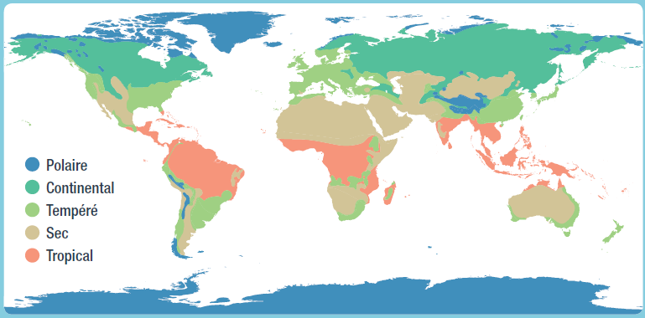
The Köppen classification – 5 main climate types
Main geographical factors that influence climate :
Distance from the equator
Topography
Altitude
Proximity to a body of water
Location within the continent (east, west, etc.)
Polar
Continental
Temperate
Dry
Tropical
Polaire
Continental
Tempéré
Sec
Tropical
Source : OCE, Ocean and Cryosphere
Notes:
The Köppen classification is the most common climatic classification. It is used in a large number of climate studies and publications.
Tropical climate
Average temperature for each month of the year > 18°C
No winter season
High annual precipitation (greater than annual evaporation)
Arid climate
Annual evaporation greater than annual precipitation
No permanent rivers
Temperate climate
Average temperature of coldest month between -3°C and 18°C
Average temperature of warmest month > 10 °C
Well-defined summer and winter seasons
Continental climate
Average temperature of coldest month < -3 °C
Average temperature of warmest month > 10 °C
Well-defined summer and winter seasons
Polar climate
Average temperature of warmest month < 10 °C
The summer season is not very marked
There are, of course, many sub-categories within this classification, and there may be several different types of climate in one country.

Slide 8
Focus: Urban microclimate, a new type of climate created by humans
First, a few observations
Over half of the world’s population lives in cities.
Many activities are concentrated in cities: housing, transport infrastructure, industry, etc.
The morphology of cities, in particular their systematic concrete development, affects local atmospheric conditions: wind circulation, humidity, fog, cloud cover, etc. This phenomenon is known as urban microclimate.
The main phenomenon: heat islands
Heat islands are a defining feature of urban microclimates. A heat island is characterized by locally higher daytime and night-time temperatures compared with neighboring rural or forested areas, or compared with regional average temperatures.
→ We need to ensure that cities are better designed to adapt to global warming.
Notes:
Explanation: While the different types of climate seen above are due to natural conditions (solar and volcanic activity, the Earth's rotation, the water cycle, etc.), human activities have also created a new type of climate over the last 40 years around major cities: the urban microclimate.
To see an example of a heat island, show your students the following slide.

Slide 9
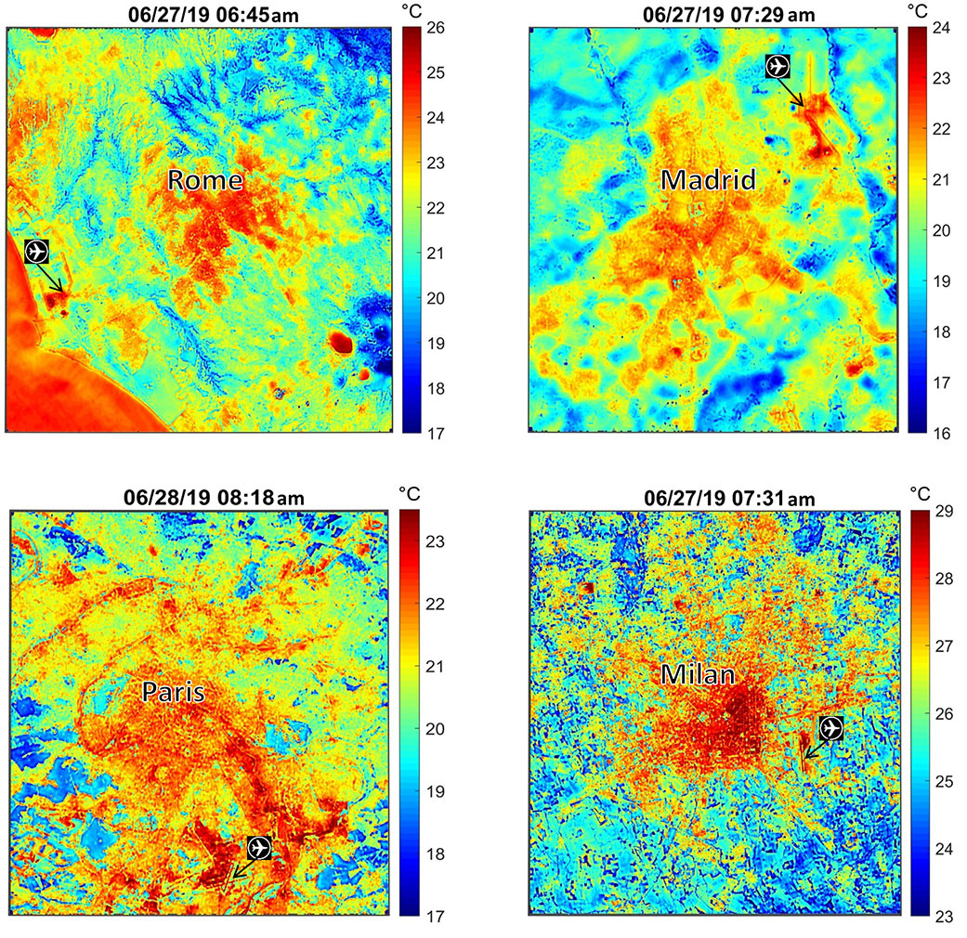
Climate stakes in cities: urban climates
Source : NASA’s Ecostress maps European heat wave from space
Notes:
Explanation: In this example we are showing maps of european cities : Rome (Italy), Madrid (Spain), Paris (France) and Milan (Italy) but feel free to adapt it to your own city.
Here you can see the night-time temperature during the 2003 heatwave in Paris. This image shows the actual weather/temperature for that night, but as this heat island phenomenon extends over time, it creates a specific climate pattern.
The global average temperature is rising, and this image helps us understand why temperatures will rise faster in urban areas.

Slide 10
The climate system
Continental land masses
Hydrosphere
Atmosphere
Biosphere
Cryosphere
Notes:
Explanation:
To study climate change, we need to define the climate system. It is a complex set of five main components:
- continental land masses
- atmosphere
- the hydrosphere (oceans, lakes, rivers, groundwater, etc.)
- the cryosphere (i.e. land and sea ice, snow cover)
- the biosphere (all living organisms in the air, on land and in the oceans).
These 5 components are linked to each other by a complex system of gears that would be difficult to describe here. What's important to remember is that any change in one of these components can have repercussions on all the others!
Key messages :
1. The climate system is a set of interconnected gears that depend on the evolution of the others.
2. Without human intervention, this system is stable or evolves very slowly..
Source : https://energyeducation.ca/encyclopedia/Climate_system

Slide 11
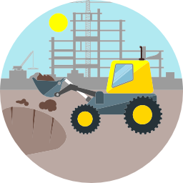
The climate system
Continental land masses
Hydrosphere
Atmosphere
Biosphere
Human activities and their GHG emissions
Cryosphere
Notes:
Explanation:
Conversely, in recent times, human activities have had a strong influence on these gears and have completely deregulated the climate system. This is what we call climate change. Our activities emit greenhouse gases, and this is one of the factors influencing climate change. In the following slide, we'll see how the climate system is affected.

Slide 12
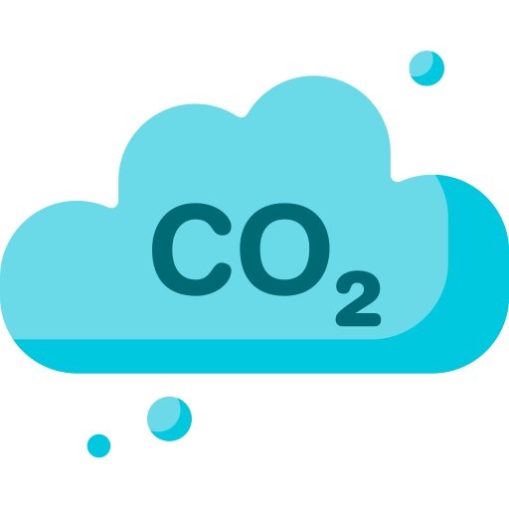
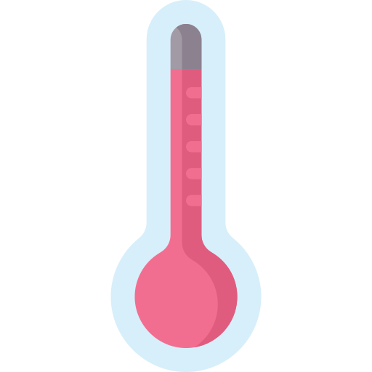
The natural greenhouse effect - How does it work?
Greenhouse gases within the atmosphere
Part of the radiation from Earth is trapped by greenhouse gases and comes back, heating up the Earth again.
Part of solar radiation crosses the atmosphere
The Earth heats up and emits radiation in return
Source : The Big Conf by Avenir Climatique, icons : Freepik
Notes:
Explanation:
Another concept to understand before going any further is the greenhouse effect. The greenhouse effect is a physical phenomenon that acts as a blanket for the Earth, allowing it to retain the heat provided by the Sun's rays. It's important to understand that this is a natural phenomenon, essential to maintaining the conditions that sustain life on Earth.
If you want to use the blanket metaphor, you could say that :
Without a blanket, we're cold, so it's important to have one (the Earth becomes livable, because without the greenhouse effect the temperature would be -18°C at most).
With a blanket, we feel good
When we sleep with five or six blankets, we're too hot (Greenhouse gases accumulate in the atmosphere like layers of blankets).
To go further :
To understand this, we need to remember that the wavelength range of a radiation depends on the temperature of the emitting body.
The sun, whose temperature is very high (around 5800°C), emits visible radiation that we can all observe. This radiation passes through the atmosphere and is captured by the Earth. The Earth, with an average temperature of 15°C, emits long-wave radiation known as infrared.
Certain gases in the atmosphere (such as carbon dioxide - CO2, water vapor - H2O, methane - CH4...) are more transparent to the sun's rays than the Earth's infrared radiation. They thus produce a greenhouse effect: the infrared radiation emitted by the Earth is absorbed by greenhouse gases, and is re-emitted, in part towards the Earth, causing warming.
Key messages :
The greenhouse effect is natural.
The atmosphere spreads some of the sun's radiation in all directions, but much of it is transmitted to the Earth.
The Earth warms up and in turn emits (infrared) radiation.
Some of this radiation is reflected back to Earth by greenhouse gases in the atmosphere.

Slide 13
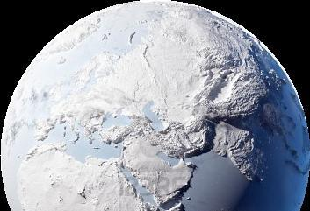
Quiz !
What would the temperature of the Earth be
without an atmosphere?
A : -50°C
B : -18°C
C : 0°C
D : 15°C
Notes:
Explanation:
What would the Earth's temperature be without an atmosphere?
Answer: -18°C, i.e. answer B

Slide 14
Quiz !
What would the temperature of the Earth be
without an atmosphere?
A : -50°C
B : -18°C
C : 0°C
D : 15°C
Without the atmosphere and the natural greenhouse effect, the Earth would be entirely frozen over !
Notes:
Explanation:
Without the greenhouse effect, the average temperature on Earth would be -18°C. Because all the sun's heat would be evacuated into space. Life would then be impossible.
The greenhouse effect is a natural phenomenon. It ensures an average temperature of 15°C on the Earth's surface. The problem is not the natural greenhouse effect, but the additional "anthropogenic" greenhouse effect (caused by human intervention), which increases the average temperature even further.
‹#›

Slide 15
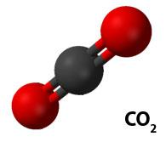
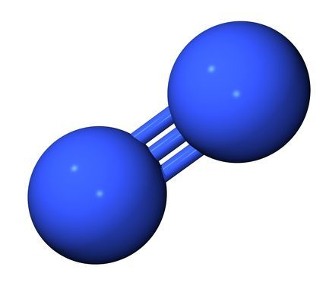
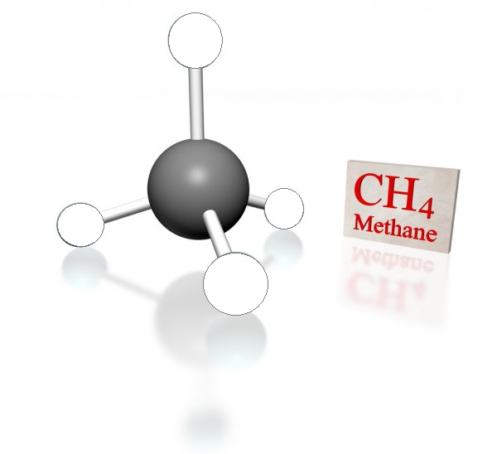
What are the greenhouse gases (GHG)?
The four main greenhouse gases
Not all the gases in the atmosphere are involved in the greenhouse effect, it depends on their physical characteristics.
Example: non greenhouse gases
CO₂
Carbon dioxide
H₂O
Water
O₂
Dioxygen
N₂
Diazote
CH₄
Methane
N₂O
Nitrous oxide
Notes:
Explanation:
The atmosphere is made up of 78% N2 (nitrogen) and 21% O2 (oxygen), which are not greenhouse gases. GHGs represent only a small quantity of the gases present in the atmosphere, but they have an enormous impact.
The four main gases responsible for greenhouse gases on Earth are :
CO2, carbon dioxide
CH4, methane
N2O, nitrous oxide
H2O, water vapour!
Although water vapour is an important greenhouse gas, it does not remain in the atmosphere for long, nor does it accumulate, unlike the other three gases. This is why water vapour does not contribute to the increase in the greenhouse effect.
To go further:
The atmosphere can contain a given amount of water vapour. This amount depends on the temperature of the atmosphere. So, even if we "emit" a lot of water vapour, this does not lead to an accumulation of water vapour in the atmosphere, since the atmosphere will already be saturated with water vapour. On the other hand, as the climate warms, the atmosphere expands (saturation vapour pressure rises) and can hold more and more water vapour, leading to more consequent global warming. Ultimately, global warming leads to more global warming. This is known as a positive feedback loop.

Slide 16
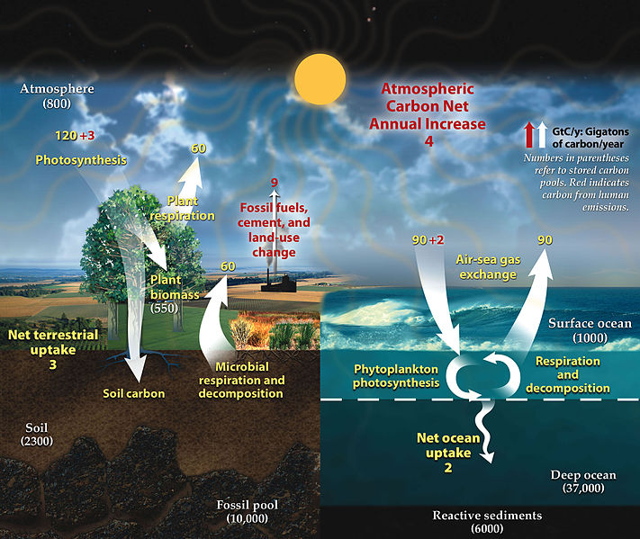
The carbon cycle
As with water, there is a natural carbon cycle
In the absence of human activity this cycle would be in equilibrium
This equilibrium is disrupted by greenhouse gas emissions caused by human activity
Source: IPCC AR4
Notes:
Explanation:
Before looking in more detail at the impact of human activities on climate change, let's take a look at the carbon cycle as a whole.
Like water, carbon follows a natural cycle. Over the course of a year, the various elements of the climate system exchange carbon. Without human activity, this cycle would be in balance.
But we burn a lot of fossil fuels. These were formed several million years ago by the fossilisation of living organisms and therefore constitute a large carbon stock. As this process is very slow, fossil fuels are non-renewable. By using this energy, human societies release this stock of carbon into the atmosphere, thereby unbalancing the natural carbon cycle.
Key messages:
1. Like water, carbon follows a natural cycle.
2. Without human activity, this cycle would be in balance.
3. GHG (greenhouse gas) emissions linked to human activities are upsetting this balance.
To go further: This infographic is in GtC, not GtCO2
1 GtC = 3.67 GtCO2
On this diagram, we can see that the flows naturally exchanged by the various natural carbon stocks are much greater than the carbon flows produced by the combustion of fossil fuels. 9 GtC compared with 120+90 GtC in the natural cycle. Except that in the natural cycle, all the natural emissions (white arrows pointing upwards) are offset by natural sinks (white arrows pointing downwards).

Slide 17
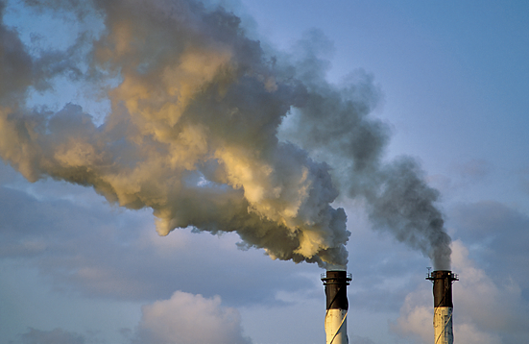
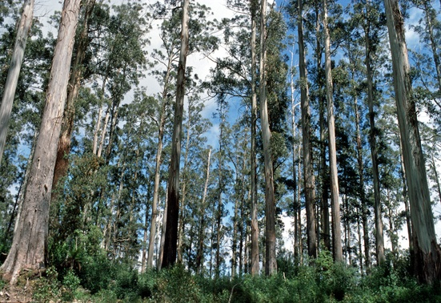
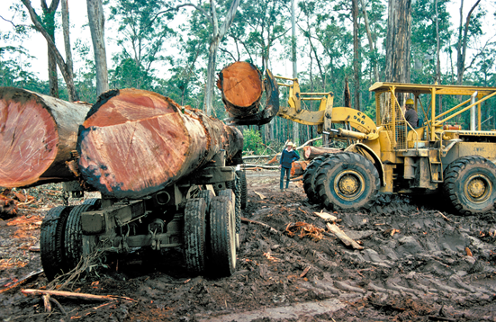
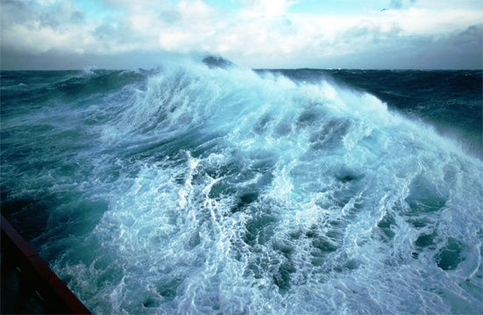
The carbon cycle
Only 44% of greenhouse gases are found in the Earth’s atmosphere
46 %
(1995)
86 %
The remainder is sequestered in forests and oceans
+
31 %
(2001)
14 %
But until when ?
23 %
Source: IPCC AR6 WG1
Notes:
Explanation:
86% of our carbon emissions are due to direct emissions (agriculture, energy consumption, etc.) and 14% to indirect emissions, mainly deforestation.
Deforestation leads to CO2 emissions for two main reasons:
Felled wood is often burnt. The CO2 captured by photosynthesis is therefore released into the atmosphere.
Forest soil captures CO2 better than agricultural soil. So if we replace a forest with agricultural land, the soil will release CO2 that was previously captured by the forest soil.
Only 46% of greenhouse gases are released into the atmosphere, contributing to an increase in the greenhouse effect and therefore to climate change. 31% of emissions are absorbed by the biosphere (forests, meadows and even algae!).
The remaining 23% dissolve in the ocean. For the time being, these natural carbon sinks prevent most of our emissions from ending up in the atmosphere and contributing to climate change.
For the time being, the more GHGs we emit, the faster these natural sinks store carbon. However, after a certain threshold, some scientists predict that these sinks will begin to saturate and release some of this stored carbon.
This is one of the uncontrolled effects of climate change. This is partly why the +2°C limit was set, but more on that later!
Key messages:
1. 88% of our GHG emissions are direct emissions (agriculture, energy consumption, etc.). 12% of emissions are linked to deforestation.
2. Only 46% of greenhouse gases end up in the atmosphere and contribute to climate change.
3. The rest of human emissions are captured by forests and the ocean, and fortunately so!
4. We are currently wondering how long the Earth will be able to limit the impact of our emissions.
Source : IPCC, AR6, WG1.

Slide 18
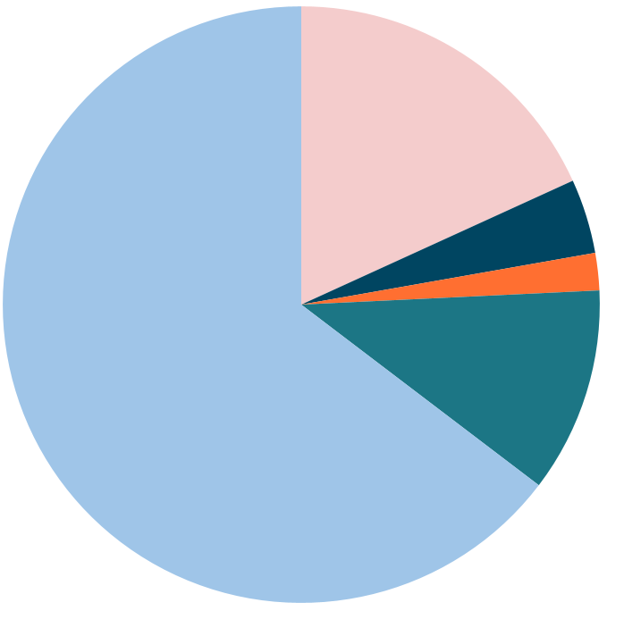
Where do greenhouse gases (GHG) come from?
Methane (CH4)
Anaerobic decomposition or combustion of organic compounds (cattle,
rice paddies, landfills, slash and
burn practices, etc.)
Carbon dioxide (CO₂)
Fossil fuel combustion and industry
18 %
Nitrous oxide (N₂O)
Nitrogen fertilizer, chemicals industry
64 %
4%
2%
Various fluorinated gases
Refrigerants, some industrial processes
11 %
Carbon dioxide (CO₂)
Land use change and deforestation
Global anthropogenic GHG emissions in 2019
Source: IPCC, AR6, WG3
Notes:
Explanation: This graph shows the proportion to which each gas contributes to the additional greenhouse effect.
Take advantage of the animations to get the audience to come up with some figures.
1st animation: CO2 from fossil fuels (= oil, coal and gas) and certain industries (steelworks and cement works, for example, which release CO2 through chemical reactions) + CO2 from deforestation.
2nd animation: methane is formed when organic matter decomposes in an environment containing little oxygen: fermentation in the stomachs of ruminants, rice paddies, landfill sites, burning, etc.
3rd animation: N2O, nitrous oxide or laughing gas. It comes from fertilisers and the chemical industry.
4th animation: fluorinated gases such as CFCs (chlorofluorocarbons), HFCs (hydrofluorocarbons), SF6 (sulphur hexafluoride), etc... Whereas the 3 previous gases come from natural sources and are gradually being eliminated by the environment, the latter are 100% synthetic and almost indestructible. They should therefore not be overlooked.
CO2 accounts for around 3/4 of the increase in the greenhouse effect caused by the GHGs emitted by mankind in recent years.
It will therefore be our "dollar", our unit of reference. We will report the emissions of all other types of gas in CO2 equivalent emissions. The warming caused by other gases is expressed as a multiple of the warming potential of CO2.
Example: 1 kg CH4 = 28 kg CO2eq

Slide 19
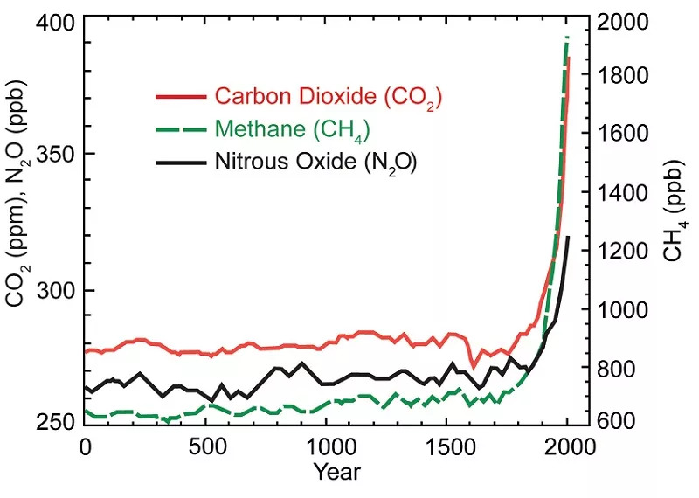
The impact of our activities on GHG emissions
In a few centuries the concentrations of greenhouse gases observed in the atmosphere have skyrocketed
Sources: U.S. National Climate Assessment (2014), IPCC AR5
Notes:
Explanation:
The concentration of CO2 in the atmosphere has risen by an average of around 280 ppm (particles per million, a unit of molecular concentration) over the last 800,000 years, officially reaching 400 ppm in 2016, i.e. +40% compared with pre-industrial levels. Around 1/3 of the current concentration of CO2 is therefore of human origin.
The concentration of methane (CH4) has increased by an average of around 650 ppb (particles per billion) over the last 2,000 years, reaching more than 1,840 ppb in 2016. This represents an increase of around 280% compared with pre-industrial levels. Methane of human origin therefore accounts for 2/3 of the current concentration.
Key messages:
1. Humans are constantly emitting greenhouse gases, some of which end up in the atmosphere. We are responsible for a surplus of 1/3 of the CO2 currently in the atmosphere, 2/3 for methane!
2. Observed concentrations of the various greenhouse gases have exploded in the space of a few centuries.
Ressources:
https://www.epa.gov/climate-change-science/causes-climate-change : Information on the causes of climate change from the US Environmental Protection Agency
The "Our Changing Climate" website and the National Climate Assessment report by the US Global Change Research Programm
http://nca2014.globalchange.gov/highlights/report-findings/our-changing-climate#graphic-20974
Great video explaining the concentration of CO2 over the last 50 years, then over 2000 years, then over 800,000 years!
[YouTube 4'16] https://www.youtube.com/watch?v=gH6fQh9eAQE&feature=youtu.be
Real-time monitoring of global average concentrations of: - carbon dioxide CO2 in the atmosphere http://www.esrl.noaa.gov/gmd/ccgg/trends/global.html
of methane CH4 : http://www.esrl.noaa.gov/gmd/ccgg/trends_ch4/index.html
Anthropocene
The Anthropocene is a neologism coined in the 1990s to describe a new era during which the influence of human beings on the biosphere has reached such a level that it has become a 'geological force' in its own right, capable of leaving its mark on the lithosphere. Although debated at international conferences, this period is not officially recognised on the geological time scale as the successor to the Holocene.
See the Wikipedia page and Alain Grandjean's blog "Chronique de l'Anthropocène".

Slide 20
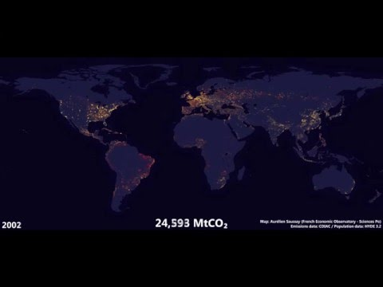
Historical CO₂ emissions
Source: Aurélien Saussay (French Economic Observatory - Science Po) on http://aureliensaussay.github.io/historicalemissions/
Notes:
Explanation:
This animation shows changes in CO2 emissions from fossil fuel combustion and cement production between 1750 and 2010. The greater the quantity of CO2 emissions, the closer the colour is to light yellow.
The United Kingdom is the only country that can be seen at the end of the 18th century, marking the start of the industrial revolution.
Then the countries of Western Europe (such as France, Germany, the Netherlands, etc.) and the United States began to emit large quantities of CO2 throughout the 19th century.
During the 20th century, the industrial development model spread across the globe, with the gradual appearance of bright spots, particularly in Asia.
This video shows the historical responsibility of developed countries (Western Europe and the United States) for CO2 emissions.

Slide 21
Quiz !
What causes greenhouse gas emissions?
A : Fossil fuel combustion
B : Tides
C : Digestive tract of ruminants
D : Cosmic radiation
Notes:
‹#›

Slide 22
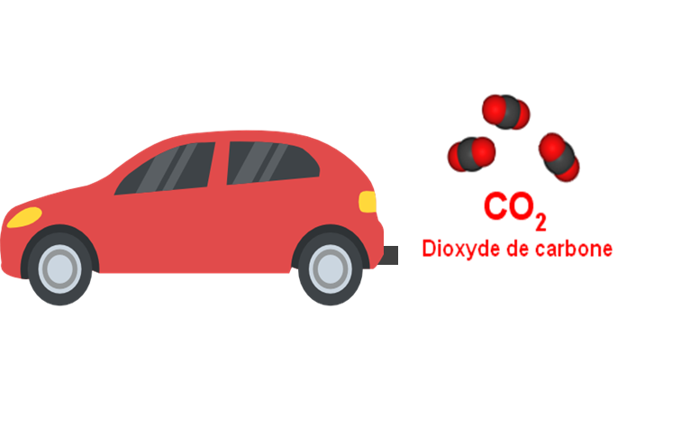
Quiz !
What causes greenhouse gas emissions?
A : Fossil fuel combustion
B : Tides
C : Digestive tract of ruminants
D : Cosmic radiation
Blurp !
Notes:
Explanation: Burning fossil fuels emits carbon dioxide (CO2), as explained in the Energy and human activities modules.
But there are other types of anthropogenic greenhouse gas.
- Methane (CH4) is formed when organic matter decomposes in an environment containing little oxygen, such as fermentation in the stomachs of ruminants.
- N2O, nitrous oxide. It comes from fertilisers and the chemical industry.
- Fluorinated gases such as CFCs (hydrofluorocarbons), HFCs (hydrofluorocarbons), SF6 (sulphur hexafluoride), etc., are also used in the chemical industry.
‹#›

Slide 23
The consequences of climate change
Part 2

Slide 24
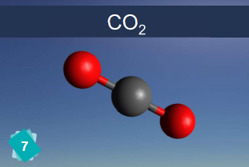
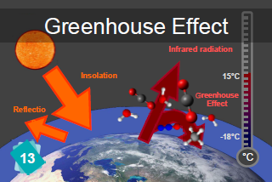
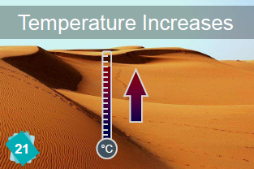
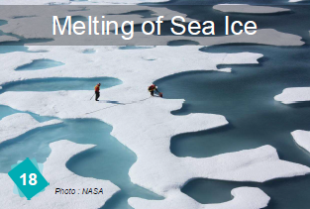
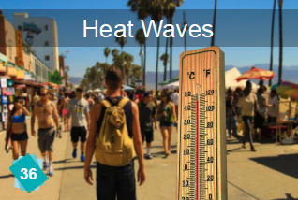
Our human activities disrupt the climate as a whole
Human activities
Greenhouse gas concentration
Additional greenhouse effect
Temperature increase
Causes
…
…
?
Effects
Rising sea levels
Disruption of ecosystems
Source: The Climate Fresk
Notes:
Explanation:
1. The more GHGs are emitted by human activities, the greater the concentration of GHGs in the atmosphere;
2. The higher the concentration of GHGs, the greater the greenhouse effect;
3. The greater the greenhouse effect, the higher the average global temperature;
4. These phenomena have a number of effects, which we will look at together.

Slide 25
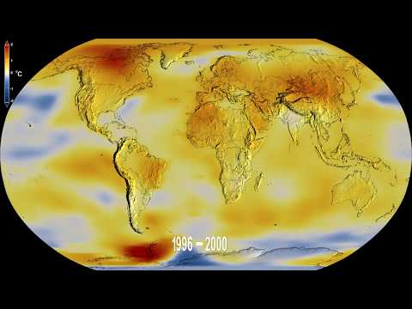
Increasing the greenhouse effect causes global warming
The global warming observed
in 2022 compared to the pre-industrial period is 1.1°C
Isn’t there an accelerating factor somewhere ?
Source: American National Aeronautics and Space Administration (NASA)
Notes:
Explanation:
This animation shows the global average temperature between 1850 and 2019, which is abnormal when compared with the average temperature between 1850 and 1900 ('pre-industrial' era).
A temperature anomaly is characterised by a difference in degrees Celsius compared with the average reference temperature, in this case calculated between 1850 and 1900. However, this anomaly is not sufficient to characterise exceptional temperatures. Some regions have highly variable temperatures, while others are very stable. We therefore need to compare the anomaly we observe with a reference anomaly, known as the "standardised anomaly".
The scientific community has indicated that the average global temperature has already risen by 1.2°C in 2022.
Key messages:
1. Already +1.2°C in 2022!
2. Isn't there a runaway effect somewhere?
To go further:
Temperature figures are available at https://climate.nasa.gov/interactives/climate-time-machine, other representations are available at http://www.climate-lab-book.ac.uk/spirals/.

Slide 26
A complex science! Dedicated experts
The Intergovernmental Panel on Climate Change
Created in 1988 under the aegis of the UN
and the World Meteorological Organization
Its mandate is to provide policy-makers with scientific assessments of past and future climate change.
The IPCC reports are intended to provide policy guidance to policymakers.
Sources: Le Réveilleur « Comprendre le GIEC et ses rapports », Bon Pote « Peut-on vraiment faire confiance au GIEC ? »
Notes:
The IPCC :
Involves 195 countries worldwide (almost all of them)
Synthesises all the scientific knowledge on the subject every 6 years since 1990
Reports on the scientific consensus on climate change
Does not make recommendations or take decisions (other bodies such as the COPs do this)
More than 14,000 articles reviewed
More than 800 scientists co-author reports
Almost 80,000 notes and comments
Explanation:
As the climate is an extremely complex system, it's best to listen to the experts to understand what's going on. In this case, the experts are the members of the IPCC, the Intergovernmental Panel on Climate Change, set up in 1988 under the aegis of the UN and the World Meteorological Organisation.
Its mandate is to provide policy-makers with scientific assessments of climate change.
Every 5 to 7 years, the IPCC publishes its Assessment Report (AR), consisting of 3 volumes and a summary report.
Future temperature trends are described according to 5 socio-economic pathways (SSPs).
The purpose of these assessments is to help decision-makers to define their orientations.
Key messages:
The IPCC (Intergovernmental Panel on Climate Change) is the world's scientific authority on climate change. It is the largest gathering of experts on a subject in the world.
It is an enormous analysis and synthesis machine. It has been producing reports every 5 to 7 years for the past 25 years.
The future is not a foregone conclusion, but these assessments prove it, and should help decision-makers to set their course.
Source : https://www.ipcc.ch/

Slide 27
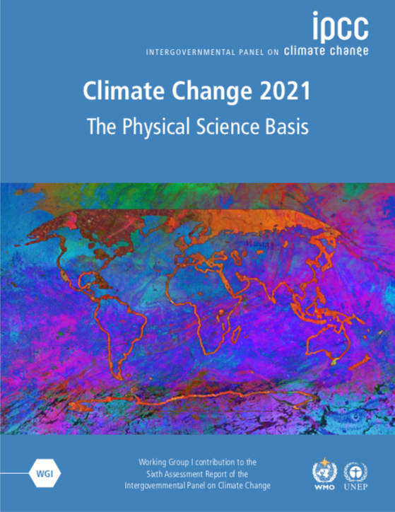
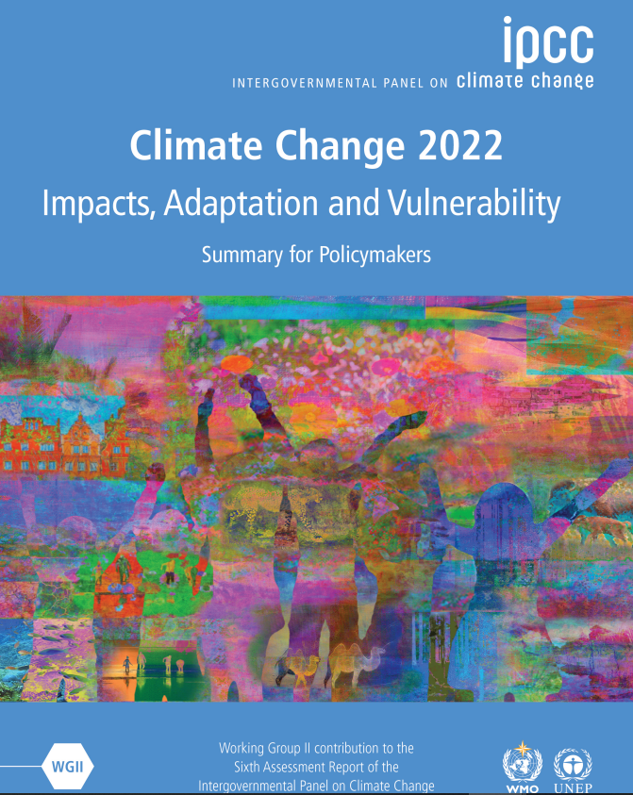
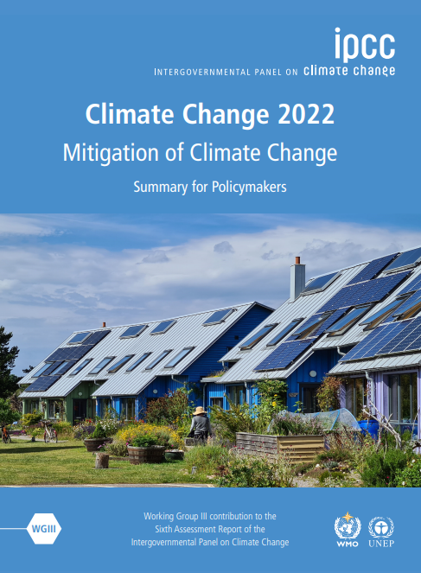
IPCC reports
There are 3 versions:
The Summary for PolicyMakers (SPM, 42 pages)
the Technical Summary (TS,159 pages)
The Full Report (FR, 3949 pages)
WGI : Update
of the knowledge
in climatology
WGII: Impacts and vulnerabilities to climate change and
adaptation policies
WGIII:
Climate Change Mitigation Policies
5th Evaluation Report (AR5)
2014
August 2021
March 2022 :
6th Evaluation Report (AR6)
April 2022
Source : Bon Pote « Synthèse et analyse du nouveau rapport du GIEC »
Notes:
Explanation:
This is the sixth evaluation report.
The first was published in 1990, the 2nd in 1995, the 3rd in 2001, the 4th in 2007, the 5th in 2014 and the 6th in 2021/2022.
There are 3 versions of each report:
summary for decision-makers
the technical summary
the full report
==> The full report should serve as an encyclopaedia if you want to go into more detail on a particular point.
The various working groups are interested in specific subjects: each working group publishes a report on the subject studied.

Slide 28
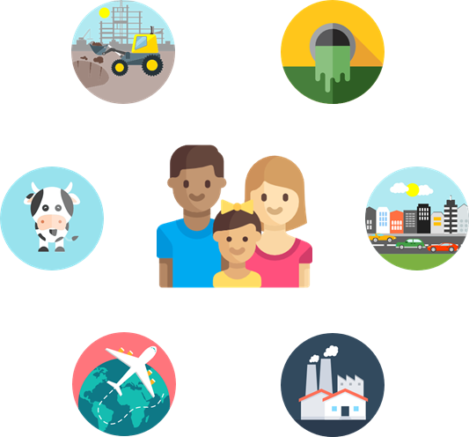
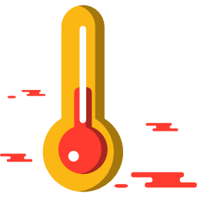
IPCC’s conclusions
Human activities are responsible for the acceleration of climate change.
It is of vital importance to limit the temperature increase to no more than 2°C by the end of the century.
Our future climate depends on the decisions we make now.
Source : IPCC AR6
Notes:
Explanation
Humankind is responsible for the acceleration of climate change: The confidence index for this causality has evolved as follows: 66% in Report No. 3 in 2001, 90% in Report No. 4 in 2007, 95% in the 2014 report and 99% in Report No. 6 in 2021. It is now indisputable that human activities are the cause of climate change, which is making extreme weather events [...] more frequent and more severe.
It is important to limit the increase in temperature to +2 degrees Celsius before the end of the century: beyond that, we risk facing a climate machine that is out of control.
There is no turning back for certain changes in the climate system (melting glaciers, warming oceans), but some changes could be slowed down and others halted by limiting warming!
Source : https://www.ipcc.ch/report/sixth-assessment-report-working-group-i/

Slide 29
What are the consequences of global temperature rise and climate change?
Notes:
Explanation:
Ask the students what consequences of climate change they can observe.

Slide 30
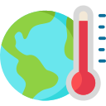
Physical impacts and their consequences for human society
Physical impacts
Societal consequences
Higher temperatures and more frequent and intense heat waves
Disturbance of precipitation patterns
Increasing frequent and/or severe extreme weather events
Rising sea level, coastal erosion, receding shoreline
Acidification of ocean waters
Ecosystems’ collapse
Dwindling water supply
Property damage
Decrease in fish catch
Lower agricultural yields
Population migration
Political and financial instability
Notes:
Explanation:
Let's look at how all this affects us in practical terms. All these effects are already observable and are likely to intensify over the next few years if nothing is done to limit climate change.
The most direct consequence is an increase in the average temperature at the Earth's surface.
Heat waves have increased in certain regions of the world.
The water cycle is also being disrupted: heavy rainfall is increasing in Europe, and droughts are on the increase around the Mediterranean.
There has also been an increase in the frequency and/or amplitude of extreme events.
In addition, the melting of glaciers and ice caps caused by rising temperatures is causing sea levels to rise. As the oceans warm, water spreads, which also contributes to rising sea levels. This has consequences for coastal areas. As the ocean absorbs some of the anthropogenic CO2 emitted, its acidity increases. This damages corals and certain planktonic shell organisms, for which the environment is becoming too acidic.
Rising sea levels are having an impact on coastal infrastructures.
An increase in extreme events and droughts can disrupt harvests, reducing yields. Ocean acidification, by threatening certain plankton, threatens the marine food chain as well as our fishing activities.
Finally, all these disruptions will force certain populations to adapt, in particular by looking elsewhere for a new place to live. These migratory movements represent a high risk of political destabilisation and conflict in the years to come! It is estimated that by 2050, there will be 500 million climate refugees in the world.
Key messages:
1. These physical consequences are already having a tangible impact on human societies.
2. The effects are manifold and are expressed differently depending on location, environment or population density.
3. Faced with this global challenge, it is difficult to establish global governance.
References: https://www.ipcc.ch/site/assets/uploads/2018/03/SREX-Chap3_FINAL-1.pdf
https://www.ipcc.ch/site/assets/uploads/2018/02/WGIIAR5-Chap5_FINAL.pdf
https://www.ipcc.ch/site/assets/uploads/2018/02/WGIIAR5-Chap30_FINAL.pdf
https://www.ipcc.ch/site/assets/uploads/2018/02/WGIIAR5-Chap3_FINAL.pdf
https://www.ipcc.ch/srccl/chapter/chapter-5/
https://www.ipcc.ch/site/assets/uploads/2018/02/WGIIAR5-Chap12_FINAL.pdf

Slide 31
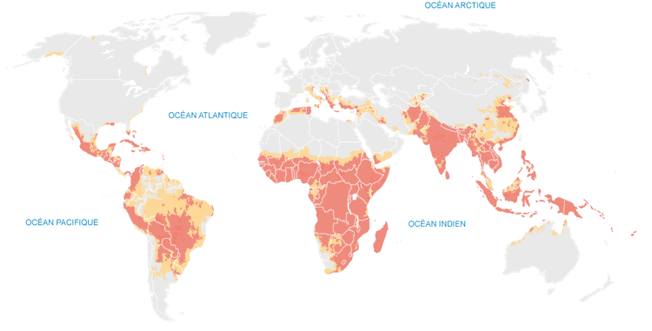
Global impacts : climate injustice
Climate Change Vulnerability Index, 2013
Arctic Ocean
Climate change will exacerbate inequalities between countries and regions
Atlantic Ocean
Pacific Ocean
Indian Ocean
High risk
Very high risk
Source: Data from Climate Change Vulnerability Index 2013, infographics by lemonde.fr
Notes:
Explanation:
So we will have to adapt. But not all the world's countries are equally equipped to meet this challenge.
Climate change will be most severe in the countries shown in red on the map. These are mainly developing countries in Africa, South America, South-East Asia and the Pacific.
In these countries, the impacts will be greater because they are more exposed. They are located in the Earth's tropical belt, which is already warmer than elsewhere.
These countries are also more vulnerable: they have fewer resources at their disposal to adapt to these disruptions, for example to build protective measures such as dykes or to install warning mechanisms or economic aid for populations in the event of a crisis.
The impacts of climate change are therefore likely to exacerbate the already existing inequalities between developed and developing countries. This will delay the development of many countries and even exacerbate a number of situations that are not encouraging in terms of armed conflict, access to health, food, poverty, etc.
Yet developing countries have not asked for anything. They are often the least responsible for climate change because they consume less energy per person than developed countries.
They emit fewer greenhouse gases. A Chinese person emits half as much greenhouse gas as a French person. A Cambodian emits 25 times less!
Although they do not benefit from the comfort offered by the use of fossil fuels, these countries will suffer all the consequences.
Here we see the emergence of the notion of climate justice, which would involve rich countries compensating poor countries so that they take responsibility for climate change and others have the means to adapt to it.
Key messages
1. Climate change will mainly affect developing countries (Africa, South America, South-East Asia) which are shown here in red, but everyone will be affected.
2. The impacts are very different and will disrupt our basic daily functions, including food production and access to water, infrastructure, biodiversity, etc.
3. The impacts of global warming will increase inequalities between and within countries.
4. We must adapt to these changes now!

Slide 32
Summary
Climate must not be confused with weather: the time scales and modes of analysis are different.
The climate is a complex and constantly changing system.
The greenhouse effect is a natural process, reinforced by anthropogenic emissions.
The climate is very sensitive to temperature: for a small variation there are significant consequences.
The current situation is unprecedented, primarily due to the speed of change.
It's no exaggeration to say that we are the cause of a global climate disruption that already has many harmful consequences.
Notes:
Activity: Read this slide or rephrase it in your own words. Break down each point and take the time to check that everyone has understood.
Key messages:
1. Climate should not be confused with weather: different time scales and different methods of analysis 2. The climate system is a complex system that is constantly changing. 3. The greenhouse effect is a natural process, reinforced by human emissions. 4. The climate is very sensitive to temperature: small variations have big consequences… 5. The situation is unprecedented, particularly in terms of the speed of change. 6. It is no exaggeration to say that we are the cause of a global climate disruption that has already had many serious consequences.

Slide 33
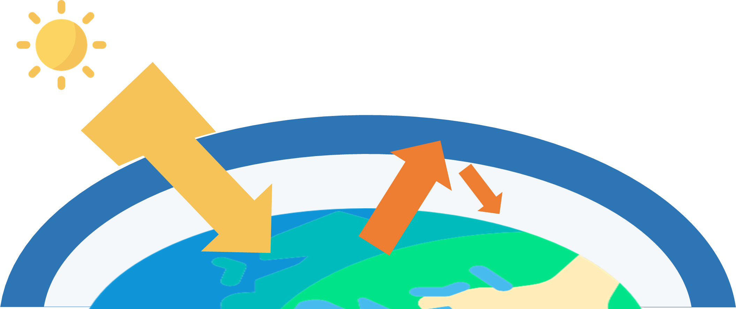
Conclusion
The acceleration of climate change is due to human activity.
The more the Earth heats up, the greater and more unpredictable the consequences!
Notes:
Activity:
Here is the summary of this module. If necessary / possible, you can do a round of questions / answers or ask students to write down their questions for later and continue.

Slide 34
Image Credits
Eucalyp via Flaticon
Freepik via Flaticon
IconPond via Flaticon
Vectors Market via Flaticon
Smashicons via Flaticon
ShareThis_OrDie

