Slide 1
Phase 3 :
Carbon Accounting

Slide 2
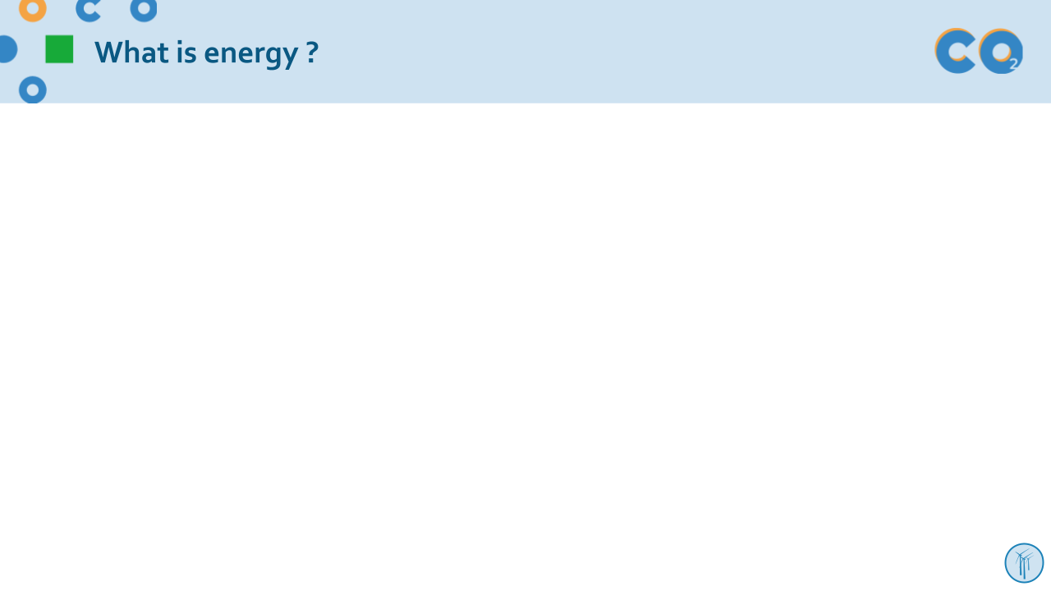
Welcome to Clicks On educational content!
Choose your path!
You can tailor your presentation to suit the content of your class, the time you have available and the topics you want to explore! To make things easier for you, we've created two easy-to-identify slide types : the light and the complete initiative :
Light initiative
Complete initiative
→ the red wire and fundamental concepts of the module
→ slides and activities to deepen your knowledge!
Don't forget the comments below the slides
Each slide is accompanied by notes to guide you through your presentation.
Complete your session with suggested activities from the module
You'll find suggested activities for each phase on our website!
Enjoy your session!

Slide 3
Estimating greenhouse gases emissions
Carbon accounting principles
Case study: Your school's carbon footprint
Notes:
Transition:
Now that we understand what climate change is and how human activities contribute to it, let's look at how to calculate GHG emissions so that we can reduce them.

Slide 4
Carbon accounting principles

Slide 5
Why should we estimate GHG emissions?
To understand how we can effectively reduce our GHG emissions
To establish benchmarks and get an idea of the quantity of GHGs emitted
To anticipate changes in our business sector and change our practices
To save money and reduce risk
Notes:
There are several reasons to estimate our greenhouse gas emissions:
First of all, we need to estimate them so that we can reduce them. Identifying the activities that emit the most greenhouse gases can guide our actions to effectively reduce emissions.
It's also important to be able to anticipate possible future changes in our field: anticipating future standards for GHG emissions, for example.
In many cases, reducing greenhouse gases can be associated with savings (by reducing energy bills, for example).

Slide 6
Why should we estimate GHG emissions?
To determine orders of magnitude by source of emissions, classify them and quantify the benefits obtained thanks to the improvements that were implemented
To determine and implement an appropriate and effective action plan
For instance, to reduce GHG emissions, which action is the most effective?
OR
Turn off devices that are in standby and unnecessary lighting?
Lowering the thermostat setting by 1°C?
Notes:
The main objective of carbon accounting is to identify the most effective actions for reducing our greenhouse gas emissions. We are not looking for exact figures, but we are trying to determine the order of magnitude of each action.
Answer: Turning down the thermostat is four times more effective. In fact, one year of heating is equivalent to 54 years of a light bulb on in terms of greenhouse gas emissions.

Slide 7
Different types of greenhouse gases and sources of emissions
There are different greenhouse gases and a multitude of emission sources!
Carbon Dioxide
Nitrous oxide
Methane
Blurp !
We need a common unit of measurement
to start counting: CO₂eq
Notes:
There are many different sources of GHG emissions, as well as different GHGs such as carbon dioxide, nitrous oxide and methane, just as there are different currencies in the world. If we want to know the total amount of money we have with 10 euros, 5 yen and 8 dollars, we have to convert all the money into dollars and add them together. The same goes for greenhouse gases. That's why we need a reference, a "dollar", but for greenhouse gases: the CO2 equivalent (we'll talk about this later).

Slide 8
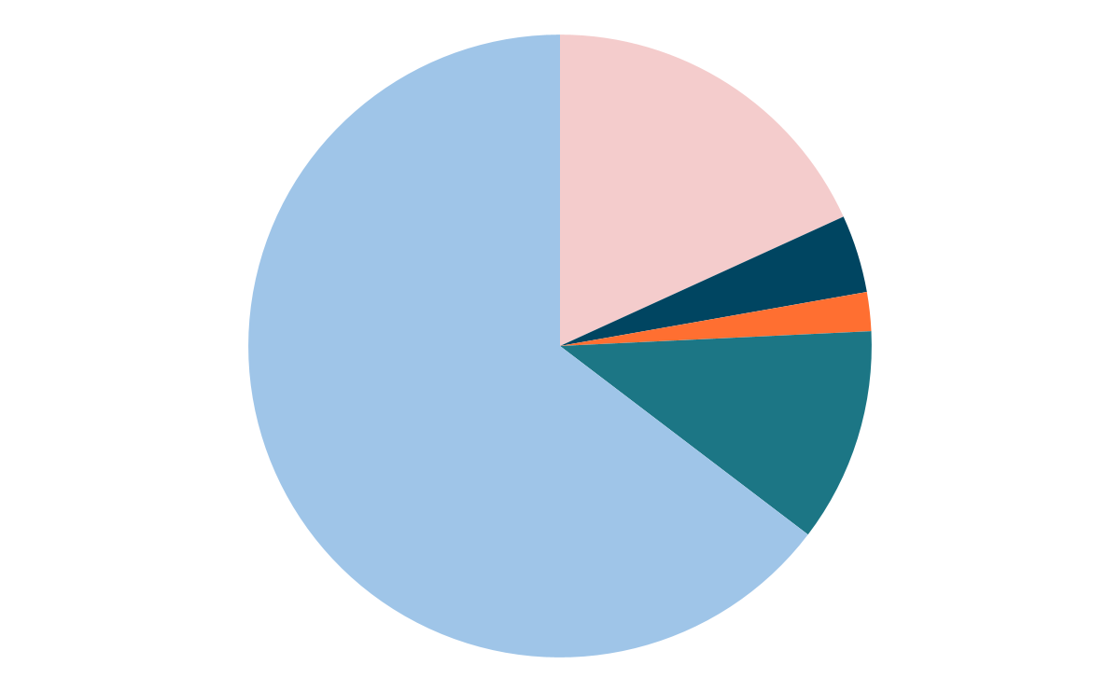
Where do greenhouse gases (GHGs) come from?
Methane (CH4)
Anaerobic decomposition or combustion of organic components (livestock, rice paddies, landfills, slash and burn practices, etc.).
Carbon dioxide (CO₂)
Fossil fuel combustion and industry
18 %
Nitrous oxide (N₂O)
Nitrogen fertilizers, chemical industry
4%
2%
64 %
11 %
Fluorinated gases
Air conditioning, some industrial processes
Carbon dioxide (CO₂)
Land use change and deforestation
Global anthropogenic GHG emissions in 2019
Source : IPCC, AR6, WG3
Notes:
Explanation: This graph shows the proportion to which each gas contributes to the additional greenhouse effect.
Take advantage of the animations to get the audience to come up with some figures.
1st animation : CO₂ from fossil fuels (= oil, coal and gas) and certain industries (steelworks and cement works, for example, which release CO₂ through chemical reactions) + CO₂ from deforestation
2nd animation : methane is formed when organic matter decomposes in an environment containing little oxygen: fermentation in the stomachs of ruminants, rice paddies, landfill sites, burning, etc.
3rd animation : N₂O, nitrous oxide, nitrous oxide or laughing gas. It comes from fertilisers and the chemical industry.
4rd animation : fluorinated gases such as CFCs (chlorofluorocarbons), HFCs (hydrofluorocarbons), carbon monoxide (CFCs) and chlorofluorocarbons (CFCs). SF₆ (sulphur hexafluoride), etc... While the 3 previous gases come from natural sources and are gradually being eliminated by the environment, the latter are 100% synthetic and almost indestructible. They should therefore not be overlooked.
CO₂ represents around 3/4 of the increase in the greenhouse effect caused by GHGs emitted by mankind in recent years.
This will therefore be our "dollar", our unit of reference. We will report emissions of all other types of gas in CO₂. equivalent emissions. The warming caused by other gases is expressed as a multiple of the warming potential of CO₂.
Example : 1 kg CH4 = 28 kg CO₂eq

Slide 9
A common unit of measurement, CO₂ equivalent: CO₂eq
Carbon dioxide
Methane
Nitrous oxide
The basic unit is the global warming caused by 1 kg of CO₂ over 100 years. The warming caused by other gases is expressed as a multiple of the warming potential of CO₂.
1 kg CO₂ = 1 kg CO₂eq
1 kg CH₄ = 28 kg CO₂eq
1 kg N₂O = 265 kg CO₂eq
Notes:
‹#›
Scientific studies have made it possible to determine, for each kg of GHG emitted into the atmosphere, the equivalent mass of CO2 that can cause the same warming for more than 100 years.
There is therefore a conversion factor for each GHG, called the Global Warming Potential (GWP), which makes it possible to relate everything to CO2, in the same way as there is a conversion factor for each currency, called the exchange rate, which makes it possible to relate everything to the dollar. However, unlike the exchange rate of each currency, the GWP of each gas does not change over time.
By definition, each kg of CO2is equivalent to 1 kg of CO2 (elementary my dear Watson)
On the other hand, when we take methane (CH4), we can see that, even though it remains in the atmosphere for a shorter period of time, each kg emitted is equivalent to the emission of 28 kg of CO2. Methane (CH4) therefore has a much greater warming power. Similarly, each kg of nitrous oxide (N2O) emitted is equivalent to 265 kg of CO2.
Source : 5th IPCC report http://www.ipcc.ch/report/ar5/wg1/
‹#›

Slide 10
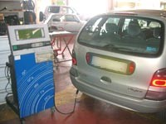
How do we measure these emissions?
Two methods :
Direct measurement
Very precise but difficult to reach
Often impossible because emissions occur elsewhere
(e.g. electricity generation) or in the past
(manufacturing processes)
Estimation using an emission factor
Emission factors represent the average quantity of CO2eq emitted per reference unit, using values based on previous studies and analyses.
This method is less precise, but sufficiently reliable for our purposes.
Direct measurement of pollutant gases on an automatic test station
Notes:
There are devices that can measure the quantity of gases emitted (for example, during the pollution check when a car is MOT'd), but they cannot be used everywhere. In the case of cars alone, they would have to be permanently connected to all the car exhaust pipes! What's more, most emissions take place outside the establishment (transport, electricity production, waste treatment, etc.) or have already taken place (construction of buildings, production of consumables and materials, manufacture of objects, etc.) and it is unrealistic to measure them.
When measurement is not possible, we have to estimate emissions based on a statistical study. For example, one organisation carries out a study of average car emissions per kilometre travelled. This result is called the Emission Factor (EF). If we know the number of kilometres driven by a car, we can then estimate its emissions using the emission factor.
The French Environment and Energy Management Agency (ADEME) has done a great deal of work collecting its emissions factors, which are available free of charge at https://www.bilans-ges.ademe.fr/en/accueil.
Several EFs may exist for the same source. For example, for a car journey, different EFs can be sought depending on whether the car runs on petrol or diesel, whether it is driven in town or in the countryside, etc. It quickly becomes tedious to define an EF for all the influencing parameters (model of car, driving style, altitude of journey, etc.), so you have to choose between accuracy and practicality.
This method is less accurate than direct measurement, but it is more than effective for the needs and objectives of the Clicks On project, particularly for classifying the different sources of emissions and helping you to define the action plan.

Slide 11
Emissions factors: How do they work?
Emissions from human activity
=
Quantity consumed x Emission factor = Total in kgCO₂eq
All these human activities emit approximately one tonne 0f CO₂eq !
2 500 kWh of electricity x 0,42 kgCO₂eq/kWh = 1 050 kgCO₂eq
4 500 kWh natural gas heating x 0,227 kgCO₂eq/kWh = 1.022 kgCO₂eq
6 000 km by car x 0,178 kgCO₂eq/km = 1 068 kgCO₂eq
450 “averagel” meals x 2,25 kgCO₂eq/meals= 1 013 kgCO₂eq
5 laptops x 202 kgCO₂eq/ordinateur= 1 010 kgCO₂eq
If you have any questions about emission factors, here's a reference website
*Data updated in 2023
Notes:
Please note that for electricity, the emission factor is the average European energy mix and therefore really depends on the energy source used to produce that electricity. Compared with France, which uses mainly low-carbon electricity, the emission factor is 0.0599 kg CO2eq/kWh. This represents more than 17,500 kWh of electricity.
There are emission factors for almost everything. Most of the ones we need are already entered in the spreadsheet. Measuring your carbon footprint in Clicks On project "simply" involves collecting the data and entering the quantities for each source of emissions, in the right units. The spreadsheet will multiply the quantities by the corresponding emission factor to obtain the emissions from the source and add up all the sources together.
You can find other emission factors, or check that everything is up to date, on ADEME's Base Carbone website: http://www.bilans-ges.ademe.fr/en/accueil

Slide 12
Emission factors and uncertainty
Emission factors are built using average values.
A statistical uncertainty margin is therefore attached to each factor. To simplify matters, the uncertainty to which an emission factor is subject is indicated on a scale of 1 to 5, with 1 representing low uncertainty and 5 high uncertainty.
Similarly, the data collected is also subject to uncertainties.
The Bilan Carbone® method works with orders of magnitude.
The important thing is not the amount of CO₂ emitted down to the last kilo, what matters is knowing where and how to act to reduce emissions.

Slide 13
Quiz !
CO₂ is used as the yardstick unit because…
A : It is the most powerful greenhouse gas
B :It was the first gas whose warming effect was discovered
C : Stands for Clicks On
D : It is the greenhouse gas most emitted by human activities.

Slide 14
Quiz !
CO₂ is used as the yardstick unit because…
A : It is the most powerful greenhouse gas
B :It was the first gas whose warming effect was discovered
C : Stands for Clicks On
D : It is the greenhouse gas most emitted by human activities.

Slide 15
Quiz !
What is the purpose of a carbone assessment ?
A : To identify the guilty party
B : Draw up an action plan
C : To adapt to climate change
D : To measure GHG emissions

Slide 16
Quiz !
What is the purpose of a carbone assessment ?
A : To identify the guilty party
B : Draw up an action plan
C : To adapt to climate change
D : To measure GHG emissions

Slide 17
Key take-aways
There are a number of greenhouse gases, and each one has a different warming potential.
A common unit of measurement is needed: kgCO2e.
It is impossible to measure all greenhouse gas emissions directly. Emission factors based on average values, with a margin of uncertainty, are used to estimate emissions.
To estimate the greenhouse gas emissions for a given use, the data collected is multiplied by the relevant emission factor.
The important thing is not to obtain an exact figure, but to determine an order of magnitude that enables us to take action.

Slide 18
Case study : your school’s carbon footprint
Now let's move on to practice!
Passons maintenant à la pratique !

Slide 19
Case study : your school’s carbon footprint
Now that we know the unit for measuring our emissions, let's look at a concrete example: your school, whose carbon footprint we want to calculate.
As part of the Clicks On project, we are using a simplification of the Bilan Carbone® method.
To begin with, you need to identify the different emission items, i.e. the different types of activity whose carbon footprint we want to measure.
Can you identify sources of emissions in your school?
Notes:
Use this slide to get students to guess which types of activity emit greenhouse gases in the school...

Slide 20
Case study : your school’s carbon footprint
Transport Travel by students and staff, shipping and deliveries, etc.
Energy
Electricity, heating, air conditioning
Consumable supplies and materials Paper, raw materials, cleaning products, services, waste, etc.
Food service School lunchroom, student restaurant, meal service, eating habits, waste.
Fixed assets Building construction, manufacture of office equipment, furniture, etc.
Notes:
We can get to the heart of the matter and take the case of the school. But the method is the same for any type of project or organisation.
What emissions do we need to take into account to calculate the carbon footprint of this school?
We are taking into account the majority of greenhouse gas emissions linked to the school's activity through the following items:
Energy : electricity, heating and air conditioning.
Travel by students and staff, as well as school trips, shipping, ...
Consumable supplies and materials used by the school : paper, raw materials, etc.
Food service: its production, transportation, transformation and waste which must be transported and treated.…
Fixed assets : building construction, for example. Even if emissions are only due to construction, we have to take them into account and write them off, generally over a period of 30 years.

Slide 21
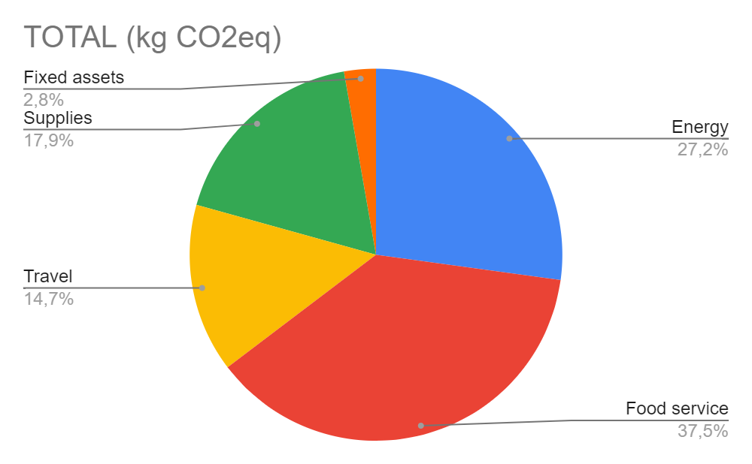
Case study : your school’s carbon footprint
How to obtain your school’s emission profile?
€
Data collection : invoices, surveys, purchases, etc.
Calculator
Results : identify the most emitting activities for the action plan phase
Notes:
First we need a calculator to obtain the profile. You can see that the profile is a histogram. This format allows us to identify the biggest emitters, so that we can work on them and reduce GHG emissions. To do this, we need to have all the activity data to estimate the quantity of greenhouse gases emitted by the school. Using the calculator, we can enter the data and convert it into GHG emissions.

Slide 22
First step: data collection
Purpose:
Collect all the data needed to calculate greenhouse gas emissions
Raise awareness of the issues at stake among all those involved and obtain help in carrying out the carbon assessment
How to proceed :
Defining the scope
List the data to be collected
Prepare data collection media
Collect the data
All arguments and hypotheses must be explained and documented in a report so that the results of the assessment can be easily understood.
Notes:
Now that we know why we estimate GHG emissions and how we measure them, let's move on to the data collection phase.
During the data collection phase, you will be meeting various people who work in your school. This is a good time not only to talk to them about the data, but also to make them aware of what you are doing and the importance of reducing our greenhouse gas emissions.
Before asking anyone any questions, make sure you prepare all your queries, list everything you need to know, and why not tell the people you're going to meet what information you'll need - it'll save you time and them too!

Slide 23
Scope of assessment
Identify the activities to assess
Functioning of a secondary school (middle school/high school) with xxx number of students, over one school year.
Determine the scope and reference year
Whole school’s activity
Commuting travel between home and school (including weekends and holidays)
Food service
Etc.
Don't forget to write down all your hypotheses!
Notes:
LIGHT INITIATIVE:
The first thing to do in a carbon assessment is to clearly define what activities you will consider or not and why. You have to define the scope of the assessment. Beyond certain emissions that cannot be avoided, the definition of the scope is arbitrary. It is your choice to make. The wider we count, the more capacity for action we have... but the more time it takes. So it all depends on your objectives and ambitions.
Following are a few tips on how to try to list all potential sources of emissions exhaustively before you make your selection. The fact of selecting or not selecting a particular source must be argued and recorded in the report that must accompany the calculation. This report is essential if you want to remember the assumptions you made the last time or to compare different assessments. With the Clicks On Calculator you will find 5 categories (Energy, Food, Transport, Supplies and Fixed Assets) with a certain amount of questions to answer and data to collect. In its normal version, the ClicksOn Calculator will require less data for each item (no waste tab, air conditioning, etc) compared to the advanced version (next slide). It is a good start but if you want to enlarge this perimeter, feel free to do it on your own.

Slide 24
Scope of assessment
Stationary sources Electricity, heating, air conditioning…
Clearly define the activity that is to be assessed
Everything that happens at the institution?
Emissions generated by education and training, including practical work sessions?
Food service, other activities?
Define the physical perimeter of the institution and establish an inventory
Everything that passes through the school -
cars, deliveries, electricity, waste, etc.
Use what happens outside the facility - catering, travel, events, leisure, etc.
Use what you have inside - heating, hot water, pruning, catering, maintenance, etc.
All arguments and hypotheses must be explained and documented in a report so that the results of the assessment can be easily understood.
Transport Travel by students and staff, shipping and deliveries etc.
Food service School lunchroom, student restaurant, meal service, eating habits, waste…
Consumable supplies and materials Paper,raw material, cleaning products, services etc.
Fixed assets
Building construction, manufacture of office equipment, furniture, etc.
Notes:
COMPLETE INITIATIVE:
The first thing to do in a carbon assessment is to clearly define what activities you will consider or not and why. You have to define the scope of the assessment. Beyond certain emissions that cannot be avoided, the definition of the scope is arbitrary. It is your choice to make. The wider we count, the more capacity for action we have... but the more time it takes. So it all depends on your objectives and ambitions.
Following are a few tips on how to try to list all potential sources of emissions exhaustively before you make your selection. The fact of selecting or not selecting a particular source must be argued and recorded in the report that must accompany the calculation. This report is essential if you want to remember the assumptions you made the last time or to compare different assessments. With the Clicks On Calculator you will find 5 categories (Energy, Food, Transport, Supplies and Fixed Assets) with a certain amount of questions to answer and data to collect. It is a good start but if you want to enlarge this perimeter, feel free to do it on your own.

Slide 25
What kind of data are we looking for ?
Here is a non-exhaustive list of information and data to be collected for an educational institution.
Energy Heating and electricity bills, air conditioning maintenance reports, etc.
Transport Means of transport used, provenance of goods and supplies delivered, etc.
The list of data to be collected depends on the assessment scope!
Consommables et matériaux Purchase invoices: paper, raw materials, cleaning products, services, etc.
Food Service Number and composition of meals served, etc.
Fixed assets List of buildings, surface area, year of construction; inventory of office equipment, furniture, vehicles, etc.
Notes:
As we said earlier, in a carbon footprint we want to know the school's total GHG emissions. But this data is not directly available. We are going to use emission factors to transform a physical flow (km, kwH, etc.) into GHG emissions. There are many different units for emission factors, for example kgCO2eq/kWh for everything that consumes a lot of energy or kgCO2eq/unit for every object that emits a lot during its production.
As part of this project, you will need to use emission factors taken from ADEME's Base Carbone and included in the calculator, so you will need to use the corresponding units. For example, the emission factor associated with computers is in kgCO2eq/unit, so you will need to find the number of computers purchased this year.
In general, you will need to find the data requested by the Clicks On calculator. If you want to extend the scope, you will need to find new emission factors and identify the most relevant data to collect, but that can be for next time.

Slide 26
Tip : Identify the appropriate resources
Some useful resource persons and sources of information
School manager and accounting manager
Local/regional government
(Deputy) Building manager
Study the functioning of the school and look at the organizational chart to find the person you need!
Information technology department
Purchasing department
Lunchroom/canteen manager
Notes:
For all the categories, the school manager and the accounting manager may have some answers, but there are others persons you should consider.
For energy issues, the local or regional authorities. In some regions, they are in charge of the energy consumption and construction. For food, the canteen manager may be a great help of course ! For supplies, you may ask the purchasing department. For fixed assets, the IT manager should know everything about computers, photocopiers, etc. In addition, the librarian of your school can help to use a computer and use it to collect data.

Slide 27
Tip : prepare data collection materials
In some categories there is a lot of data to collect
It would be very time consuming to ask each student:
How do they get to school?
What do they eat every day?
To make data collection easier, you can use questionnaires and sampling : :
Design a questionnaire and send it to a sample of students and teams.
Extrapolate the results to all the students and teams.
Don't be swamped by the amount of data you need to collect!
Notes:
For certain categories, such as energy or supplies, you may be lucky enough to find all the information on a single bill! But that won't be the case for categories such as food or transport. You're going to have to ask all the students, teachers and the whole ANE team how they get to school and what they eat every day (in a typical week, for example)? You could try asking each person directly, but you'll save a lot of time by using a questionnaire.
If you're having trouble designing these questionnaires, you can look at the Data Collection Guide, which will help you create effective forms and analyse the results you get. You can also ask other Clicks On’s schools !

Slide 28
Let's do the maths!
Now that you've collected the data, all you have to do is calculate your school's carbon footprint
using the Clicks On calculator !

Slide 29
Clicks On Calculator
Summary report
To have an overview of the data collected and the emissions accounted for.
2 possible levels of precision
Divided into categories
For each category, it is possible to integrate more data to get a more accurate result
Energy, food, transportation, supplies and fixed expenses
Tool through a worksheet
Support
It allows to evaluate the greenhouse gas (GHG) emissions emitted by the school or educational center.
If you have doubts on how to use the tool, you will have personalized support through the project's specialized staff, the FAQ and the eTwinning Platform
CALCULATOR
Notes:
Once the data has been collected, you can use the Clicks On calculator. This tool includes the 5 emission sources and the various fields for entering the data collected by students and teachers. The tool will automatically calculate the emissions for each source. Each data entry is incremented on the dashboard on the home page of the calculator, which then provides an overview and enables you to draw up an action plan to reduce these emissions.

Slide 30
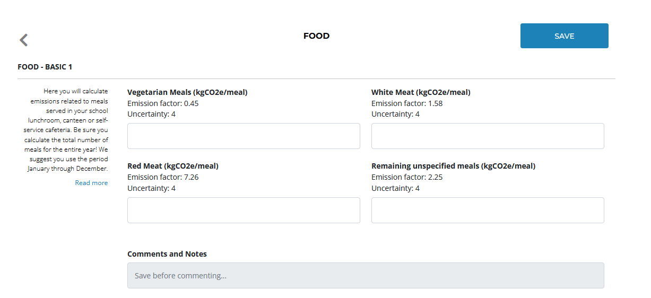
Clicks On Calculator
Emission factors and uncertainty are given for information only.
Activity data that you have collected to be completed here
Read: Instructions for completing your data
Indicate your assumptions, intermediate calculations or any other useful information in this section
Notes:
Follow the instructions on the tool and measure the carbon footprint !

Slide 31
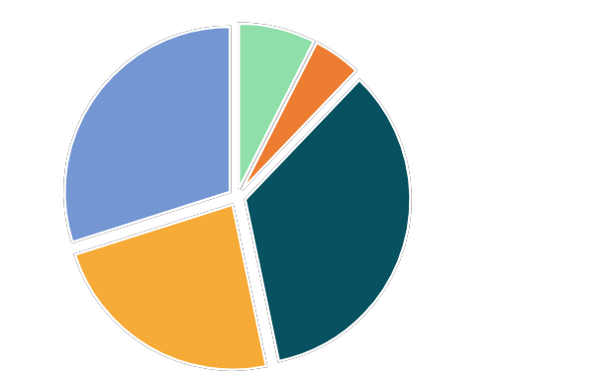
Et la suite ?
Achats
9 %
Déchets
7 %
Transport 23 %
Quelles sont les actions prioritaires ?
Quelles sont les usages qui génèrent
le plus d’émissions ?
Quelles sont les usages sur lesquels nous pouvons agir facilement ?
Service de restauration 21 %
Consommation énergétique 35 %
Notes:
At the end of the calculation, we have a better understanding of the biggest sources of emissions in our school. Now it's time to take action to reduce them!
To do this, we need to ask ourselves what the priority actions are and design an effective action plan to reduce our emissions in the short and medium term. We will learn how to do this in our next Powerpoint "Phase 4 - Action plan".

Slide 32
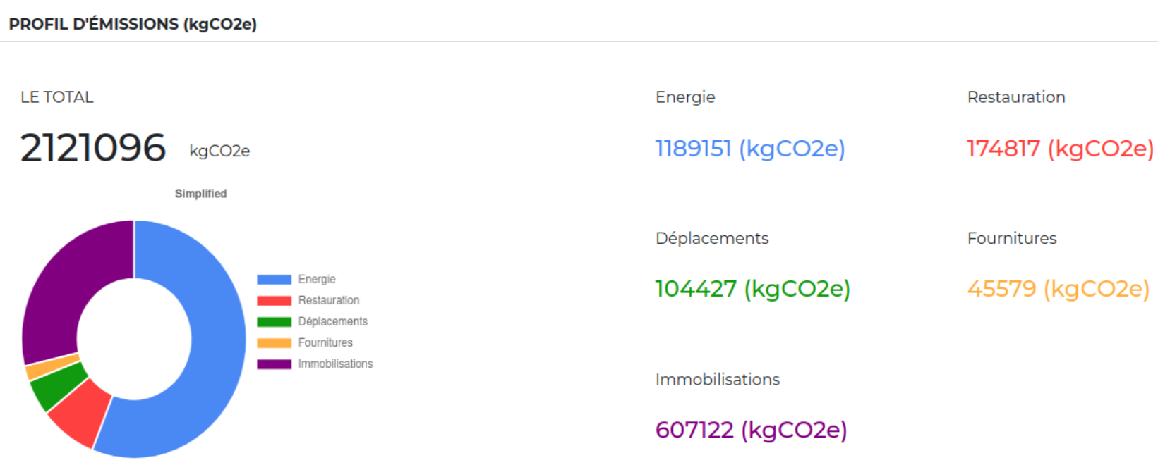
What’s next ?
Carbon footprint analysis
→ Which items generate the most emissions?
→ Where should action be taken to reduce the school's carbon footprint?
Now it's time to move on to
to creating your action plan!
Notes:
At the end of the calculation, we have a better understanding of the most important sources of emissions in our school. Now it's time to take action to reduce them!
To do this, we need to ask ourselves what the priority actions are and devise an effective action plan to reduce our emissions in the short, medium and long term. We'll be learning how to do this in our next Powerpoint "Phase 4 - Action plan".

Slide 33
Conclusions and assessments
What have we found…
DIFFICULT
DIFFERENT
LEARNED
Notes:
Explanation:
After collecting data and measuring the school's CO2 emissions, we propose a simple evaluation tool that allows us to reflect and imagine the project beyond the present moment and the measurement that the students have just completed.
To establish a final reflection on Phase 3 with the students, you can use the activity: Difficult, Different and Learned :
In this case, have students, divided into groups of three, agree as a team on something they found difficult, something they could have done differently, and something they learned. Ask them to write it on a post-it note and put it on three boards with the questions: What did we find difficult, what could we have done differently and what did we learn? You can also use the Difficult, Different, Learned template in the Appendix. If possible, someone can then read them out loud and discuss them with the whole group.

Slide 34
Credits
Via Flaticons : Icon Pond, Vectors market, Smashicons, Freepik, Dimi Kazak, mynamepong, IconGeek26, monkik, Kiranshastry, Chanut-is-Industries, Roundicons
Via getdrawings.com : Rainbow Passion
Via pngtree.com : 588ku

