Slide 1
Phase 4
Action plan

Slide 2
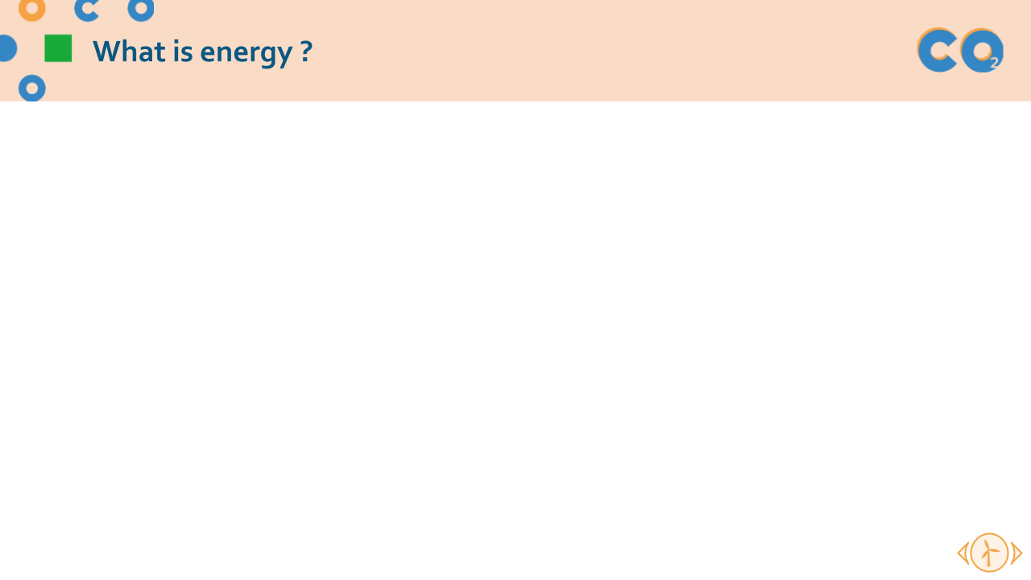
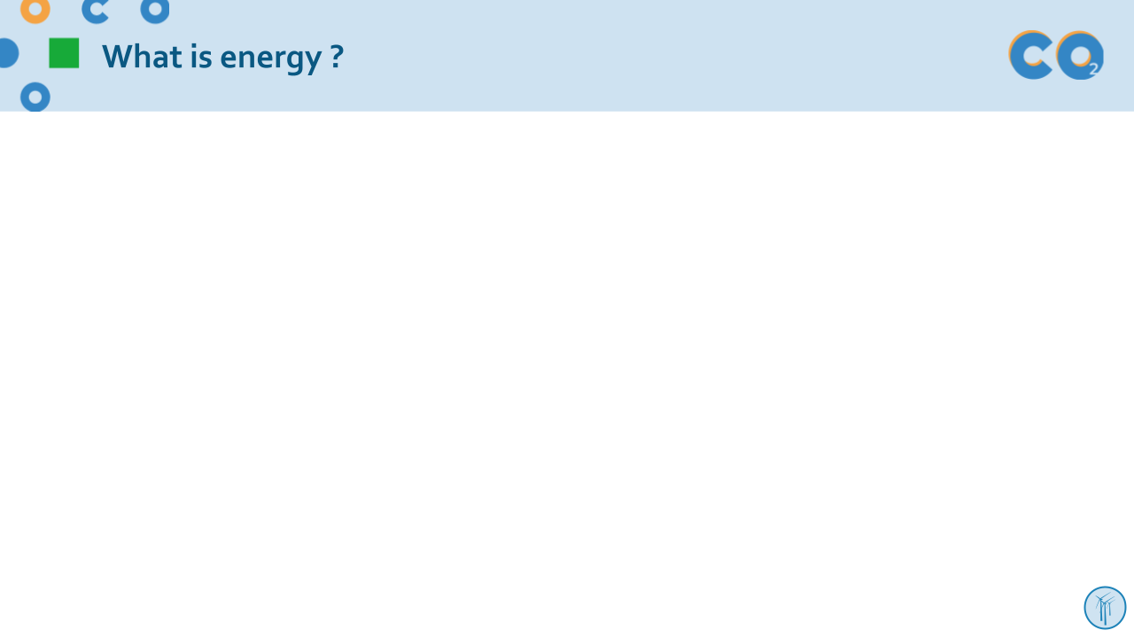
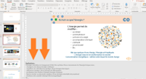
Welcome to Clicks On educational content!
Choose your path!
You can tailor your presentation to suit the content of your class, the time you have available and the topics you want to explore! To make things easier for you, we've created two easy-to-identify slide types : the light and the complete initiative :
Light initiative
Complete initiative
→ the red wire and fundamental concepts of the module
→ slides and activities to deepen your knowledge!
Don't forget the comments below the slides
Each slide is accompanied by notes to guide you through your presentation.
Complete your session with suggested activities from the module
You'll find suggested activities for each phase on our website!
Enjoy your session!

Slide 3
Action plan
Our individual action makes a difference
What are the levers for collective action ?
Notes:
Explanation :
Now that we have understood why we should reduce our GHG emissions and what are the main sources of emissions within our school, we should think about how to actually reduce them. This whole ppt is here to help prioritize your actions and draw an efficient action plan.

Slide 4
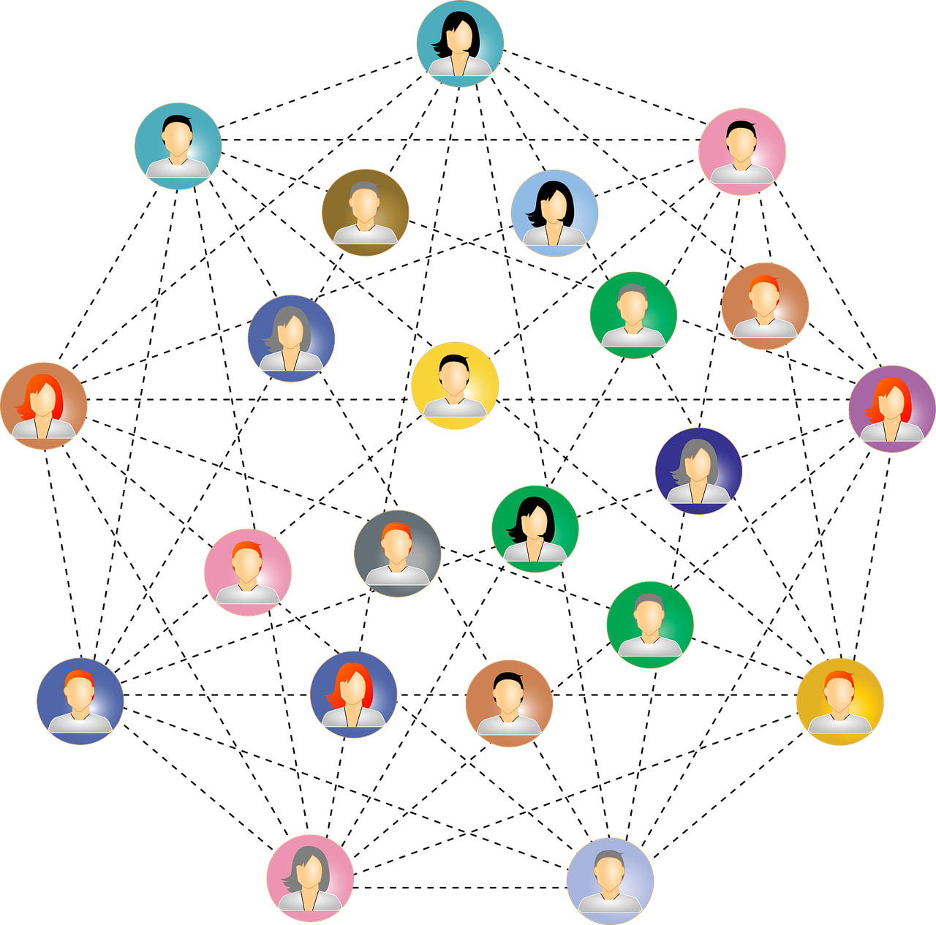
What can we do ?
Individually
Collectively
Notes:
You, me, him, her, everyone at his or her level can take action!
Becoming an actor of change is within everyone's power: all you have to do is activate different levers of action.
We can make a change:
individually, within our homes, through our lifestyle and our daily lives.
collectively through our projects and the initiatives in which we participate

Slide 5
What can we do ?
Steps taken by individuals can help reduce our carbon footprint by between 25% and 45%*
Individually
*Source : Publication Faire sa part, Carbone 4, June 2019
Sources : Carbone 4
Notes:
The study "Faire sa part" (Doing your part) published in 2019 by the consulting firm Carbone 4, which specializes in energy transition, indicates that individual commitment would reduce the carbon footprint by 25 to 45%.
Significant changes in individual behavior related to transportation, food and individual consumption would reduce the carbon footprint by 25%.
To reach a 45% reduction it would be necessary to carry out investment actions such as a thermal renovation, a change of boiler or the purchase of an electric vehicle.
Individual actions should therefore not be neglected!

Slide 6
What objectives need to be set?
4
Carbon neutrality
1990
2020
2050
9,2 tCO₂ eq /yr
7,8 tCO₂ eq /yr
2,2 tCO₂ eq / yr
3,5
Sources : ONU et Rapport du Conseil Général de l’environnement et du développement durable.
Notes:
In September 2019, the UN announced that 66 states have now joined the goal of carbon neutrality by 2050, among them the European Union’s countries.
For the European Union, it means a reduction of four times the per capita emissions of 1990. This would be equivalent to an average "carbon budget" per citizen of about 2 tons CO2 eq per year. As our emissions have not really decreased since 1990, this would still be equivalent to divide them by 3.5 compared to our current emissions. Such a huge reduction implies a lot for our lifestyles and forces us to shape a whole new kind of society. Moreover, there are big differences between the countries of the European Union. For France, Italy and Spain for example, the emissions should be divided by 5.

Slide 7
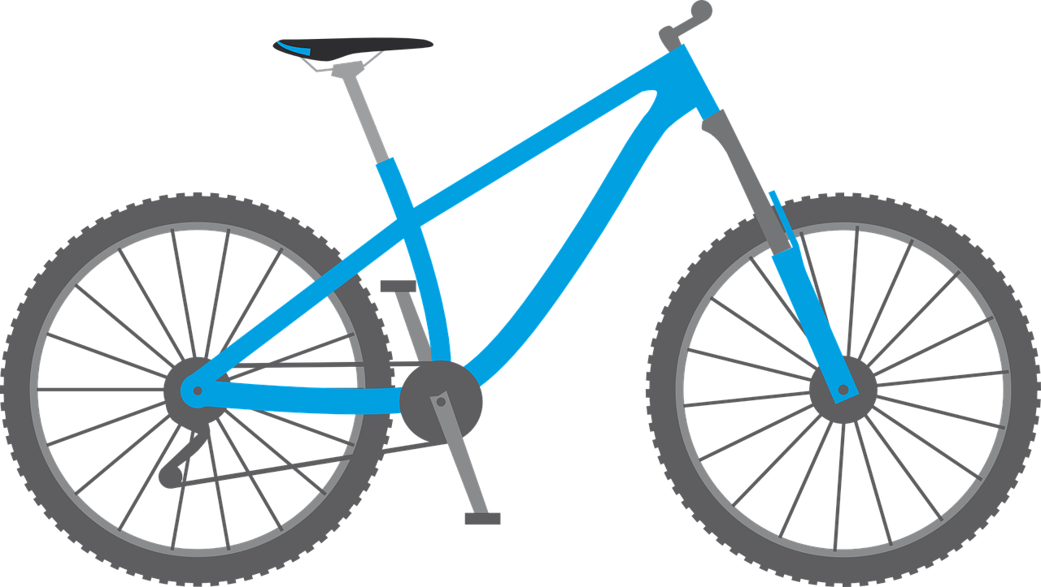
First level of action
Everyone can take action at their own personal scale
Individually
Goods and services
At home
Transport
Food
Notes:
We saw that everyone can act at their own level, and the impact is not negligible.
Globally we have to remember that we should first “Use less energy”, which also means buy less products and repair what can be repaired, then “Use energy efficiently”, which means using the right tool and finally “Use renewable energy”.

Slide 8
Quiz !
What are the main categories of emissions at a personal level ?
A : Food
B : Transport
C : Health care
D : Energy used at home
Notes:
Of course it really depends on your habits. The question refers to an average value.

Slide 9
Quiz !
What are the main categories of emissions at a personal level ?
A : Food
B : Transport
C : Health care
D : Energy used at home

Slide 10
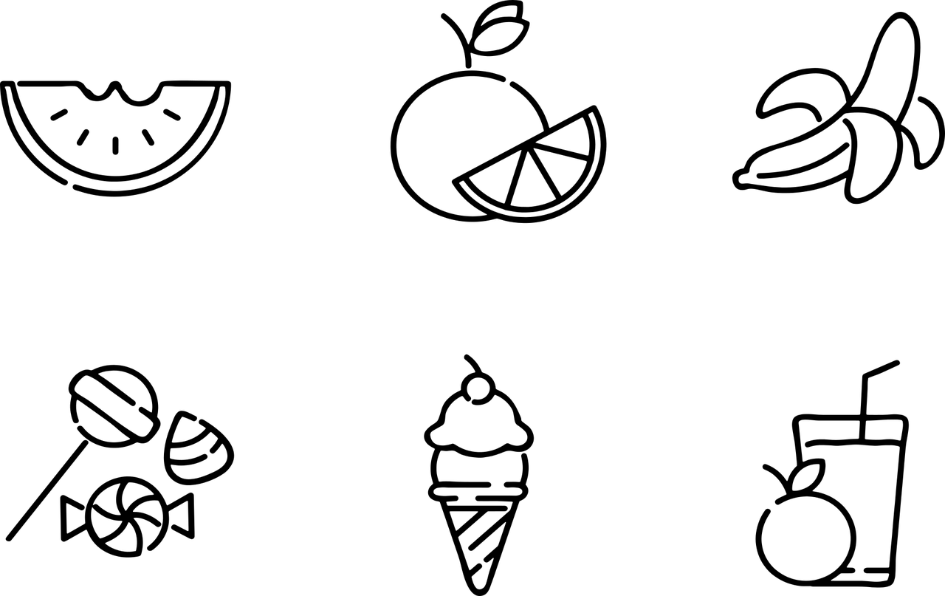
Annual personal carbon footprint
Main emission categories
Food: 2 457 kg CO2e
Transport: 1 838 kg CO2e
18
Services: 1 783 kg CO2e
Consumer goods: 2 393 kg CO2e
Energy consumed in the home: 1 556 kg CO2e
Source: Publication Faire sa part, Carbone 4, June 2019
Notes:
Correction of the quizz (reminder of the human activities module) In Europe, a person is emitting 8.4 tonnes of CO2eq per year on average, but huge differences exist between european people. If the mean values are important, we have to keep in mind that there are also huge differences between individuals, the highest emitters emitting, in some countries, 20 times more GHG than lowest emitters. Food takes an important part in our GHG emissions, mostly because of the consumption of meat and because we eat several times a day. Clothes and electronic goods comes next on average.
Then transport, due to plane and car travels. Services regroups all the public or private services we all benefit from : road maintenance, schools, hospitals, and so on. Finally, the energy consumed in our habitation is also an important part of our emissions, especially if we heat our home with heating oil.

Slide 11
First level of action
To go even further you can take part in collective action organized at your school or in your community.
Collectively
Notes:
We saw that it is essential to question our individual impact, but to achieve our objective it is also essential to take collective action. It is high time we organise together or participate in events that can have a significant impact on the ecological transition.

Slide 12
What can we do together ?
After school
In my school
Advocacy groups
Raise awareness
Eco-delegates / Environmental clubs
School carbon assessment
Contest, awards
‹#›
Notes:
Here are some ideas for action for the students:
Within the school you can:
- Organise awareness-raising actions with the content of the Clicks On or by creating adapted content. To raise awareness, you can also organise activities such as the ones suggested in the Clicks On Kit.
- Participate in the election of eco-delegates who will be in charge of defining concrete objectives, organising actions and contributing to their deployment within the establishment and outside.
- The carbon assessment you have done is very important to have an idea of the actual emissions. If you want to know if your actions have a real impact, you will have to do a carbon assessment in some years, so you will have to convince other students to do it !
- Organise challenges: photo competitions, drawing, sports challenges, eloquence competitions. Be creative to raise awareness while calling on everyone's talents!
Outside the school, you can also join associations that provide training in the challenges and take concrete action on a daily basis:
- With Little citizen for climate you can become an ambassador for this association which mobilises young people from all over the world who care about the preservation of our planet and have decided to take action to raise awareness of the climate emergency. They are accompanied by scientists who accompany them to better understand the stakes of the climate emergency.
- We are Ready now offers on its website many concrete ideas and solutions to solve the social problems we are facing.
There are a lot of different groups and organizations whose objectives are to reduce greenhouse gas emissions and fight climate change. Look on the Internet, ask your family and friends ans you will surely find one for you !
But for the moment, you still have to draw an action plan for the school !

Slide 13
Express your views
Before drawing an action plan, we should ask ourselves why have we not taken (enough) action?
Notes:
Students share their ideas with justification.

Slide 14
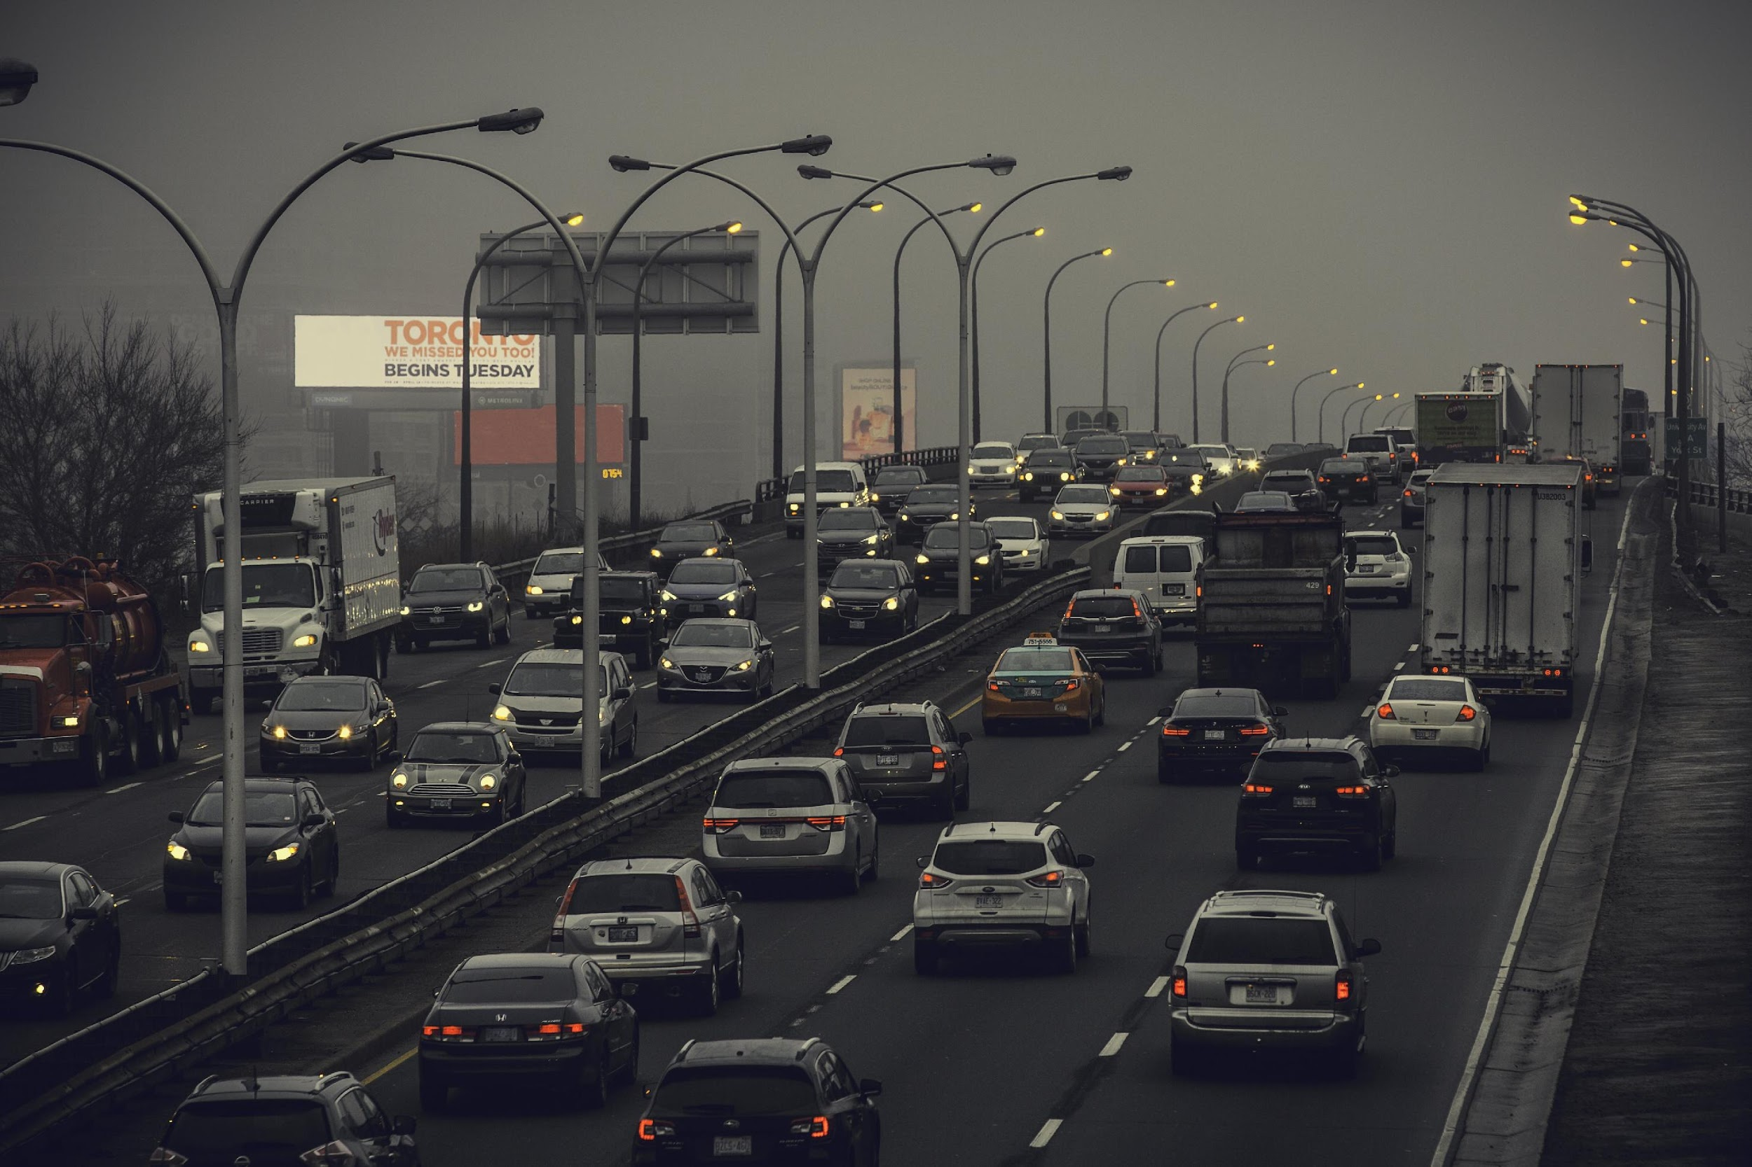
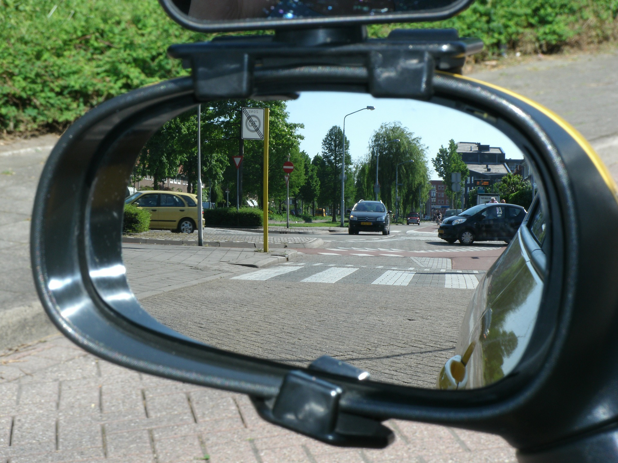
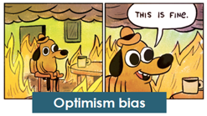
Obstacles to change
Anything that blocks or slows down transformation of society is an obstacle to progress on climate issues. (Habits, difficulty to understand the issue due to its complexity, political or financial objectives, etc.)
Obstacles impede change:
of standards
of practices
of players.
They reinforce users’ preferences and hinder evolution of their behaviour.
Notes:
Of course, it is clear that some people do not want to reduce their greenhouse gas emissions nor ours, as this necessarily leads to a reduction in our consumption and thus potentially a loss of income or privileges in the short term. However, even well-meaning people who would have a vested interest in reducing our greenhouse gas emissions experience many obstacles to change.
The first obstacle is very specific to climate change. It is a global problem that results from the sum of greenhouse gas emissions from all of our human activities, and it is difficult to grasp the full extent of the problem, both spatially and temporally, so there is no simple answer. Moreover, the complexity of this problem makes us think that we are powerless to solve it and if we can't do anything about it, there is no point in changing anything. To fight this psychological reflex, we must keep in mind what the IPCC teaches us: each degree counts because each additional degree of warming increases the negative consequences of climate disruption.
Secondly, for thousands of years, we learnt to react to immediate and well identified threats which is the opposite of climate change. Greenhouse gases remain in the atmosphere and accumulate, for example the lifetime of methane in the atmosphere is 25 years and that of carbon dioxide is 100 years. This means that all the gases we emit today will warm the Earth for several decades. We must be able to anticipate future disasters caused by our current emissions and this is not at all obvious, it is called the distance bias.
With climate change, we are all more or less victims of what is called the optimism bias, we tend to underestimate the consequences that climate change will have on us.
Finally, there are many other factors, such as the socio-cultural context in which you live, but also the lack of responsibility of individuals in front of a global problem, the impression of being the only person to make efforts, the fear of change and of relearning how to live differently, etc.
All of those psychological or socio-technical obstacles are slowing us down in reducing our emissions just as we were jammed in the traffic.

Slide 15
Socio-cultural context
Proposed solutions must be thought out in their context
Culture
User needs and constraints
Legislation and regulations
Other factors
To be an actor for change we must
Accept that change takes a long time, because it is dependent on existing structures
Make compromises without losing sight of the ultimate goal.
Notes:
As mentioned, the socio-cultural context may be an obstacle to change. The socio-cultural context includes every aspect related to the culture of a community but also to the stakeholders personal needs and constraints and to the local and national legislation. Clearly, today a lot of necessary actions cannot be taken because of it and we have to accept that some changes take some time. Sometimes it will force us to make compromises but we should never lose sight of our objective of reduction.
The socio-cultural context is also important because the implementation of our actions depends on it. We may have a very efficient solution to tackle climate change, but if it is not accepted by the population, it will be very hard to implement it and to get positive results. As the majority of our human activities are emitting greenhouse gases, reducing our emissions forces us to reconsider our entire society, from our personal habits to a global scale. Because all communities are different, one solution may be appropriate for one community and not for another.

Slide 16
What constitutes an appropriate solution?
An appropriate solution is one that
Addresses the issue at hand
Is adapted to the context
Has no negative side effects and does not replace one impact with another.
Two important factors to take into account
Level of technology
Socio-cultural context
Notes:
It is not easy to take action to reduce greenhouse gas emissions and it is even more difficult to take efficient ones. Let’s keep in mind what stands as an appropriate solution. An appropriate solution is one that :
addresses the issue at hand
is adapted to the context
has no negative side effects and does not replace one impact with another.
There are multiple factors to take into account when evaluating a solution and two are particularly important : the level of technology they require and as we saw the socio-cultural context in which they will be implemented. The level of technology is important because if a solution requires a very high level of technology, or even some technologies that are not usable yet, it might not be an appropriate solution because it cannot be implemented. We have to take action now and cannot wait for future technology.

Slide 17
Action Plan
Steps and process

Slide 18
4-steps action plan
RESULTS AND GOALS
ACTION PROTOTYPING
DRAWING ACTION PLAN
EVALUATION & VALIDATION
Notes:
Show your students how to create an action plan using these 4 steps
Start with the results obtained using the Clicks On calculator.
Then a phase of prototyping an action
Before determining the complete action plan
Evaluate your selected actions and validate the final action plan

Slide 19
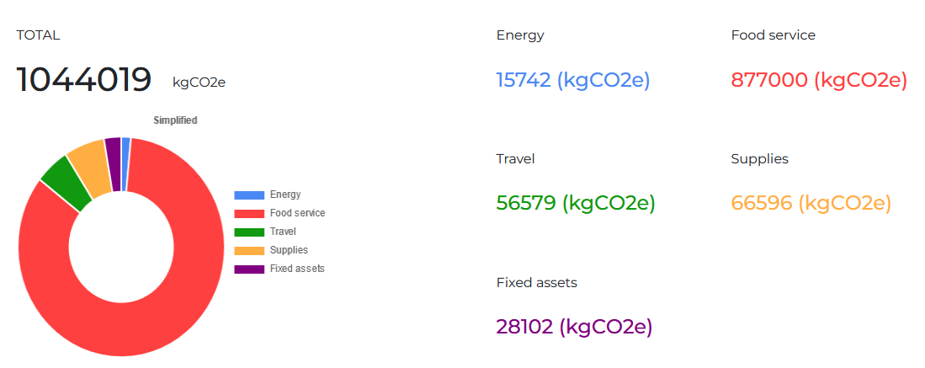
Step 1 - An assessment and targets to be defined
Notes:
Use the results obtained with the Clicks On calculator as a basis - Comment on them with your students.
Note: The results shown on the slide are for illustrative purposes only and are not representative. You can replace these results with your own.

Slide 20
Step 1 - An assessment and targets to be defined
What types of reduction targets for what types of transition actions?
2 paths to follow :
What is practically feasible
And/or
What is based on the Paris Agreement and national strategies
Reducing emissions or creating the conditions for reducing emissions?
⇒ Concrete actions to reduce emissions
⇒ Educational/awareness-raising actions
Need to create synergies with other stakeholders for a long-term vision
Notes:
Setting reduction targets with a GHG focus
2 areas/levels of ambition
Depending on what is achievable (head teacher says it is possible or not because...)
Or what is based on national strategy, Paris agreement: divide by 8 in thirty years, i.e. one third of emissions every ten years
Objective: to reduce emissions or create the conditions for this reduction. The aim here is to focus actions on the highest emission sources and on areas where action can be taken easily/quickly.
More educational objectives: e.g.: all pupils must have been made aware of the climate change
Actions according to their degree of concreteness (reduction of emissions, awareness actions...)

Slide 21
Step 2 - Prototyping an action using creative process
Challenge definition
Suggested solutions
Classification
Prototyping
Presentation
Select the most emitting catgories
Individually, suggest as many ideas as possible
Using post-its, each student in the group writes down their ideas in 2 stages:
normal ideas then crazy ideas
Criteria’s presentation
- Impact ?
- Implementation easiness
- Time scale
1st vote
Chaque élève vote pour ses 3 actions favorites
Prototype’s presentation :
Explain the challenge and the prototype Let other groups ask their questions
“What do you know about..” ?
Divergence : Students write down what they know about the addressed topic. Example : “What do you know about the school’s canteen ?
2nd vote
Chaque élève vote pour 1 action favorite parmi les 3 qui ont obtenue le plus de votes précédemment
Demander aux élèves de faire une remarque sur le prototype et d’ajouter une suggestion
Exemple : Je trouve très intéressant votre représentation de la cantine et vous auriez pu inclure le chef d’établissement
Gathering ideas & prioritising
Ideas convergence
The group sorts the written facts by thematic or similar ideas
Prototyping favourite action
Material :
DIY Prototype - Drawing
Ideas convergence The group sorts the suggested solutions by thematic or similar ideas
Selection of ideas to be voted on
Remove actions that do not meet the initial objectives or those that are very low on the criteria
Synthesis Definition of the challenge
Formulate a question about the problem identified that begins with "how can we?"
Le groupe qui restitue ne peut pas rebondir sur les suggestions mais doit simplement répondre « Merci »
Notes:
Il est important de mettre en avant que chaque post-it contienne un morceau d’information, c’est-à-dire : ce doit être une phrase entière (pas un mot), qui communique une seule chose (cela limite plusieurs interprétations possibles), et on ne recherche aucune solution dans cette partie du processus.
Comment pouvons-nous... [augmenter, réduire, diminuer, améliorer, changer, optimiser, éliminer, créer, atteindre] que... [utilisateurs/cibles] progressent... [besoin] en... [sujet] ?
Exemple : Comment pouvons-nous faire en sorte que les élèves consomment moins de viande à la cantine ?
Développez plusieurs challenges et choisissez celui qui est le plus attrayant et le plus motivant pour vous.

Slide 22
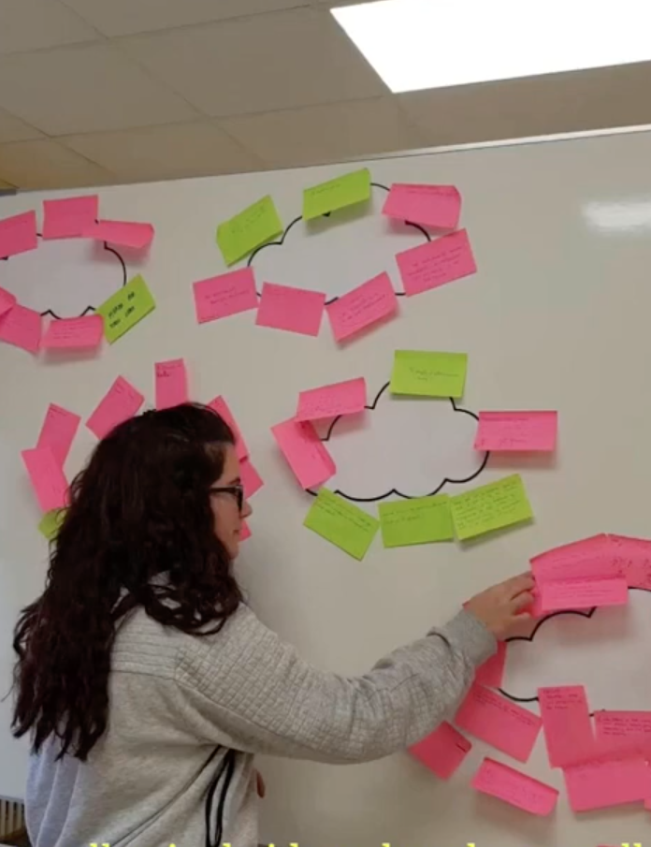
Define the challenge
Select the most emitting item(s)
“What do you know about…” ? Divergence Example « What do you know about your school catering? »
Convergence of ideas
Synthesis / Define the challenge 🡪 Formulate a question about the problem identified that begins with "how can we?"
Notes:
Material : Post it and pens - + white sheet or piece of wall It is important to emphasise that each post-it note contains a piece of information, i.e. it must be a whole sentence (not a word), which communicates a single fact (this limits several possible interpretations), and no solution is sought in this part of the process.
Animation: show the steps one after the other Steps :
- Divergence : “What do you know about” -> Student have to write down about their knowledge on the identified topics
- Convergence : Students sort written facts by theme or similar ideas
- Formulate a question around the identified problem that begins with "how can we?"
How can we ... [rise, reduce, decrease, improve, change, optimise, eliminate, create, reach] what... [users/targets] improve... [need] in... [topic] ?
Example : How can we ensure that students eat less meat at the canteen?

Slide 23
Keys to generate the challenge
Divergence:
You don't have to write solutions, but pieces of information
it is not a matter of agreeing or disagreeing, but of looking at the topic from different perspectives
Convergence :
We look for possible focuses of action and we do it based on information, not words,
It’s not a classification but sorting your ideas
Synthesis :
We want to reinforce the idea that this comes from the group, and not from those who wrote the post-it

Slide 24
Proposal for solutions
Suggest as many individuals ideas as possible
Using post-its, each pupil in the group writes down their ideas in 2 stages:
normal ideas then crazy ideas
Ideas convergence
The group forms "clouds of ideas".
🡪 Reorganise ideas by theme or similar ideas
Notes:
Animation : faire apparaître les étapes les une après les autres

Slide 25
Classification
Presentation of criteria
- Which impact(s)? - Easiness of implementation - Time
Gathering ideas & prioritising
Selection of ideas to be voted on 🡪 Remove actions that do not meet the initial objectives or those that are very low on the criteria

Slide 26
Prototyping
First vote Each student votes for his/her 3 favorite actions
2nd vote Each student votes for 1 favorite action among the 3 that have obtained the most votes previously
Prototyping of the favourite 🡪 Material : Material: DIY prototype - Drawing

Slide 27
Oral presentation
Presentation of the prototype Explain the challenge and the prototype Let other groups ask their questions
Ask students to make one compliment on the prototype and add a suggestion Example : : I find your representation of the canteen very interesting and you could have included the headmaster of the school
The group that presents cannot bounce back on the suggestions but must simply answer « Thank you »

Slide 28
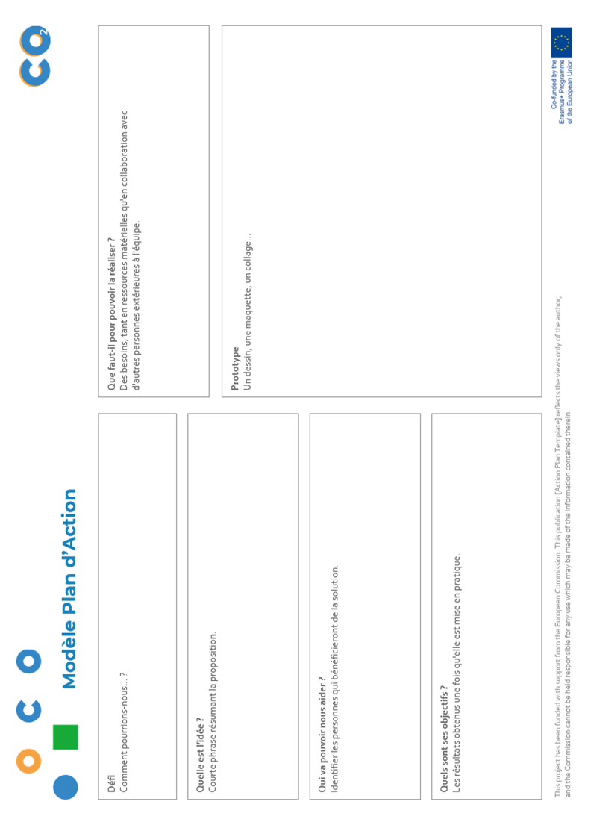
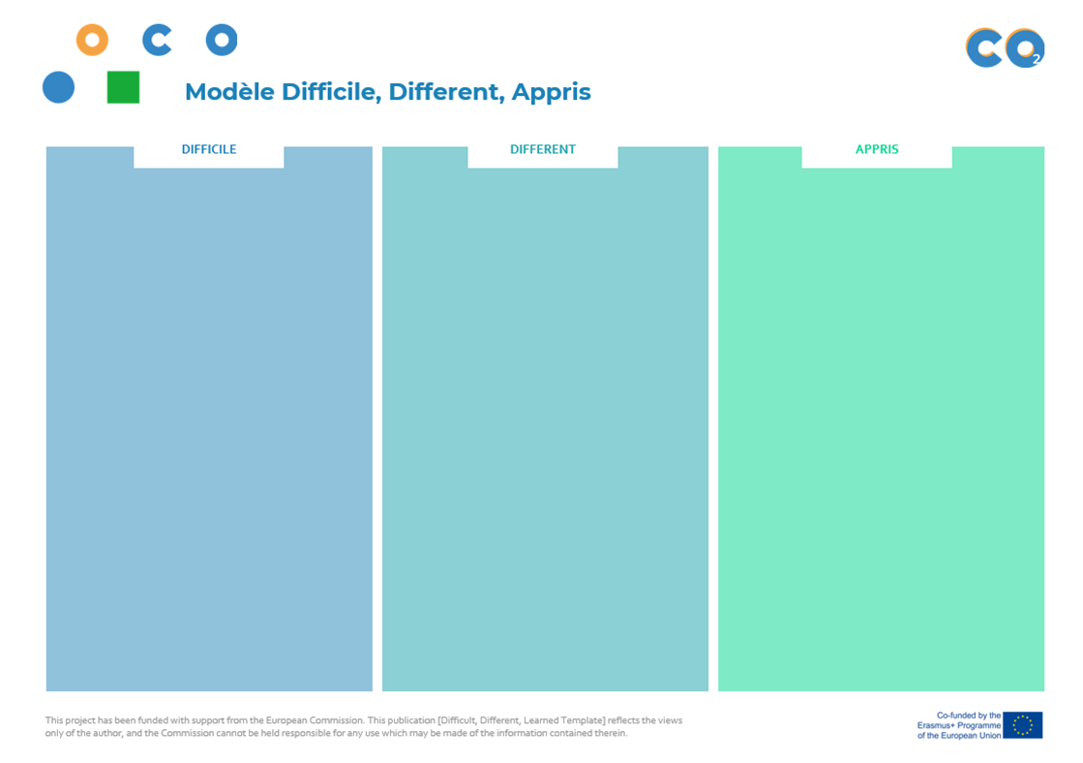
Step 2 - To conclude the session
→ Fiches à retrouver sur www.clickson.eu/fr/kit-enseignant à la fin du “Guide pédagogique enseignant”

Slide 29
Step 3 - Drawing an action plan
Write down the list of actions to be integrated in the action plan
> Repeat step 2
Options
Without the prototyping phase (Whole class or sub-group)
only proposed solutions + classification (whole class)
Every steps can be repeated if time and interest allow (sub-group)
> Co-construction with the involvement of the relevant staff or an expert
> Choose 10 actions (2 / emission category)
> Do not neglect the “small” items as these easy actions = promote the group's overall dynamic
Notes:
Define the list of actions to be included in your plan
The idea is to repeat the previous stage, but at a faster pace: no prototyping. We talk about "co-construction" because :
⇒ Recommendation: Involvement of various staff in certain stages of the phase (NSA, headteacher). ⇒Option: involve an expert
> Repetition of step 2
The idea is to repeat stage 2 in co-construction and to go faster (therefore withdrawing the prototyping stage, unless there is time and a desire to do so).
Objective: choose 10 actions (2 actions per item)
only solutions + classification (whole class) without prototyping (the important stage here is classification) (whole class or sub-groups) if you feel like it and have the time, of course, you can repeat each action (in sub-groups).
-Be careful not to neglect the "small" workstations, as these easy actions promote the overall dynamics of the group.

Slide 30
Step 4 - Feasibility assessment and validation of the action plan
Evaluation of the action plan
Establish action sheet
→ Set up timetable / Design needs, resources etc.
→ Discussions / meetings → Quantified reduction targets → Anticipate the follow-up of actions
→ Fiche à retrouver sur www.clickson.eu/fr/kit-enseignant à la fin du “Guide pédagogique enseignant”
Validation of the action plan
Draw up the finalised version of the action plan (anticipation of phase 5) Have the headmaster and staff of the school validate the action plan
Notes:
Option : Élargir le plan d’action si envie/autre projet en cours Ceci est un cadre – Faites comme vous le pouvez !

Slide 31
Réalisez un plan d’action avec la solution
Défi
Prototype
En quoi consiste l’idée ?
Qui allons-nous aider ?
Qu’est-ce qui va permettre de l’atteindre ?

Slide 32
Crédits
Via Flaticons :
Freepik
Darius Dan
Icon Pond
Flat Icons
Maxim Basinski Premium
Smashicons
IconFinder

