Slide 1
Phase 5 :
Spread the word
Notes:
Lors de cette phase, les élèves en apprendront plus sur les stratégies de transition, les facteurs clés pour mettre en place une transition à la hauteur des enjeux et les bénéfices obtenus avec la transition. Les élèves peuvent maintenant partager leurs expériences, les résultats du projet et les pistes d’amélioration pour les années suivantes.

Slide 2
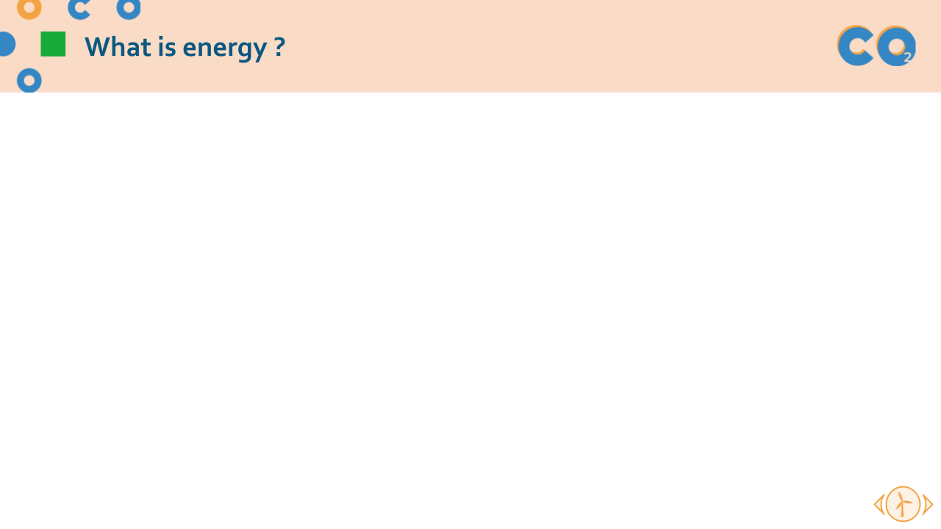
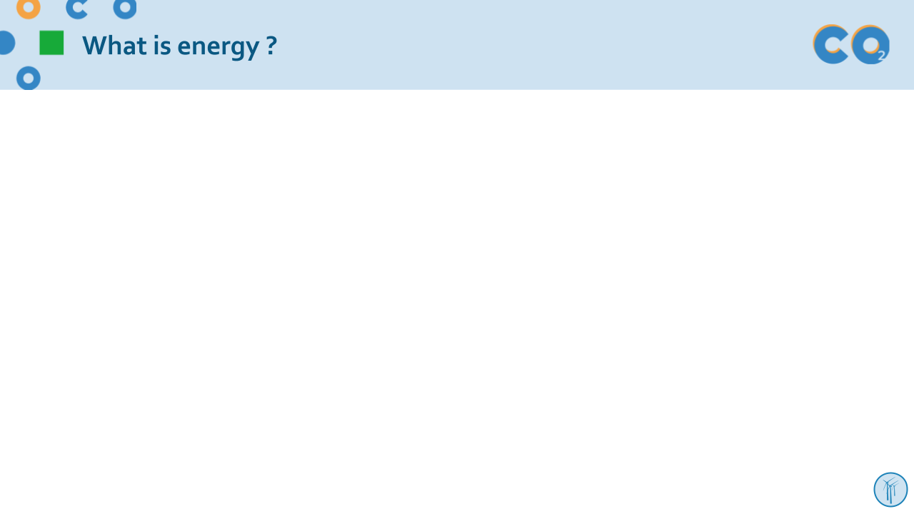
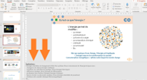
Welcome to Clicks On educational content!
Choose your path!
You can tailor your presentation to suit the content of your class, the time you have available and the topics you want to explore! To make things easier for you, we've created two easy-to-identify slide types : the light and the complete initiative :
Light initiative
Complete initiative
→ the red wire and fundamental concepts of the module
→ slides and activities to deepen your knowledge!
Don't forget the comments below the slides
Each slide is accompanied by notes to guide you through your presentation.
Complete your session with suggested activities from the module
You'll find suggested activities for each phase on our website!
Enjoy your session!

Slide 3
Teachings on Climate Change
Evaluating and evolving of the lessons learned
STOP
START
CONTINUE
Notes:
STOP, START, CONTINUE (in groups):
It is very constructive to identify aspects that worked better or did not work as well
Use this evaluation tool: Stop / Start / Continue. You need to get team consensus on three things.
First, something that was not done during the process that you want to do (START).
Second, something that has been done that the group thinks should be stopped (STOP).
Finally, something that has been done and should be continued (CONTINUE).
Write each aspect in three columns, each corresponding to a block (START / STOP / CONTINUE). Then read them out loud and discuss them with the whole group.
Remember that the solutions can be improved and that you can do the work process as many times as you feel necessary. Skills come with practice. Therefore, the more you practice, the better the results will be.

Slide 4
Your turn ! Restitution

Slide 5
Organise your feedback session
Present this year’s results
Your school’s carbon footprint
Action plan
Implemented action…
A multitude of format options
An exhibit, a theatre play, an article in local journal
A meeting for the whole school
A presentation in neighbouring secondary schools…
→ Be creative, this is the time to promote your work and to..
spread the word !
Notes:
This is the time to conclude the year with a special event that will allow the students, accompanied by their teachers, to show what they have achieved during the school year. It's also an opportunity to take fellow students, colleagues and parents on a journey of transition.

Slide 6
A transition is imperative Summary of the current situation on various levels
Notes:
Before finalising the debriefing session, we propose in this section to take an initial approach to transition strategies.
We are therefore going beyond the school level to look at the national, international level, the individual and the collective.

Slide 7
What has been done in international politics
6th reports
of the IPCC
COP27
Sharm El-Sheikh
Creation of the
IPCC
UN Ocean Conference
Lisbon
COP1 Berlin
COP21 Paris
COP26 Glasgow
UNFCCC
1988
1994
1995
2015
Novembre 2021
2021/2022
Juin
2022
Novembre
2022
Wassat?
IPCC: Intergovernmental Panel on Climate Change
COP : Conference Of Parties
UNFCCC : United Nations Framework Convention on Climate Change
Interactive timeline showing key milestones in the evolution of international climate policy
Notes:
The IPCC was created in 1988 by two United Nations institutions: the World Meteorological Organization (WMO) and the United Nations Environment Programme (UNEP). It provides decision-makers with the latest scientific knowledge on climate change, its causes, its impacts, and the various mitigation and adaptation strategies to be implemented.
The UNFCCC (United Nations Framework Convention on Climate Change) entered into force on March 21, 1994. Today, its membership is almost universal. The 197 countries that have ratified the convention are called Parties to the Convention. Preventing "dangerous" human interference with the climate system is the main objective of the UNFCCC.
The COP is the supreme decision-making body of the Convention. All States that are Parties to the Convention are represented at the COP (Conference Of Parties), where they consider the implementation of the Convention and any other legal tools that the COP adopts, and where they take the necessary decisions to promote the effective implementation of the Convention, including institutional and administrative arrangements.
The Paris Agreement seeks to accelerate and scale up the action and investment needed for a sustainable low-carbon future. Its central objective is to strengthen the global response to the threat of climate change by keeping the temperature increase below 2 degrees Celsius above pre-industrial levels and continuing efforts to limit the temperature increase above 1.5 degrees Celsius. The Agreement also aims to strengthen the capacity of countries to manage the impacts of climate change.

Slide 8
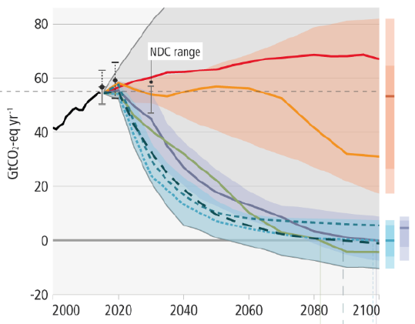
The 2 °C objective
C7 Current policies + 2030 promises
=> warming limited to +4°C (>50%)
C6 Emissions are stabilized at a low level before the end of the 21st century => warming limited to +3°C (>50%)
C3 Progressive strengthening of short-term mitigation measures
=> warming limited to 2°C (>67%)
C1 Different drastic reduction scenarios
=> warming limited to 1.5°C, with no or very low overshoot (>50%)
Scenario based on sobriety (Low-Demand)
High use of Renewable energies
Shifting development Pathways
The Paris Agreements aim to limit global warming by "limiting the increase in global average temperature to well below 2°C above pre-industrial levels and continuing efforts to limit the temperature increase to 1.5°C above pre-industrial levels”
Notes:
Climate experts have projected future outcomes under different hypothetical scenarios (C1-C8) depending on greenhouse gas emission trends.
Four of the eight trajectories analyzed by the IPCC lead in 2100 to an increase in temperature of more than 2 degrees compared to the pre-industrial era (1850). The most optimistic scenario is the only one in which we dot not exceed 2°C augmentation.
In the most pessimistic trajectory (the one that will occur if we do not act to protect the climate by limiting our greenhouse gas emissions), temperatures could rise by as much as 4°C.
Explanations :
In fact if we set a limit at 2°C not to be exceeded we still have a few years to stabilize our emissions (because until now they are still increasing). And about 50 years to completely stop emitting greenhouse gases.
With the Paris agreement, all states agreed for the first time on the need to limit climate change to 2°C compared to the pre-industrial era.
Before the Paris agreement, the UN tried to reach a consensus with all states by imposing "quotas" of emissions not to be exceeded for each country. With this system, an agreement was never reached in 20 years of negotiations.
With the Paris Accord, each state published a roadmap (its NDC, National Determined Contributions) and its commitments to limit its GHG emissions. In addition, all states signed a text affirming their will to limit global warming to 2°C before 2100. If we compile all this, we arrive on a trajectory between 2.3°C and 3.5°C. So the crucial objective of the next negotiations, which take place every year, will be to reinforce the commitments of the states so that this trajectory is aligned with the 2°C target. This also proves that we must remain mobilized and that the climate issue has not been eliminated with the Paris Agreement.
As we saw in the previous ppt, setting up a below 2°C objective is a way to simplify the problem, we may think we have a clear objective now, but we still have a large variety of actions to take to achieve carbon neutrality.
Key messages :
1.The Paris agreement is indeed historic. It was about time after 21 years of negotiations... But that doesn't mean that the climate has been saved yet...
2.It highlights a new mechanism: NDCs (Nationally Determined Contributions), or voluntary "national contributions" to GHG reduction.
3.The "climateactiontracker" tool gives a temperature rise of around 2.8°C following the compilation of pledges from each State. Countries must be even more ambitious.
4.There is still no supra-national body allowing sanctions in case of non-compliance with commitments. The post-Kyoto Protocol analysis bears witness to this failure...
Source : https://www.ipcc.ch/report/sixth-assessment-report-working-group-3/

Slide 9
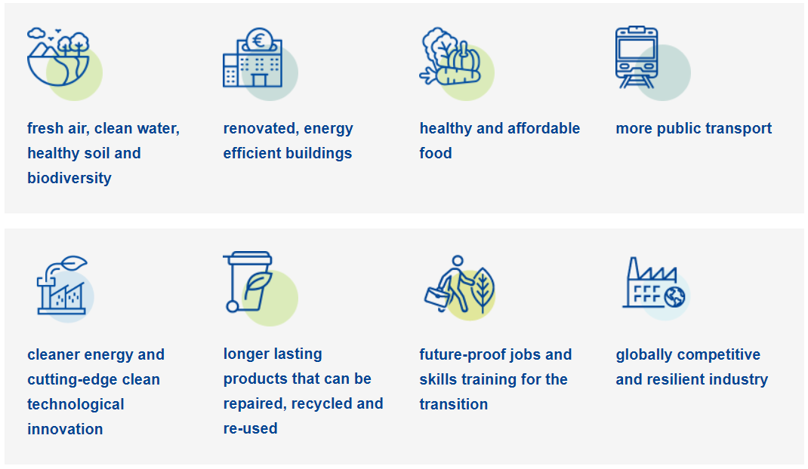
What about Europe ?
The benefits of the European Green Deal
The European Green Deal will improve the well-being and health of citizens and future generations by providing:
Notes:
The European Green Deal is a set of policy initiatives by the European Commission with the overarching aim of making Europe climate neutral in 2050. Climate change and environmental degradation are an existential threat to Europe and the world. To overcome these challenges, the European Green Deal will transform the EU into a modern, resource-efficient and competitive economy, ensuring:
no net emissions of greenhouse gases by 2050
economic growth decoupled from resource use
no person and no place left behind

Slide 10
Global carbon budget carbone
2°C budget 1 150 GtCO₂
1.5°C budget 400 GtCO₂
2018
Current GHG emissions
≈ 50 GtCO₂/an
 | Time remaining at constant emission levels
2°C ̶ 23 years 1.5°C ̶ 8 years starting from 2018
Carbon budget
Already emitted 2 390 GtCO₂
Greenhouse gas equivalent 200 GtCO₂eq
Notes:
It is not easy to know how many GHG we can emit before reaching a 2° global warming, but climate experts estimated in 2018 that this threshold will be reached if we emit 1150GtCO₂ more, and 400GtCO₂ for a 1.5° augmentation. At the actual level of emission : 50GtCO₂/an, we only have few years to take action.
Remaining carbon budget - Mercator Research Institute on Global Commons and Climate Change (MCC) (mcc-berlin.net)
Source : IPCC AR6, WGI, Table SPM.2 - Estimates of historical carbon dioxide (CO2) emissions and remaining carbon budgets.

Slide 11
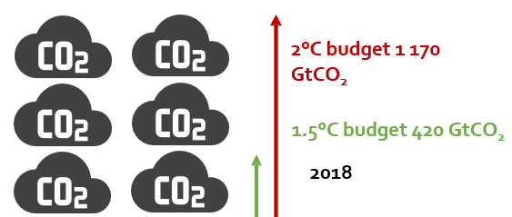
Anticipating the depletion of fossil fuel resources
1.5°C
2°C
To limit global warming to a 2°C rise in temperature, 73% of remaining fossil energy must be left in the ground.
525 GtCO₂eq
Gas
To limit global warming to a 1.5°C rise in temperature, 90% of remaining fossil energy must be left in the ground.
Our reserves
730 GtCO₂eq
Oil
…
2 950 GtCO₂eq
Coal
1.5 budget 400 GtCO₂e
2°C budget 1 150 GtCO₂e
Notes:
There is and will be less and less fossil fuels because they are not renewables. But we have already discovered enough gas, oil and coal to take us far beyond +2°C global warming. Then the question is not, whether we will lack of fossil fuels or not, but will we be able to stop burning fossil fuels fast enough to limit global warming and its consequences ?

Slide 12
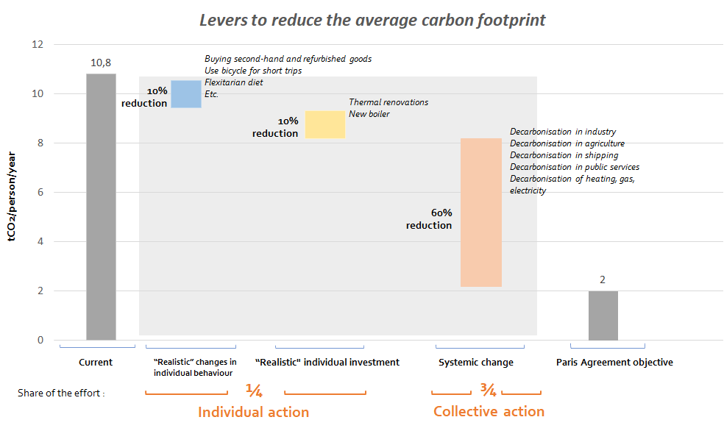
Citizen, company or government authority ?
Steps taken by individuals can help reduce our carbon footprint by between 25% and 45%*
The remaining transition action must be taken by
National government
Local authorities
Companies and businesses
Source adaptée : Carbone 4, juin 2019
Notes:
Nous savons que nous devons réduire de beaucoup nos émissions de GES pour maintenir le réchauffement climatique en dessous de 2 °C. Nous pouvons prendre de nombreuses mesures individuellement mais puisque nous devons changer notre société dans son ensemble, nous devons agir collectivement à différents niveaux, nous devons repenser nos organisations locales et nationales et changer la manière dont nous produisons et consommons au niveau des entreprises. Maintenant que vous en savez plus sur ce projet, vous avez la possibilité de sensibiliser autour de vous et d’impliquer d’autres personnes pour réduire massivement nos émissions !

Slide 13
From carbon accounting to carbon strategy
Carbon assessment
Devise action plan, measures and reductions
Action plan monitoring and carbon assessment update
Lay out a transition strategy
The action plan comprises all the measures to reduce GHG emissions generated by the organization’s activities.*
Strategy sets a medium- and/or long-term course to achieve the objectives set by the organization.
By including carbon emissions in its strategy the organization can mobilize resources and pursue long-term action.
Source: https://www.bilans-ges.ademe.fr/docutheque/docs/GUIDE%20PLAN%20D'ACTION.pdf
Notes:
Il ne nous reste que quelques années pour agir, mais nous devons continuer de réduire nos émissions au long terme, c’est pourquoi il est important de développer une stratégie de transition. La comptabilité carbone permet d’évaluer les émissions, et ainsi les premiers impacts du changement climatique. Il est cependant nécessaire d’aller plus loin pour déclencher réellement la transition vers une faible teneur en carbone : les organisations doivent mettre en place des plans d’action et les appliquer au cours du temps.

Slide 14
What is the low carbon transition ?
IPCC reports
Global limits
GHG emissions over time
Carbon budget
Impact of human activity
Allotment by sector of activity
International agreements and commitments
Low carbon transition
Notes:
To achieve a low carbon transition, it is important to focus on what is our task and what is not. It is not our job to define objectives, the objectives are set by the climate experts from the IPCC and the efforts shared among all countries and sectors of activity in the COP or other institutions like the International Energy Agency (IEA). What we should focus on is how to effectively reduce our emissions, what changes can we make to our societies.

Slide 15
National and international climate objectives
International objectives
United Nations Framework Convention on Climate Change 🡪 Paris Agreement
Aims: “Hold the increase in the global average temperature to well below 2°C above pre-industrial levels and pursue efforts to limit the temperature increase to 1.5°C above pre-industrial levels”
Non-binding commitment
National objectives
Commitment to pursue national objectives
National carbon budget, for example the National Low Carbon Strategy in France
National trajectories by sector of activity
Notes:
As we said earlier, we have international objectives and an international agreement called the Paris Agreement. It is not a binding commitment and there is no sanction if countries do not reach their national objectives but it is drawing a first step for establishing a low-carbon transition. A lot of countries complete their commitment to the Paris Agreement by national objectives and national laws specifying, for example, the sectoral objectives of certain industries.

Slide 16
Climate goals in France – the National Low Carbon Strategy
Shortly after publication of the IPCC report the French government updated its National Low Carbon Strategy, reinforcing the commitment to achieve carbon neutrality by 2050.
Figure 1 - GHG emissions and sinks in France 2005 – 2050
2017 Start of scenario period
2030 Target: reduce GHG by 40% from 1990 levels
Trend
Start of scenario period
Greenhouse gas emissions
2050 Target: carbon neutrality
Carbon sequestration
GHG emissions
GHG sinks
Notes:
Here is the example for France and its National Low Carbon Strategy. We can see that there are a lot of efforts to make to reach our goal of carbon neutrality.

Slide 17
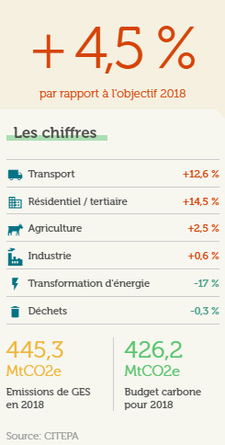
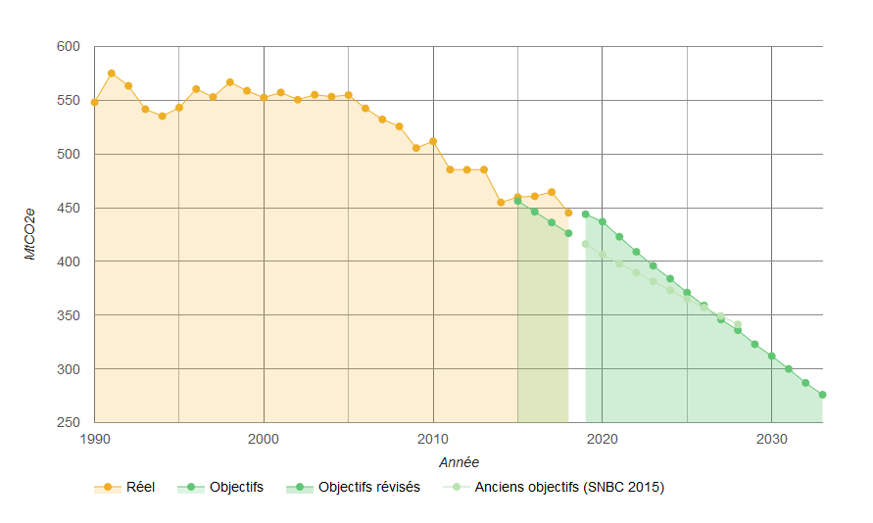
We are not keeping up with our objectives
Overall GHG emissions in France
Target : reduce our GHG emissions by a factor of 6 or 8
This means a 6% reduction per year, on average
Since 2005 the average reduction is only 2% per year.
Sources: Réseau Action Climat-France, CLER, Observatoire énergie climat
Notes:
It is important to set up a strategy and to draw action plans, but what matters are the actions that are taken. In France, we are not keeping up with our objectives and we must make more efforts.

Slide 18
Local public policy
Anticipate risk
Inequality between territories and populations
3- Health risks
4- Diminishing natural resources
2- Energy at the core of our daily concerns
5-
Territories are menaced
More and more people, fewer and fewer resources
1- Climate change is manifest
6- Fragile economy
A coordinated response and solidarity are necessary
Public policy must better address the issues at stake
We need to change individual and collective practices
Notes:
It is important to take actions at all levels and especially at the local level. Indeed, climate change is already having big consequences on local communities whether by the increase of natural risks or the reducing of natural resources. For many territories, they should not only think how to reduce their emissions but also adapt to climate change right now and anticipate the future risks.

Slide 19
Key messages for a successful transition
Understand global issues and stakes
Energy use, climate change, scenarios and trajectories, etc.
Mobilize all stakeholders
Anticipate climate risk
Assess the impacts of your organization
Follow the principles of carbon assessment methodology
Set relevant targets and goals in line with an international scenario
Pursue steps to avoid, reduce and offset emissions

Slide 20
But what do we do now ?
Renovate 50% of housing units by 2030, replace all heating-oil boilers and 50% of gas-fired heating systems
Reduce vehicle traffic by half
These are drastic changes that seem unthinkable today… But are necessary to reach our goals
Reduce consumption of meat and dairy products by two-thirds
No new soil sealing as of 2019
Shift nearly all air travel to rail
Minimum device life: 4 years for a smartphone, 8 years for a computer, 12 years for a screen. Reduce the volume of electronic data exchange by two-thirds.
Source : B&L évolution, Comment aligner la France sur une trajectoire 1,5°C
Notes:
To maintain climate change below 2°C, we should make drastic changes in our societies, drastic changes that may seem unthinkable but are necessary. Well beyond our individual actions, it is high time to organize collectively and find alternatives to create a new society.
On this slide, you can see some propositions that was made by a french consulting firm who tried to establish a road map for France to be in line with a 1.5°C trajectory. If nothing else is done in the next few years, the same actions will soon be needed to stay below 2°C.

Slide 21
Less CO₂, better quality of life
Health
Healthy food and sustainable agriculture
Low-impact mobility
Housing and comfort
Source reduction – less waste
Thermal comfort levels
Lower energy bills
World peace
Energy and geopolitical independence
Political stability
Economy
Innovation
Jobs
Notes:
Hopefully, reducing our GHG emissions and creating a new society is not only about efforts and constraints. On the contrary, it is the opportunity to improve our quality of our entire life. It is not only avoiding the extra degrees but also a real social project that remains to be built! Of course, decarbonizing a world is not something that can be done overnight, everything takes time, but by changing our starting point, a lot of new perspectives are offered to us. Here are some advantages that are in line with reducing our GHG emissions:
Higher standards in our diet and a different way of getting around represent a positive impact on our health.
Energy transition also means reducing the amount of waste at source, and implementing the right heating and insulation measures in our homes means more comfort in our daily lives and definite savings on our bills.
Reducing our dependence on fossil fuels is also a way to gain independence from producer countries and to build a world that is less conflict-ridden.
Finally, the transition that is taking place in the sectors that are evolving is the creation of a number of jobs that cannot be relocated and that have high added value.
You see, finally, less CO2 doesn't imply a return to the Middle Ages, sleeping on the floor lit by candlelight, but on the contrary a more comfortable way of life, less conflicts, more equality, better health, more solidarity.... It's a dream come true!
Key messages :
Less CO2 does not mean that life will be ruined or that you'll have to go back to candlelight. On the contrary, it also means a more comfortable life, improved health, more solidarity, healthier food, a more peaceful world...etc.

Slide 22
How do we make choices ?
Stand back and think about the opportunities of the low carbon transition.
Include long-term action in global strategy.
Monitor and evaluate the impact of measures taken, using indicators and successive carbon assessments.

Slide 23
Key takeaways
Reducing greenhouse gas emissions can yield many benefits in terms of sustainable development.
To begin the low carbon transition, carbon criteria must be included in a global strategy. The transition must be pursued at all levels – government, organizations, individual citizens.
The ideal approach is to select solutions that will give improve results for several indicators of social and economic benefits.
Conclusion : We must keep on thinking and fighting!

Slide 24
Credits images
Via Flaticons :
Smashicons
Freepik
Vectors Market
Pixel Perfect
turkkub
DinosoftLabs
Vivien Bocquelet
IconFinder
Iconnice Studio
Alexandr Martinov
Marta Konik
Chanut is Industries
Sumit Saengthong

